Slide 1
Chapter 4
Deliberation with Temporal
Domain Models
Dana S. Nau
University of Maryland

Slide 2
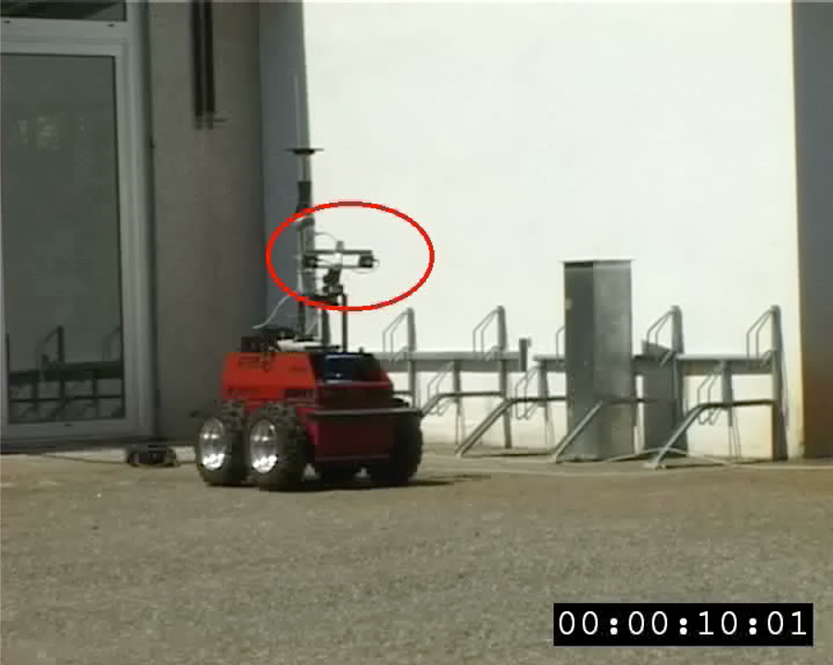
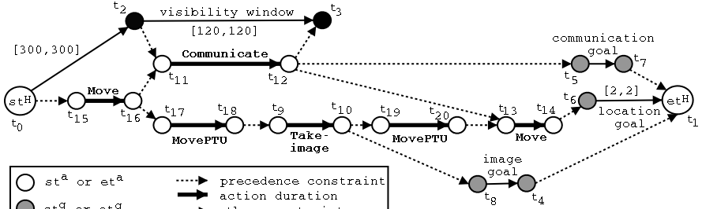
IxTeT
LAAS/CNRS, Toulouse, France
mid-1990s
Video:
  https://www.cs.umd.edu/~nau/apa/ixtet.mov
Notes:
La mission de ce robot est d’explorer une zone, de la cartographier et de communiquer sur sa mission lorsqu'il se trouve dans des fenêtres où la communication est possible.
Le robot est contraint: arrêt lors de la communication ou prise d’image
La mission se déroule avec des aléas qui nécessitent de revoir le plan
The flexibility of partially specified timelines allow for a natural implementation of plan refinement functions needed for acting, as illustrated here.

Slide 3

RAX/PS
Planning/control of DS1 spacecraft
NASA Ames and JPL, 1999
Thrust Goals
Delta_V(direction=b, magnitude=200)
Power
contained_by
equals
Attitude
Point(b)
meets
contained_by
met_by
Engine
Warm Up
Thrust (b, 200)
Off
Executive
Spacecraft
Notes:
Exploring the Borrelly comet and Braille asteroid (99-01)
environment well structured and predictable

Slide 4
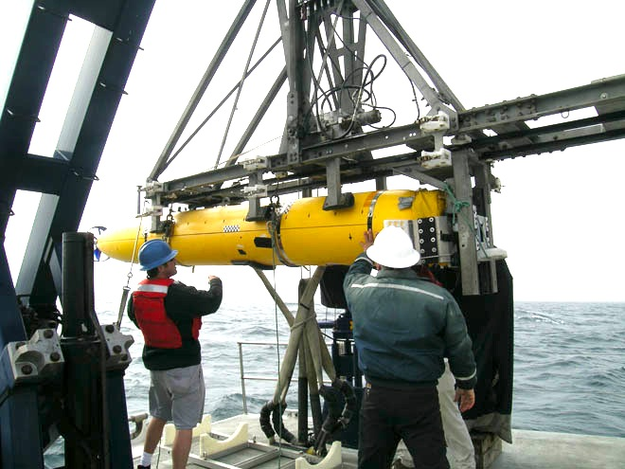
T-ReX Casper (NASA JPL)
Planning/control of AUVs
Monterey Bay Aquarium Research Institute, ≈ 2005-2010
Planning/control of spacecraft
NASA JPL, ongoing
Notes:
temps: ressource essentielle pour l’action
requis pour traiter de la concurrence

Slide 5
Temporal Models
Constraints on state variables and events
  Reflect predicted actions and events
Actions have duration
  preconditions and effects may occur at times other than start and end
Time constraints on goals
  relative or absolute
Exogenous events expected to occur in the future
Maintenance actions: maintain a property
  e.g., track a moving target, keep a door closed
Concurrent actions
  interacting effects, joint effects
Delayed commitment
  instantiation at acting time

Slide 6
Outline
Introduction
4.2 Representation
  Timelines
  Actions and tasks
  Chronicles
4.3 Temporal planning
4.4 Constraint management
4.5 Acting with temporal models

Slide 7
Timelines
Up to now, we’ve used a “state-oriented view”
    Time is a sequence of states s₀, s₁, s₂
    Instantaneous actions transform each state into the next one
    No overlapping actions
Switch to a “time-oriented view”
  Discrete: time points are integers
    t = 1, 2, 3, …
  For each state variable x, a timeline
    values of x during different time intervals
  State at time t = {state-variable values at time t}
t
t+1
x
state variables
y
time

Slide 8
Timeline
A pair (T,C )
  partially predicted evolution of one state variable
T : temporal assertions
    [t₁, t₂] loc(r1) : (loc1, l)
    [t₂, t₃] loc(r1) = l
    [t₃, t₄] loc(r1) : (l, loc2)
C : constraints
    t₁ < t₂ < t₃ < t₄
    l ≠ loc1
    l ≠ loc2
If T contains [t,t′] x : (v,v′) or [t,t′] x = v then C always contains t ≤ t′
  To keep the examples from getting cluttered, we’ll often be sloppy and not write t ≤ t′ explicitly
persistence
requires t₁ ≤ t₂
change
requires t₃ ≤ t₄
and l ≠ loc2

Slide 9
Consistency
A consistent timeline:
  T₁ = {[t₁,t₂] loc(r)=loc1, [t₃,t₄] loc(r):(loc1,loc2)}
  C₁ = {t₁< t₂< t₃}
Let (T,C) be a timeline
Let (T ′,C′) be a ground instance of (T,C)
  (T ′,C′) is consistent if
    T ′ satisfies C′
    and
    no state variable in (T,C) has more than one value at a time
(T,C) is consistent if it has at least one consistent ground instance
loc2
loc2
loc(r)
loc1
loc1
loc(r1)
loc1
loc1
time
time
t₁
t₂
t₃
t₄
1
3
4
9
  (T₁,C₁) a ground instance of (T₁,C₁)
Poll: is this timeline consistent?
  T₂ = {[t₁,t₂] loc(r)=loc1,
  [t₃,t₄] loc(r):(l,loc2)}
  C₂ = {t₁< t₃< t₂}
loc1
loc2
loc(r)
l
time
t₁
t₃
t₂
t₄

Slide 10
Security
(T,C) is secure if
  it’s consistent (has at least one
  consistent ground instance)
  every ground instance that satisfies
  the constraints is consistent
In PSP (Chapter 2), analogous to a partial plan that has no threats
Can make a consistent timeline secure
by adding separation constraints:
  r ≠ r1
  t₂ < t₃
  t₄ < t₁
  t₂ = t₃, r = r1 , l = loc1
  t₄ = t₁, r = r1 , l = loc1
Analogous to resolvers in PSP
Not secure:
  T₁ = {[t₁,t₂] loc(r) = loc1, [t₃,t₄] loc(r) : (l,loc2)}
  C₁ = {t₁< t₂, t₃< t₄}
Separation constraints:
  t₂ < t₃
  t₂ = t₃, l = loc1
loc2
loc2
loc(r)
loc1
l
loc(r1)
loc1
loc3
time
time
t₁
t₂
t₃
t₄
0
4
5
6
  (T₁,C₁) a ground instance

Slide 11
Union of Multiple Timelines
book omits
this part
Timelines for k different state variables, all of which are fully ground:
  (T₁,C₁), …, (T_{k},C_{k})
Union is (T,C):
  T = T₁∪…∪T_{k}
  C = C₁∪…∪C_{k}
If every (T_{i},C_{i}) is secure, then (T₁,C₁) ∪ …∪ (T_{k},C_{k}) is also secure

Slide 12
Causal support
Consider the assertion [t₁,t₂] loc(r1) = loc1
  How did r1 get to loc1 in the first place?
Let α be either [t₁,t₂] x = v₁ or [t₁,t₂] x : (v₁, v₂)
Causal support for α
  Information saying α is supported a priori
  Or another assertion that produces x = v₁ at time t₁
      [t₀,t₁] x = v₁
      [t₀,t₁] x : (v₀, v₁)
A timeline T is causally supported if every assertion α in T has a causal support
Three ways to modify a timeline to add causal support …
loc(r1)
loc1
t₁
t₂
time

Slide 13
Establishing causal support
(1) Add a persistence assertion
loc2
loc2
loc(r1)
loc1
Persistence
loc3
Change
T = {[t₁,t₂] loc(r1):(loc1,loc2),
[t₃,t₄] loc(r1):(loc2,loc3)}
C = {t₁< t₂ < t₃< t₄}
t1
t2
t3
t4
time
loc2
Add [t₂,t₃] loc(r1) = loc2
  Supported by the first
  temporal assertion
  Supports the second one
loc(r1)
loc1
Persistence
loc2
Change
t1
t2
t3
t4
time

Slide 14
Establishing causal support
loc2
(2) Add constraints
loc1
l
loc(r1)
loc(r)
T = {[t₁,t₂] loc(r1):(loc1,loc2),
[t₃,t₄] loc(r) = l}
C = {t₁< t₂, t₃< t₄}
t₁ t₂ t₃ t₄
time
loc2
loc2
loc1
loc(r1)
Add t₂ = t₃, r = r1, l = loc2
loc(r1)
t₁ t₂ = t₃ t₄
time

Slide 15
Establishing causal support
(3) Add a change assertion
(by adding an action)
loc1
loc4
loc(r1)
loc3
T = {[t₁,t₂] loc(r1) = loc1,
[t₃,t₄] loc(r1):(loc3,loc4)}
C = {t₁< t₂ < t₃< t₄}
t1
t2
t3
t4
time
loc1
loc4
Add an action that includes
  [t₂,t₃] loc(r1):(loc1,loc3)
loc(r1)
loc3
t1
t2
t3
t4
time

Slide 16
Primitive Tasks (Actions)
Action or primitive task (or just primitive):
  a triple (head,T,C)
    head is the name and parameters
    (T,C) is the union of a set of timelines
Always two additional parameters
  starting time t_{s} , ending time t_{e}
In each temporal assertion in T,
    left endpoint is like a precondition
      ⬄ need for causal support
    right endpoint is like an effect
w
r
d
leave(r,d,w)
// robot r goes from loading dock d to waypoint w
assertions:
[t_{s},t_{e}] loc(r): (d,w)
[t_{s},t_{e}] occupant(d): (r,empty)
  constraints:
t_{e} ≤ t_{s} + δ₁
adjacent(d,w)
  Action duration t_{e} – t_{s} ≤ δ₁

Slide 17
Primitive Tasks (Actions)
k
r
c
w
r
d
    enter(r,d,w)
    // robot r goes from waypoint w to loading dock d
    assertions:
    [t_{s},t_{e}] loc(r): (w,d)
    [t_{s},t_{e}] occupant(d): (empty,r)
    constraints:
    t_{e} ≤ t_{s} + δ₂
    adjacent(d,w)
  Action duration t_{e} – t_{s} ≤ δ₂
  Dock d becomes occupied by r
d
take(k,c,r,d)
// crane k takes container c from robot r
assertions:
[t_{s},t_{e}] pos(c): (r, k) // where c is
[t_{s},t_{e}] grip(k): (empty, c) // what’s in k’s gripper
[t_{s},t_{e}] freight(r): (c,empty) // what r is carrying
[t_{s},t_{e}] loc(r) = d // where r is
constraints:
attached(k,d)

Slide 18
Primitive Tasks (Actions)
leave(r,d,w) robot r leaves dock d to an adjacent waypoint w
enter(r,d,w) r enters d from an adjacent waypoint w
take(k,c,r) crane k takes container c from robot r
put(k,c,r) crane k puts container c onto robot r
navigate(r,w,w′) r navigates from waypoint w to connected waypoint w′
stack(k,c,p) crane k stacks container c on top of pile p
unstack(k,c,p) crane k takes a container c from top of pile p
k
c
• w
r
c, c′ - containers
d, d′ - loading docks
k, k′ - cranes
p, p′ - piles
r - robot
w, w′ - waypoints
p
d
k′
• w′
p′
d′

Slide 19
Tasks and Methods
Task: move robot r to dock d
  [t_{s} ,t_{e}] move(r,d)
Method:
  m-move1(r,d,d′,w,w′)
  task: move(r,d)
  refinement:
  [t_{s},t₁] leave(r,d′,w′)
  [t₂,t₃] navigate(r,w′,w)
  [t₄,t_{e}] enter(r,d,w)
  assertions:
  [t_{s},t_{s}+1] loc(r) = d′
  constraints:
  adjacent(d,w),
  adjacent(d′,w′), d ≠ d′,
  connected(w,w′),
  t₁ ≤ t₂, t₃ ≤ t₄
  [t_{s} ,t_{e}] move(r,d)
navigate
leave
enter
t_{s} t₁ t₂ t₃ t₄ t_{e}
ts
t1
t2
t3
t4
te
book omits r
• w
d
• w′
r
d′

Slide 20
Tasks and Methods
Task: move container c from pile p to robot r
  [t_{s} ,t_{e}] load(k,r,c,p)
Method:
  m-load1(k,r,c,p)
  task: load(k,r,c,p)
  refinement:
  [t_{s},t₁] unstack(k,c,p)
  [t₂,t_{e}] put(k,c,r)
  assertions:
  constraints:
  t₁ ≤ t₂
  [t_{s},t_{e}] load(k,r,c,p)
unstack
put
t_{s} t₁ t₂ t_{e}
k
k
k
c
r
r
r
c
c
p
p
p
d
d
d

Slide 21
Tasks and Methods
  [t_{s} ,t_{e}] uncover(c,p)
Task: remove everything
above container c in pile p
  [t_{s} ,t_{e}] uncover(c,p)
Method:
  m-uncover(c,p,k,d,p′)
  task: uncover(c,p)
refinement: [t_{s},t₁] unstack(k,c′,p) // action
[t₂,t₃] stack(k,c′,p′) // action
[t₄,t_{e}] uncover(c,p) // recursive uncover
  assertions: [t_{s},t_{s}+1] pile(c) = p
  [t_{s},t_{s}+1] top(p) = c′
  [t_{s}, t_{s}+1] grip(k) = empty
constraints: attached(k,d), attached(p,d),
attached(p′,d),
p ≠ p′, c′ ≠ c, t₁ ≤ t₂, t₃ ≤ t₄
stack
unstack
uncover
c = c3 - container
p = p1 - pile it’s in
k = k1 - crane
d = d1 - loading dock
p′ = p2 - offload pile
t_{s} t₁ t₂ t₃ t₄ t_{e}
ts
t1
t2
t3
t4
te
k
k
c′
…
c
c
c′
p′
p′
d
d
p
p

Slide 22
Tasks and Methods
Task: robot r brings
container c to pile p
  [t_{s} , t_{e}] bring(r,c,p)
m-bring(r,c,p,p′,d,d′)
task: bring(r,c,p)
refinement: [t_{s},t₁] move(r,d′ )
[t_{s},t₂] uncover(c,p′)
[t₃,t₄] load(k′,r,c,p′)
[t₅,t₆] move(r,d)
[t₇,t_{e}] unload(k,r,c,p)
assertions: [t_{s},t₃] pile(c) = p′
[t_{s},t₃] freight(r) = empty
constraints: attached(p′,d′), attached(p,d), d ≠ d′
attached(k′,d′), attached(k,d), k ≠ k′
t₁ ≤ t₃, t₂ ≤ t₃, t₄ ≤ t₅, t₆ ≤ t₇
[t_{s} , t_{e}] bring(r,c,p)
pile(c) = p′
cargo(r) = nil
move
t₁
move
uncover
load
unload
t₂
t_{s} t₃ t₄ t₅ t₆ t₇ t_{e}
k
r
• w
p
k′
d
• w′
c
p′
d′

Slide 23
Chronicles
Chronicle ϕ = (A,S,T,C)
  A: temporally qualified tasks
  S : a priori supported assertions
  T: temporally qualified assertions
  C: constraints
ϕ can include
  Current state, future predicted events
  Tasks to perform
  Assertions and constraints to satisfy
Can represent
  a planning problem
  a plan or partial plan
ϕ₀:
tasks: [t₀,t₁] bring(r,c1,d4)
supported: [t_{s}] loc(r1)=d1
[t_{s}] loc(r2)=d2
[t_{s}+10,t_{s}+δ] docked(ship1)=d3
[t_{s}] top(pile-ship1)=c1
[t_{s}] pos(c1)=pallet
assertions: [t_{e}] loc(r1)=d1
[t_{e}] loc(r2)=d2
constraints: t_{s} = 0 < t₀ < t₁ < t_{e} , 20 ≤ δ ≤ 30
[t_{s} , t_{e}] bring(r,c1,d4)
loc(r1)=d1
top(pile-ship1)=c1
docked(ship1)=d3
loc(r1)=d1
t_{s} t₀ t_{s}+10 t_{s}+ δ t₁ t_{e}

Slide 24
Outline
Introduction
Representation
4.3 Temporal planning
  Resolvers and flaws
  Search space
4.4 Constraint management
4.5 Acting with temporal models

Slide 25
Planning
  ϕ₀: tasks: (none)
  supported: (none)
assertions: [t₁,t₂] loc(r1) = l
[t₃,t₄] loc(r1) : (loc3,loc4)
constraints: adjacent(loc3,w1)
adjacent(w1,loc3)
adjacent(loc4,w2)
adjacent(w2,loc4)
connected(w1,w2)
Planning problem:
  a chronicle ϕ₀ that has some flaws
    analogous to flaws in PSP
To resolve the flaws, add
  assertions
  constraints
  actions
l
loc4
loc(r1)
loc3
t1
t2
t3
t4
  ϕ₁: tasks: [t₂,t₃] move(r1,loc3)
  supported: (none)
assertions: [t₁,t₂] loc(r1) = l
[t₃,t₄] loc(r1) : (loc3,loc4)
constraints: adjacent(loc3,w1)
adjacent(w1,loc3)
adjacent(loc4,w2)
adjacent(w2,loc4)
connected(w1,w2)
l
loc4
loc(r1)
move
loc3
t1
t2
t3
t4

Slide 26
Flaws (1)
Like an open goal in PSP
l
loc4
loc(r1)
loc3
1. Temporal assertion α that isn’t causally supported
  What causes r1 to be at loc3 at time t₃?
Resolvers:
  Add constraints* to support α from an assertion in ϕ
    l = loc3, t₂ = t₃
  Add a new persistence assertion* to support α
    l = loc3, [t₂,t₃] loc(r1) = loc3
  Add an action or task to support α
    [t₂,t₃] move(r1,loc3)
      refining it will produce an action that supports α
      (see next slide)
__________
*where the book uses equality constraints, I’ll use substitutions
t1
t2
t3
t4
l
loc4
loc(r1)
l = loc3
t1
t2=t3
t4
loc4
loc(r1)
l = loc3
t1
t2
t3
t4
l
loc4
loc(r1)
move
loc3
t1
t2
t3
t4

Slide 27
Flaws (2)
Like a task in HTN planning
Method:
  m-move1(r,d,d′,w,w′)
  task: move(r,d)
  refinement:
  [t_{s},t₁] leave(r,d′,w′)
  [t₂,t₃] navigate(r,w′,w)
  [t₄,t_{e}] enter(r,d,w)
  assertions:
  [t_{s},t_{s}+1] loc(r) = d′
  constraints:
  adjacent(d,w),
  adjacent(d′,w′), d ≠ d′,
  connected(w,w′),
  t₁ ≤ t₂, t₃ ≤ t₄
2. Non-refined task
  Resolver: refinement method
    Applicable if it matches the task
    and its constraints are consistent with ϕ’s
  Applying the resolver:
    Modify ϕ by replacing the task with m
Example: [t₂,t₃] move(r1,loc3)
  Refinement will replace
  it with something like
      [t₂,t₅] leave(r1,l,w)
      [t₅,t₆] navigate(r,w,w′)
      [t₆,t₃] enter(r1,loc3,w′)
    plus constraints
l
loc4
loc(r1)
move
loc3
t1
t2
t3
t4

Slide 28
Flaws (3)
Like a threat in PSP
l
loc3
3. A pair of possibly-conflicting temporal assertions
  temporal assertions α and β possibly conflict if they can
  have inconsistent instances
  e.g., [t₁,t₂] loc(r1) = loc1, [t₃,t₄] loc(r) : (l, l′)
  ↓ ↓ ↓ ↓ ↓ ↓ ↘
  instance: [1,5] loc(r1) = loc1, [3,8] loc(r1) : (loc2,loc3)
Resolvers: separation constraints
  r ≠ r1
  t₂ < t₃
  t₄ < t₁
  t₂ = t₃, r = r1 , l = loc1
    Also provides causal support for [t₃,t₄] loc(r) : (l, l′)
  t₄ = t₁, r = r1 , l = loc1
    Also provides causal support for [t₁,t₂] loc(r1) = loc1
loc(r1)
loc(r)
loc2
t1
t2
t3
t4
loc1
loc3
loc(r1)
loc2
loc(r1)
1
3
5
8

Slide 29
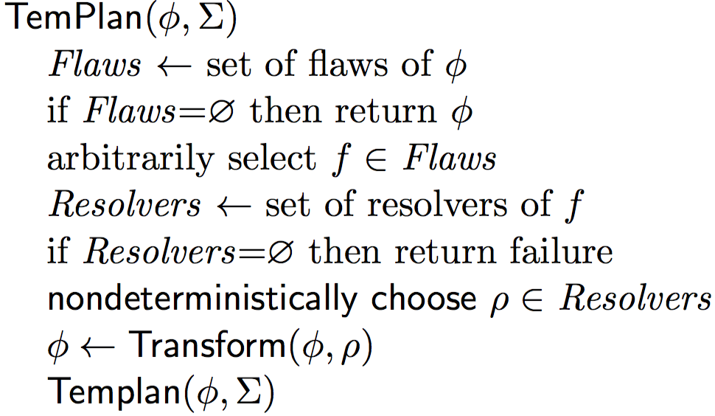
Planning Algorithm
Like PSP in Chapter 2
  Repeatedly selects flaws and chooses resolvers
In the book, TemPlan uses recursion
  Can be rewritten to use a loop
  Just programming style, equivalent either way
Selecting a resolver ρ is an OR-branch
  backtracking point
Selecting a flaw f is an AND-branch
  not a backtracking point, must eventually select all of them
If it’s possible to resolve all flaws, at least one of the nondeterministic execution traces will do so
TemPlan(ϕ, Σ)
loop:

Slide 30
Example
  ϕ₀: tasks: bring(r,c1,p3)
  bring(r′,c2,p4)
  supported: [0] loc(r1)=d3
  [0] loc(r2)=d4
  [0] freight(r1)=empty
  [0] freight(r2)=empty
  [0] pile(c1)=p′1
  [0] pile(c2)=p′2
  . . .
assertions: (none)
constraints: adjacent(d1,w12), . . .
ϕ₀ = (A,S,T,C)
  Establishes state-variable values at time t = 0
  Flaws: two unrefined tasks
Select bring(r,c1,p3) to resolve first
d1
Note:
  [0] x = v means [0,0] x = v

Slide 31
Method instance
  ϕ₀: tasks: bring(r,c1,p3)
  bring(r′,c2,p4)
  supported: [0] loc(r1)=d3
  [0] loc(r2)=d4
  [0] freight(r1)=empty
  [0] freight(r2)=empty
  [0] pile(c1)=p′1
  [0] pile(c2)=p′2
  . . .
assertions: (none)
constraints: adjacent(d1,w12), . . .
One relevant method
  Instantiate c ← c1 and p ← p3 to match bring(r,c1,p3)
m-bring(r,c,p,p′,d,d′,k,k′)
task: bring(r,c,p)
refinement: [t_{s},t₁] move(r,d′)
[t_{s},t₂] uncover(c,p′)
[t₃,t₄] load(k′,r,c,p′)
[t₅,t₆] move(r,d)
[t₇,t_{e}] unload(k,r,c,p)
assertions: [t_{s},t₃] pile(c) = p′
[t_{s},t₃] freight(r) = empty
constraints: attached(p′,d′),
attached(p,d), d ≠ d′
attached(k′,d′),
attached(k,d), k ≠ k′
t₁ ≤ t₃, t₂ ≤ t₃, t₄ ≤ t₅, t₆ ≤ t₇
m-bring(r,c1,p3,p′1,d3,d1,k3,k1)
task: bring(r,c1,p3)
refinement: [t_{s},t₁] move(r,d1)
[t_{s},t₂] uncover(c1,p′1)
[t₃,t₄] load(k1,r,c1,p′1)
[t₅,t₆] move(r, d3)
[t₇,t_{e}] unload(k3,r,c1,p3)
assertions: [t_{s},t₃] pile(c1) = p′1
[t_{s},t₃] freight(r) = empty
constraints: attached(p′1,d1),
attached(p3,d3), d3 ≠ d1
attached(k1,d1),
attached(k3,d3), k3 ≠ k1
t₁ ≤ t₃, t₂ ≤ t₃, t₄ ≤ t₅, t₆ ≤ t₇
d1
Poll: did I instantiate p′,d,d′,k,k′ prematurely?

Slide 32
Apply the method instance
  ϕ₁: tasks: [t_{s},t₁] move(r,d1)
  [t_{s},t₂] uncover(c1,p′1)
  [t₃,t₄] load(k1,r,c1,p′1)
  [t₅,t₆] move(r, d3)
  [t₇,t_{e}] unload(k3,r,c1,p3)
  bring(r′,c2,p4)
  supported: [0] loc(r1)=d3
  [0] loc(r2)=d4
  [0] freight(r1)=empty
  [0] freight(r2)=empty
  [0] pile(c1)=p′1
  [0] pile(c2)=p′2
  . . .
assertions: [t_{s},t₃] pile(c1) = p′1
[t_{s},t₃] freight(r) = empty
  constraints: t_{s}<t₁≤t₃, 0<t₂≤t₃, t₄≤t₅, t₆≤t₇
adjacent(d1,w12), . . .
Changes to ϕ₀
  Remove bring(r,c1,p3)
  Add new tasks, assertions, constraints
Flaws: 6 unrefined tasks, 2 unsupported assertions
Select bring(r′,c2,p4) to resolve next
d1

Slide 33
Method instance
  ϕ₁: tasks: [t_{s},t₁] move(r,d1)
  [t_{s},t₂] uncover(c1,p′1)
  [t₃,t₄] load(k1,r,c1,p′1)
  [t₅,t₆] move(r, d3)
  [t₇,t_{e}] unload(k3,r,c1,p3)
  bring(r′,c2,p4)
  supported: [0] loc(r1)=d3
  [0] loc(r2)=d4
  [0] freight(r1)=empty
  [0] freight(r2)=empty
  [0] pile(c1)=p′1
  [0] pile(c2)=p′2
  . . .
assertions: [t_{s},t₃] pile(c1) = p′1
[t_{s},t₃] freight(r) = empty
constraints: t_{s}<t₁≤t₃, 0<t₂≤t₃, t₄≤t₅, t₆≤t₇
adjacent(d1,w12), . . .
Instantiate r ← r′, c ← c2, p ← p4 to match bring(r′,c2,p4)
Rename timepoint variables t_{s},, t_{e}, t₁, …, t₇ to avoid name conflicts
m-bring(r,c,p,p′,d,d′,k,k′)
task: bring(r,c,p)
refinement: [t_{s},t₁] move(r,d′)
[t_{s},t₂] uncover(c,p′)
[t₃,t₄] load(k′,r,c,p′)
[t₅,t₆] move(r,d)
[t₇,t_{e}] unload(k,r,c,p)
assertions: [t_{s},t₃] pile(c) = p′
[t_{s},t₃] freight(r) = empty
constraints: attached(p′,d′),
attached(p,d), d ≠ d′
attached(k′,d′),
attached(k,d), k ≠ k′
t₁ ≤ t₃, t₂ ≤ t₃, t₄ ≤ t₅, t₆ ≤ t₇
m-bring(r′,c2,p4,p′2,d4,d2,k4,k2)
task: bring(r′,c2,p4)
refinement: [t′_{s},t′₁] move(r′,d2)
[t′_{s},t′₂] uncover(c2,p′2)
[t′₃,t′₄] load(k2,r′,c2,p′2)
[t′₅,t′₆] move(r′,d4)
[t′₇,t′_{e}] unload(k4,r′,c2,p4)
assertions: [t′_{s},t′₃] pile(c2) = p′2
[t′_{s},t′₁] freight(r′) = empty
constraints: attached(p′2,d2),
attached(p4,d4), d4 ≠ d2
attached(k2,d2),
attached(k4,d4), k4 ≠ k2
t′₁ ≤ t′₃, t′₂ ≤ t′₃, t′₄ ≤ t′₅, t′₆ ≤ t′₇
d1
Poll: to get the method instance, I substituted r←r′ in m-bring. Should I also substitute r←r′ in ϕ₁?

Slide 34
Apply the method instance
  ϕ₂: tasks: [t_{s},t₁] move(r,d1)
  [t_{s},t₂] uncover(c1,p′1)
  [t₃,t₄] load(k1,r,c1,p′1)
  [t₅,t₆] move(r, d3)
  [t₇,t_{e}] unload(k3,r,c1,p3)
[t′_{s},t′₁] move(r′,d2)
[t′_{s},t′₂] uncover(c2,p′2)
[t′₃,t′₄] load(k4,r′,c2,p′2)
[t′₅,t′₆] move(r′,d4)
[t′₇,t′_{e}] unload(k2,r′,c2,p′2)
  supported: [0] loc(r1)=d3
  [0] loc(r2)=d4
  [0] freight(r1)=empty
  [0] freight(r2)=empty
  [0] pile(c1)=p′1
  [0] pile(c2)=p′2
  . . .
assertions: [t_{s},t₃] pile(c1) = p′1
[t_{s},t₃] freight(r) = empty
[t′_{s},t′₃] pile(c2) = p′2
[t′_{s},t′₁] freight(r′) = empty
constraints: t_{s}<t₁≤t₃, t_{s}<t₂≤t₃, t₄≤t₅, t₆≤t₇,
t′_{s}<t′₁≤t′₃, t′_{s}<t′₂≤t′₃, t′₄≤t′₅, t′₆≤t′₇
adjacent(d1,w12), . . .
Changes:
  Remove bring(r′,c2,p4)
  Add tasks, assertions, constraints
Flaws: 10 unrefined tasks, 4 unsupported assertions
Select [t_{s},t₃] pile(c1) = p′1 to resolve next
d1

Slide 35
Resolvers for a temporal assertion
  ϕ₂: tasks: [t_{s},t₁] move(r,d1)
  [t_{s},t₂] uncover(c1,p′1)
  [t₃,t₄] load(k1,r,c1,p′1)
  [t₅,t₆] move(r, d3)
  [t₇,t_{e}] unload(k3,r,c1,p3)
[t′_{s},t′₁] move(r′,d2)
[t′_{s},t′₂] uncover(c2,p′2)
[t′₃,t′₄] load(k4,r′,c2,p′2)
[t′₅,t′₆] move(r′,d4)
[t′₇,t′_{e}] unload(k2,r′,c2,p′2)
  supported: [0] loc(r1)=d3
  [0] loc(r2)=d4
  [0] freight(r1)=empty
  [0] freight(r2)=empty
  [0] pile(c1)=p′1
  [0] pile(c2)=p′2
  . . .
assertions: [t_{s},t₃] pile(c1) = p′1
[t_{s},t₃] freight(r) = empty
[t′_{s},t′₃] pile(c2) = p′2
[t′_{s},t′₁] freight(r′) = empty
constraints: t_{s}<t₁≤t₃, t_{s}<t₂≤t₃, t₄≤t₅, t₆≤t₇,
t′_{s}<t′₁≤t′₃, t′_{s}<t′₂≤t′₃, t′₄≤t′₅, t′₆≤t′₇
adjacent(d1,w12), . . .
Four ways to support [t_{s},t₃] pile(c1)=p′1
A. Support from [0] pile(c1)=p′1 by constraining t_{s} = 0
B. Support from [0] pile(c1)=p′1 by adding persistence [0,t_{s}] pile(c1)=p1
C. Add a task [t₈,t_{s}] unload(k,r′′,c1,p′1)
D. Add a primitive task [t₈,t_{s}] unstack(k,c1,p′1)
d1
Poll: Suppose r = r1 here.
As a side effect, which resolvers will also support
[t_{s},t₃] freight(r1) = empty?
Vote for A, B, C, or D,
or E (none of them),
F (more than one),
G (unsure)

Slide 36
Support the assertion
  ϕ₂: tasks: [0,t₁] move(r,d1)
  [0,t₂] uncover(c1,p′1)
  [t₃,t₄] load(k1,r,c1,p′1)
  [t₅,t₆] move(r,d3)
  [t₇,t_{e}] unload(k3,r,c1,p3)
[t′_{s},t′₁] move(r′,d2)
[t′_{s},t′₂] uncover(c2,p′2)
[t′₃,t′₄] load(k4,r′,c2,p′2)
[t′₅,t′₆] move(r′,d4)
[t′₇,t′_{e}] unload(k2,r′,c2,p′2)
  supported: [0] loc(r1)=d3
  [0] loc(r2)=d4
  [0] freight(r1)=empty
  [0] freight(r2)=empty
  [0] pile(c1)=p′1, [0,t₃] pile(c1)=p′1
  [0] pile(c2)=p′2
  . . .
assertions: [0,t₃] freight(r) = empty
[t′_{s},t′₃] pile(c2) = p′2
[t′_{s},t′₁] freight(r′) = empty
constraints: 0<t₁≤t₃, 0<t₂≤t₃, t₄≤t₅, t₆≤t₇,
t′_{s}<t′₁≤t′₃, t′_{s}<t′₂≤t′₃, t′₄≤t′₅, t′₆≤t′₇
adjacent(d1,w12), . . .
Support [t_{s},t₃] pile(c1) = p′1 from [0] pile(c1)=p′1 by constraining t_{s} = 0
  Move it to the “supported” list
Next: support [0,t₃] freight(r) = empty
d1

Slide 37
Support another assertion
  ϕ₃: tasks: [0,t₁] move(r2,d1)
  [0,t₂] uncover(c1,p′1)
  [t₃,t₄] load(k1,r2,c1,p′1)
  [t₅,t₆] move(r2,d3)
  [t₇,t_{e}] unload(k3,r2,c1,p3)
[t′_{s},t′₁] move(r′,d2)
[t′_{s},t′₂] uncover(c2,p′2)
[t′₃,t′₄] load(k4,r′,c2,p′2)
[t′₅,t′₆] move(r′,d4)
[t′₇,t′_{e}] unload(k2,r′,c2,p′2)
  supported: [0] loc(r1)=d3
  [0] loc(r2)=d4
  [0] freight(r1)=empty
  [0] freight(r2)=empty
  [0] pile(c1)=p′1, [0,t₃] pile(c1)=p′1
  [0] pile(c2)=p′2
[0,t₃] freight(r2) = empty
. . .
assertions: [t′_{s},t′₃] pile(c2) = p′2
[t′_{s},t′₁] freight(r′) = empty
constraints: 0<t₁≤t₃, 0<t₂≤t₃, t₄≤t₅, t₆≤t₇,
t′_{s}<t′₁≤t′₃, t′_{s}<t′₂≤t′₃, t′₄≤t′₅, t′₆≤t′₇ adjacent(d1,w12), . . .
Support [0,t₃] freight(r) = empty from [0] freight(r2)=empty by constraining r = r2
  Move it to the “supported” list
Next: support [t′_{s},t′₃] pile(c2)=p′2
d1

Slide 38
Support another assertion
  ϕ₃: tasks: [0,t₁] move(r2,d1)
  [0,t₂] uncover(c1,p′1)
  [t₃,t₄] load(k1,r2,c1,p′1)
  [t₅,t₆] move(r2,d3)
  [t₇,t_{e}] unload(k3,r2,c1,p3)
[0,t′₁] move(r′,d2)
[0,t′₂] uncover(c2,p′2)
[t′₃,t′₄] load(k4,r′,c2,p′2)
[t′₅,t′₆] move(r′,d4)
[t′₇,t′_{e}] unload(k2,r′,c2,p′2)
  supported: [0] loc(r1)=d3
  [0] loc(r2)=d4
  [0] freight(r1)=empty
  [0] freight(r2)=empty
  [0] pile(c1)=p′1, [0,t₃] pile(c1)=p′1
  [0] pile(c2)=p′2, [0,t′₃] pile(c2)=p′2
[0,t₃] freight(r2) = empty
. . .
assertions: [0,t′₁] freight(r′) = empty
constraints: 0<t₁≤t₃, 0<t₂≤t₃, t₄≤t₅, t₆≤t₇,
0<t′₁≤t′₃, 0<t′₂≤t′₃, t′₄≤t′₅, t′₆≤t′₇
adjacent(d1,w12), . . .
Support [t′_{s},t′₃] pile(c2)=p′2 from [0] pile(c2)=p′2 by constraining t′_{s} = 0
  Move it to the “supported” list
Next: support [t′_{s},t′₁] freight(r′) = empty
d1

Slide 39
Support another assertion
  ϕ₄: tasks: [0,t₁] move(r2,d1)
  [0,t₂] uncover(c1,p′1)
  [t₃,t₄] load(k1,r2,c1,p′1)
  [t₅,t₆] move(r2,d3)
  [t₇,t_{e}] unload(k3,r2,c1,p3)
[0,t′₁] move(r1,d2)
[0,t′₂] uncover(c2,p′2)
[t′₃,t′₄] load(k4,r1,c2,p′2)
[t′₅,t′₆] move(r1,d4)
[t′₇,t′_{e}] unload(k2,r1,c2,p′2)
  supported: [0] loc(r1)=d3
  [0] loc(r2)=d4
  [0] freight(r1)=empty
  [0,t₃] freight(r2) = empty
  [0] pile(c1)=p′1, [0,t₃] pile(c1)=p′1
  [0] pile(c2)=p′2, [0,t′₃] pile(c2)=p′2
  [0] freight(r2)=empty
  [0,t′₁] freight(r1) = empty
. . .
constraints: 0<t₁≤t₃, 0<t₂≤t₃, t₄≤t₅, t₆≤t₇,
0<t′₁≤t′₃, 0<t′₂≤t′₃, t′₄≤t′₅, t′₆≤t′₇
adjacent(d1,w12), . . .
Support [t′_{s},t′₁] freight(r′) = empty from [0] freight(r1)=empty by constraining r′ = r1
  Move it to the “supported” list
Next: refine task [0,t₁] move(r1,d2)
d1

Slide 40
Method instance
  ϕ₄: tasks: [0,t₁] move(r2,d1)
  [0,t₂] uncover(c1,p′1)
  [t₃,t₄] load(k1,r2,c1,p′1)
  [t₅,t₆] move(r2,d3)
  [t₇,t_{e}] unload(k3,r2,c1,p3)
[0,t′₁] move(r1,d2)
[0,t′₂] uncover(c2,p′2)
[t′₃,t′₄] load(k4,r1,c2,p′2)
[t′₅,t′₆] move(r1,d4)
[t′₇,t′_{e}] unload(k2,r1,c2,p′2)
  supported: [0] loc(r1)=d3
  [0] loc(r2)=d4
  . . .
  constraints: 0<t₁≤t₃, 0<t₂≤t₃, t₄≤t₅, t₆≤t₇,
  0<t′₁≤t′₃, 0<t′₂≤t′₃, t′₄≤t′₅, t′₆≤t′₇
adjacent(d1,w12), . . .
Instantiate r←r1, d←d2, t_{s}←0, t_{e}←t₁ to match [0,t₁′] move(r1,d3)
  Rename timepoint variables
  t₁,…, t₄ to avoid name conflicts
m-move1(r,d,d′,w,w′)
task: move(r,d)
refinement:
[t_{s},t₁] leave(r,d′,w′)
[t₂,t₃] navigate(r,w′,w)
[t₄,t_{e}] enter(r,d,w)
assertions:
[t_{s},t_{s}+1] loc(r) = d′
constraints:
adjacent(d,w),
adjacent(d′,w′), d ≠ d′,
connected(w,w′),
t₁ ≤ t₂, t₃ ≤ t₄
m-move1(r1,d2,d3,w23,w23) task: move(r2,d1)
refinement:
[0,t₁′′] leave(r1,d3,w23)
[t₂′′,t₃′′] navigate(r1,w23,w23)
[t₄′′,t₁′] enter(r1,d2,w23)
assertions:
[0,1] loc(r1) = d3
constraints:
adjacent(d2,w23),
adjacent(d3,w23), d2 ≠ d3,
connected(w23,w23),
t₁′′ ≤ t₂′′, t₃′′ ≤ t₄′′
d1

Slide 41
Modified chronicle
  ϕ₅: tasks: [0,t₁] move(r2,d1)
  [0,t₂] uncover(c1,p′1)
  [t₃,t₄] load(k1,r2,c1,p′1)
  [t₅,t₆] move(r2,d3)
  [t₇,t_{e}] unload(k3,r2,c1,p3)
[0,t₁′′] leave(r1,d3,w23)
[t₂′′,t₃′′] navigate(r1,w23,w23)
[t₄′′,t₁′] enter(r1,d2,w23)
[0,t′₂] uncover(c2,p′2)
[t′₃,t′₄] load(k4,r1,c2,p′2)
[t′₅,t′₆] move(r1,d4)
[t′₇,t′_{e}] unload(k2,r1,c2,p′2)
  supported: [0] loc(r1)=d3, [0,1] loc(r1) = d3
  [0] loc(r2)=d4
  . . .
  constraints: 0<t₁≤t₃, 0<t₂≤t₃, t₄≤t₅, t₆≤t₇,
  0<t′₁≤t′₃, 0<t′₂≤t′₃, t′₄≤t′₅, t′₆≤t′₇
t₁′′≤ t₂′′, t₃′′≤ t₄′′
adjacent(d1,w12), . . .
Replace [0,t′₁] move(r1,d2) with 3 tasks
Assertion [0,1] loc(r1) = d3 is already supported, add it to the “supported” list
Add some constraints
Flaws: 12 tasks
Next: support [0,t₁′′] leave(r1,d3,w23)
d1

Slide 42
Primitive task instance
  ϕ₆: tasks: [0,t₁] move(r2,d1)
  [0,t₂] uncover(c1,p′1)
  [t₃,t₄] load(k1,r2,c1,p′1)
  [t₅,t₆] move(r2,d3)
  [t₇,t_{e}] unload(k3,r2,c1,p3)
[0,t₁′′] leave(r1,d3,w23)
[t₂′′,t₃′′] navigate(r1,w23,w23)
[t₄′′,t₁′] enter(r1,d2,w23)
[0,t′₂] uncover(c2,p′2)
[t′₃,t′₄] load(k4,r1,c2,p′2)
[t′₅,t′₆] move(r1,d4)
[t′₇,t′_{e}] unload(k2,r1,c2,p′2)
  supported: [0] loc(r1)=d3, [0,1] loc(r1) = d3
  [0] loc(r2)=d4
  . . .
  constraints: 0<t₁≤t₃, 0<t₂≤t₃, t₄≤t₅, t₆≤t₇,
  0<t′₁≤t′₃, 0<t′₂≤t′₃, t′₄≤t′₅, t′₆≤t′₇
t₁′′≤ t₂′′, t₃′′≤ t₄′′
adjacent(d1,w12), . . .
Instantiate r←r2, d←d3, t_{s}←0, t_{e}←t₁′′ to match [0,t₁′′] leave(r1,d3,w23)
leave(r,d,w)
assertions:
[t_{s},t_{e}] loc(r): (d,w)
[t_{s},t_{e}] occupant(d): (r,empty)
  constraints:
t_{e} ≤ t_{s} + δ₁
adjacent(d,w)
leave(r1,d3,w23)
assertions:
[0,t₁′′] loc(r1): (d3,w23)
[0,t₁′′] occupant(d3): (r1,empty)
  constraints:
t₁′′ ≤ 0 + δ₁
adjacent(d3,w23)
d1

Slide 43
Modified chronicle
  ϕ₆: tasks: [0,t₁] move(r2,d1)
  [0,t₂] uncover(c1,p′1)
  [t₃,t₄] load(k1,r2,c1,p′1)
  [t₅,t₆] move(r2,d3)
  [t₇,t_{e}] unload(k3,r2,c1,p3)
[t₂′′,t₃′′] navigate(r1,w23,w23)
[t₄′′,t₁′] enter(r1,d2,w23)
[0,t′₂] uncover(c2,p′2)
[t′₃,t′₄] load(k4,r1,c2,p′2)
[t′₅,t′₆] move(r1,d4)
[t′₇,t′_{e}] unload(k2,r1,c2,p′2)
  supported: [0] loc(r1)=d3, [0,1] loc(r1) = d3
  [0] loc(r2)=d4
  . . .
  assertions: [0,t₁′′] loc(r1): (d3,w23)
  [0,t₁′′] occupant(d3): (r1,empty)
  constraints: 0<t₁≤t₃, 0<t₂≤t₃, t₄≤t₅, t₆≤t₇,
  0<t′₁≤t′₃, 0<t′₂≤t′₃, t′₄≤t′₅, t′₆≤t′₇
t₁′′≤ t₂′′, t₃′′≤ t₄′′
t₁′′ ≤ δ₁
adjacent(d1,w12), . . .
Removed [0,t₁′′] leave(r1,d2,w23), added 2 assertions, one constraint
Next: support [0,t₁′′] enter(r1,d2,w23)
d1

Slide 44
Primitive task instance
  ϕ₆: tasks: [0,t₁] move(r2,d1)
  [0,t₂] uncover(c1,p′1)
  [t₃,t₄] load(k1,r2,c1,p′1)
  [t₅,t₆] move(r2,d3)
  [t₇,t_{e}] unload(k3,r2,c1,p3)
[t₂′′,t₃′′] navigate(r1,w23,w23)
[t₄′′,t₁′] enter(r1,d2,w23)
[0,t′₂] uncover(c2,p′2)
[t′₃,t′₄] load(k4,r1,c2,p′2)
[t′₅,t′₆] move(r1,d4)
[t′₇,t′_{e}] unload(k2,r1,c2,p′2)
  supported: [0] loc(r1)=d3, [0,1] loc(r1) = d3
  [0] loc(r2)=d4
  . . .
  assertions: [0,t₁′′] loc(r1): (d3,w23)
  [0,t₁′′] occupant(d3): (r1,empty)
  constraints: 0<t₁≤t₃, 0<t₂≤t₃, t₄≤t₅, t₆≤t₇,
  0<t′₁≤t′₃, 0<t′₂≤t′₃, t′₄≤t′₅, t′₆≤t′₇
t₁′′≤ t₂′′, t₃′′≤ t₄′′
t₁′′ ≤ δ₁
adjacent(d1,w12), . . .
    enter(r,d,w)
    assertions:
    [t_{s},t_{e}] loc(r): (w,d)
    [t_{s},t_{e}] occupant(d): (empty,r)
    constraints:
    t_{e} ≤ t_{s} + δ₂
    adjacent(d,w)
Instantiate r ← r1,
t_{s} ← t₄′′, t_{e} ← t₁′
    enter(r1,d2,w23)
    assertions:
    [t₄′′,t₁′] loc(r1): (w23,d2)
    [t₄′′,t₁′] occupant(d2): (empty, r1)
    constraints:
    t₁′ ≤ t₄′′ + δ₂
    adjacent(d2,w23)
d1

Slide 45
Modified chronicle
  ϕ₆: tasks: [0,t₁] move(r2,d1)
  [0,t₂] uncover(c1,p′1)
  [t₃,t₄] load(k1,r2,c1,p′1)
  [t₅,t₆] move(r2,d3)
  [t₇,t_{e}] unload(k3,r2,c1,p3)
[t₂′′,t₃′′] navigate(r1,w23,w23)
[0,t′₂] uncover(c2,p′2)
[t′₃,t′₄] load(k4,r1,c2,p′2)
[t′₅,t′₆] move(r1,d4)
[t′₇,t′_{e}] unload(k2,r1,c2,p′2)
  supported: [0] loc(r1)=d3, [0,1] loc(r1) = d3
  [0] loc(r2)=d4
  . . .
  assertions: [0,t₁′′] loc(r1): (d3,w23)
  [0,t₁′′] occupant(d3): (r1,empty)
  [t₄′′,t₁′] loc(r1): (w23,d2)
  [t₄′′,t₁′] occupant(d2): (empty,r1)
  constraints: 0<t₁≤t₃, 0<t₂≤t₃, t₄≤t₅, t₆≤t₇,
  0<t′₁≤t′₃, 0<t′₂≤t′₃, t′₄≤t′₅, t′₆≤t′₇
t₁′′≤ t₂′′, t₃′′≤ t₄′′
t₁′′ ≤ δ₁, t₁′ ≤ t₄′′+δ₂
adjacent(d1,w12), . . .
Remove [t₄′′,t₁′] enter(r1,d2,w23), add 2 assertions, one constraint
Next: support [t₂′′,t₃′′] navigate(r1,w23,w23)
d1

Slide 46
Problems with navigation
  ϕ₆: tasks: [0,t₁] move(r2,d1)
  [0,t₂] uncover(c1,p′1)
  [t₃,t₄] load(k1,r2,c1,p′1)
  [t₅,t₆] move(r2,d3)
  [t₇,t_{e}] unload(k3,r2,c1,p3)
[t₂′′,t₃′′] navigate(r1,w23,w23)
[0,t′₂] uncover(c2,p′2)
[t′₃,t′₄] load(k4,r1,c2,p′2)
[t′₅,t′₆] move(r1,d4)
[t′₇,t′_{e}] unload(k2,r1,c2,p′2)
  supported: [0] loc(r1)=d3, [0,1] loc(r1) = d3
  [0] loc(r2)=d4
  . . .
  assertions: [0,t₁′′] loc(r1): (d3,w23)
  [0,t₁′′] occupant(d3): (r1,empty)
  [t₄′′,t₁′] loc(r1): (w23,d2)
  [t₄′′,t₁′] occupant(d2): (empty,r1)
  constraints: 0<t₁≤t₃, 0<t₂≤t₃, t₄≤t₅, t₆≤t₇,
  0<t′₁≤t′₃, 0<t′₂≤t′₃, t′₄≤t′₅, t′₆≤t′₇
t₁′′≤ t₂′′, t₃′′≤ t₄′′
t₁′′ ≤ δ₁, t₁′ ≤ t₄′′+δ₂
adjacent(d1,w12), . . .
Book’s description of navigate(r,w,w′):
  r navigates from waypoint w to connected waypoint w′
When are two waypoints connected?
  (1) If there’s a road network between them?
  (2) If they’re on the same road and adjacent?
  (3) If they’re on the same road (but not necessarily adjacent)?
Is a waypoint connected to itself?
d1

Slide 47
Possibility (1)
  ϕ₆: tasks: [0,t₁] move(r2,d1)
  [0,t₂] uncover(c1,p′1)
  [t₃,t₄] load(k1,r2,c1,p′1)
  [t₅,t₆] move(r2,d3)
  [t₇,t_{e}] unload(k3,r2,c1,p3)
[t₂′′,t₃′′] navigate(r1,w23,w23)
[0,t′₂] uncover(c2,p′2)
[t′₃,t′₄] load(k4,r1,c2,p′2)
[t′₅,t′₆] move(r1,d4)
[t′₇,t′_{e}] unload(k2,r1,c2,p′2)
  supported: [0] loc(r1)=d3, [0,1] loc(r1) = d3
  [0] loc(r2)=d4
  . . .
  assertions: [0,t₁′′] loc(r1): (d3,w23)
  [0,t₁′′] occupant(d3): (r1,empty)
  [t₄′′,t₁′] loc(r1): (w23,d2)
  [t₄′′,t₁′] occupant(d2): (empty,r1)
  constraints: 0<t₁≤t₃, 0<t₂≤t₃, t₄≤t₅, t₆≤t₇,
  0<t′₁≤t′₃, 0<t′₂≤t′₃, t′₄≤t′₅, t′₆≤t′₇
t₁′′≤ t₂′′, t₃′′≤ t₄′′
t₁′′ ≤ δ₁, t₁′ ≤ t₄′′+δ₂
adjacent(d1,w12), . . .
Suppose w is connected to w′ if a network of roads connects them
  Can write navigate as a task, but not a primitive
  Assertions and constraints depend on the route from w to w′
Write a method whose body is a path-planning algorithm
d1

Slide 48
Possibility (2)
  ϕ₆: tasks: [0,t₁] move(r2,d1)
  [0,t₂] uncover(c1,p′1)
  [t₃,t₄] load(k1,r2,c1,p′1)
  [t₅,t₆] move(r2,d3)
  [t₇,t_{e}] unload(k3,r2,c1,p3)
[t₂′′,t₃′′] navigate(r1,w23,w23)
[0,t′₂] uncover(c2,p′2)
[t′₃,t′₄] load(k4,r1,c2,p′2)
[t′₅,t′₆] move(r1,d4)
[t′₇,t′_{e}] unload(k2,r1,c2,p′2)
  supported: [0] loc(r1)=d3, [0,1] loc(r1) = d3
  [0] loc(r2)=d4
  . . .
  assertions: [0,t₁′′] loc(r1): (d3,w23)
  [0,t₁′′] occupant(d3): (r1,empty)
  [t₄′′,t₁′] loc(r1): (w23,d2)
  [t₄′′,t₁′] occupant(d2): (empty,r1)
  constraints: 0<t₁≤t₃, 0<t₂≤t₃, t₄≤t₅, t₆≤t₇,
  0<t′₁≤t′₃, 0<t′₂≤t′₃, t′₄≤t′₅, t′₆≤t′₇
t₁′′≤ t₂′′, t₃′′≤ t₄′′
t₁′′ ≤ δ₁, t₁′ ≤ t₄′′+δ₂
adjacent(d1,w12), . . .
Suppose w is connected to w′ if they’re adjacent and on the same road
  Can write navigate as a task, but not a primitive
  Assertions and constraints depend on how many waypoints from w to w′
Write a method that goes to an adjacent waypoint then calls navigate again
d1

Slide 49
Possibility (3)
  ϕ₆: tasks: [0,t₁] move(r2,d1)
  [0,t₂] uncover(c1,p′1)
  [t₃,t₄] load(k1,r2,c1,p′1)
  [t₅,t₆] move(r2,d3)
  [t₇,t_{e}] unload(k3,r2,c1,p3)
[t₂′′,t₃′′] navigate(r1,w23,w23)
[0,t′₂] uncover(c2,p′2)
[t′₃,t′₄] load(k4,r1,c2,p′2)
[t′₅,t′₆] move(r1,d4)
[t′₇,t′_{e}] unload(k2,r1,c2,p′2)
  supported: [0] loc(r1)=d3, [0,1] loc(r1) = d3
  [0] loc(r2)=d4
  . . .
  assertions: [0,t₁′′] loc(r1): (d3,w23)
  [0,t₁′′] occupant(d3): (r1,empty)
  [t₄′′,t₁′] loc(r1): (w23,d2)
  [t₄′′,t₁′] occupant(d2): (empty,r1)
  constraints: 0<t₁≤t₃, 0<t₂≤t₃, t₄≤t₅, t₆≤t₇,
  0<t′₁≤t′₃, 0<t′₂≤t′₃, t′₄≤t′₅, t′₆≤t′₇
t₁′′≤ t₂′′, t₃′′≤ t₄′′
t₁′′ ≤ δ₁, t₁′ ≤ t₄′′+δ₂
adjacent(d1,w12), . . .
Suppose w is connected to w′ if they’re on the same road, but not necessarily adjacent
  Then navigate is easy: loc(r) : (w,w′)
Works well if we redraw the figure to have two waypoints on each road
With only one waypoint, a degenerate case: [t₂′′,t₃′′] loc(r1) : (w23,w23)
d1

Slide 50
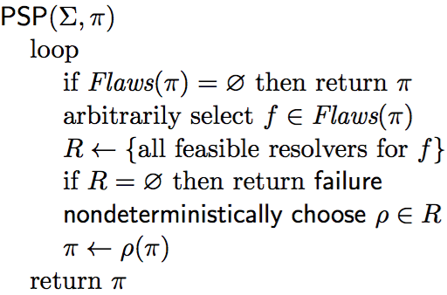
Heuristics for Guiding TemPlan
Flaw selection, resolver selection heuristics similar to those in PSP
  Select the flaw with the smallest number of resolvers
  Choose the resolver that rules out the fewest resolvers for the other flaws
There is also a problem with constraint management
  We ignored it when discussing PSP
  Discuss it next

Slide 51
Summary of Sections 4.1, 4.2, 4.3
Timelines
  Temporal assertions (change, persistence), constraints
  Conflicts, consistency, security, causal support
Chronicle: union of several timelines
  Consistency, security, causal support
  Actions represented by chronicles; preconditions ⬄ causal support
Planning problems
  three kinds of flaws and their resolvers:
    tasks, causal support, security
  partial plans, solution plans
Planning: TemPlan
  Like PSP but with tasks, temporal assertions, temporal constraints

Slide 52
Outline
Introduction
Representation
Temporal planning
4.4 Constraint Management
  Consistency of object constraints and time constraints
  Controlling the actions when we don’t know how long they’ll take
4.5 Acting with temporal models

Slide 53
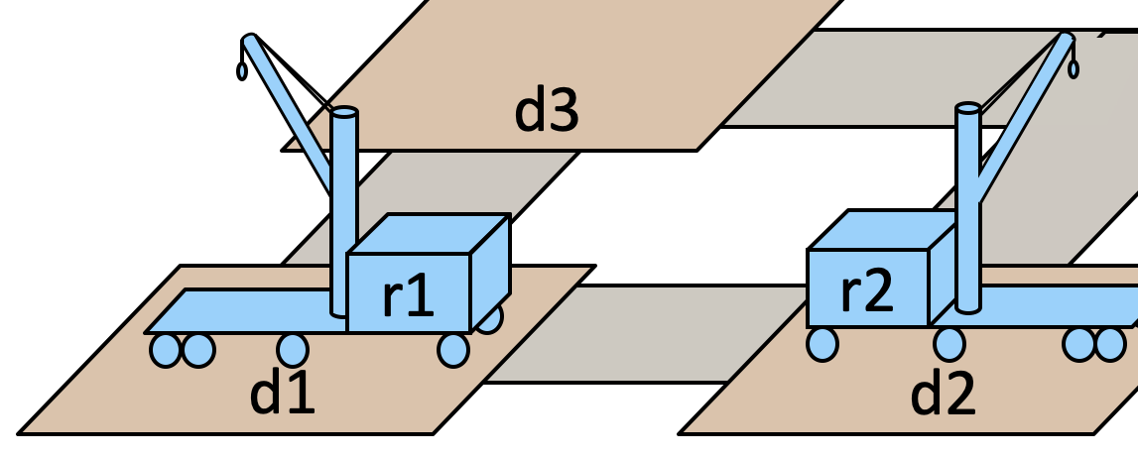
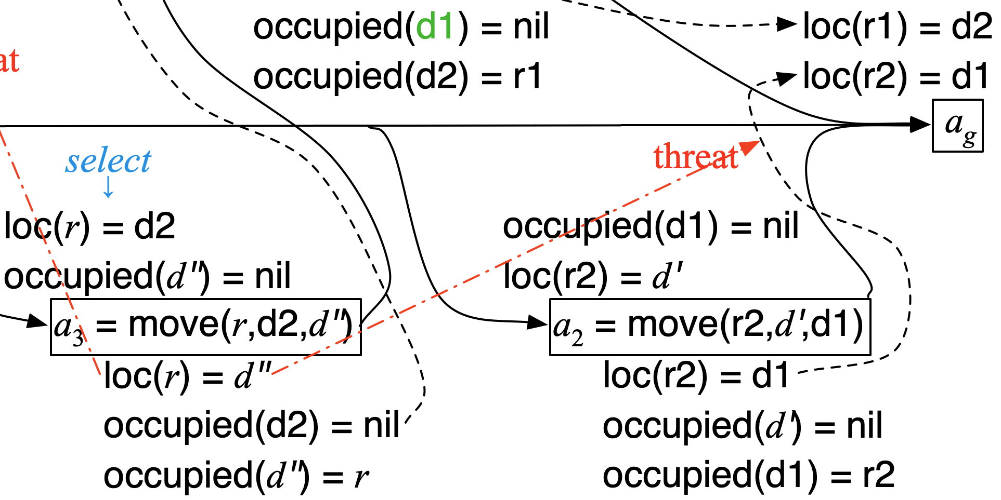
Constraint Management
Each time TemPlan applies a resolver, it modifies (T,C)
  Some resolvers will make (T,C) inconsistent
      No solution in this part of the search space
  Would like to detect inconsistency, prune the search space
    Otherwise we’ll waste time looking for a solution
Analogy: PSP checks simple cases of inconsistency
  E.g., can’t create a constraint a≺b
  if there’s already a constraint b≺a
But PSP ignores more complicated cases
  E.g., suppose there are three threats
    To resolve them, suppose PSP chooses
    d′′ ≠ d1 , d′′ ≠ d2 , d′′ ≠ d3
    No solutions in this part of the search
    space, but PSP searches it anyway

Slide 54
Constraint Management in TemPlan
      T = {…}
      C = (t₁ < t₂ < t₃ < t₁)
At various points, check consistency of C
  If C is inconsistent, then (T,C) is inconsistent
  Can prune this part of the search space
If C is consistent, (T,C) may or may not be consistent
  Example:
    T = {[t₁,t₂] loc(r1)=loc1,
    [t₃,t₄] loc(r1)=loc2}
    C = (t₁ < t₃ < t₄ < t₂)
  Gives loc(r1) two values during [t₃,t₄]

Slide 55
Consistency of C
C contains two kinds of constraints
  Object constraints
    loc(r) ≠ l₂ , l ∈ {loc3, loc4}, r = r1, o ≠ o′
  Temporal constraints
    t₁ < t₃ , a < t, t < t′, a ≤ t′ − t ≤ b
Assume object constraints are independent of temporal constraints and vice versa
  exclude things like t < distance (r,r′)
Then two separate subproblems
  (1) check consistency of object constraints
  (2) check consistency of temporal constraints
  C is consistent iff both are consistent

Slide 56
Object Constraints
Constraint-satisfaction problem (CSP) – NP-hard
Can write an algorithm that’s complete but runs in exponential time
    If there’s an inconsistency, always finds it
    Might do a lot of pruning, but spend lots of time at each node
Instead, use a technique that’s
incomplete but takes polynomial time
    arc consistency, path consistency*
Detects some inconsistencies but not others
  Runs much faster, but prunes fewer nodes
__________
*See Russell & Norvig, Artificial Intelligence: A Modern Approach

Slide 57
Time Constraints
t2
To represent time constraints:
Simple Temporal Networks (STNs)
  Networks of constraints on time points
Synthesize incrementally them starting from ϕ₀
  Templan can check time constraints in time O(n³)
Incrementally instantiated at acting time
Kept consistent throughout planning and acting
[3, 4]
[1, 2]
[1, 7]
t1
t4
t3
[1, 2]
[6, 7]
[4, 5]
t5

Slide 58
Time Constraints
Simple Temporal Network (STN):
a pair (V,E), where
    V = {a set of temporal variables {t₁, …, t_{n}}
    E ⊆ V ² is a set of arcs
Each arc (t_{i},t_{j}) is labeled with an interval [a,b]
    Represents constraint t_{j} − t_{i} ∈ [a, b]
    Or equivalently, t_{i} − t_{j} ∈ [–b, –a]
Notation: instead of t_{j} − t_{i} ∈ [a, b], write r_{ij} = [a,b]
To represent unary constraints:
  Dummy variable t₀ ≡ 0
  Arc r_{0i} = [a,b] represents t_{i} – 0 ∈ [a,b]
t₂
[1,2]
[3,4]
t₁
t₃
[3,7]
t₂
[1,2]
[3,4]
t₁
t₃
[–7,–3]
t₂
[1,2]
[3,4]
t₀
t₃
[3,7]

Slide 59
Time Constraints
t₂
[1,2]
[1,2]
Solution to an STN:
  any assignment of integer values to the time points
  such that all the constraints are satisfied
Consistent STN: has a solution
Minimal STN:
    for every arc (t_{i},t_{j}) with label [a,b],
      for every t ∈ [a,b],
        there’s at least one solution such that t_{j} − t_{i} = t
  If we make any of the time intervals shorter,
  we’ll exclude some solutions
t₁
t₃
[0,100]
Solutions:
  (t₂–t₁, t₃–t₂, t₃–t₁) ∈
  {(1,1,2), (1,2,3), (2,1,3), (2,2,4)}
t₂
[1,2]
[1,2]
t₁
t₃
[2,4]

Slide 60
Time Constraints
Solution to an STN:
  any assignment of integer values to the time points
  such that all the constraints are satisfied
Consistent STN: has a solution
Minimal STN:
    for every arc (t_{i},t_{j}) with label [a,b],
      for every t ∈ [a,b],
        there’s at least one solution such that t_{j} − t_{i} = t
  If we make any of the time intervals shorter,
  we’ll exclude some solutions
Poll: Is this network consistent?
t₂
[1,2]
[3,4]
t₁
t₃
[2,3]
t₂
[1,2]
[3,4]
Poll: Is this network minimal?
t₁
t₃
[1,7]

Slide 61
Operations on STNs
Intersection, ∩
  t_{j} – t_{i} ∈ r_{ij} = [a_{ij} , b_{ij}]
  t_{j} – t_{i} ∈ r′_{ij} = [a′_{ij} , b′_{ij}]
Infer t_{j} – t_{i} ∈ r_{ij} ∩ r′_{ij} = [max(a_{ij},a′_{ij}), min(b_{ij},b′_{ij})]
Composition, •
  t_{k} – t_{i} ∈ r_{ik} = [a_{ik},b_{ik}]
  t_{j} – t_{k} ∈ r_{kj} = [a_{kj},b_{kj}]
Infer t_{j} – t_{i} ∈ r_{ik} • r_{kj} = [a_{ik} +a_{kj}, b_{ik} +b_{kj}]
Reason: shortest and longest times for the two intervals
Consistency checking
  r_{ik} , r_{kj} , r_{ij} are consistent only if r_{ij} ∩ (r_{ik} • r_{kj}) ≠ ∅
Special case for networks with just three nodes
  Consistent iff if r_{ij} ∩ (r_{ik} • r_{kj}) ≠ ∅
r_{ij}
t_{i}
t_{j}
r′_{ij}
r_{ij} ∩ r′_{ij}
r_{ik}
t_{k}
r_{kj}
t_{i}
t_{j}
r_{ik} • r_{kj}
t_{k}
r_{kj}
r_{ik}
r_{ij}
t_{j}
t_{i}
r_{ik} • r_{kj}
r_{ij} ∩ (r_{ik} • r_{kj})

Slide 62
Two Examples
Let d₁₂ = t₂–t₁ ∈ r₁₂ = [1,2]
  d₂₃ = t₃–t₂ ∈ r₂₃ = [3,4]
  d₁₃ = d₁₂+d₂₃
Solution iff d₁₃ ∈ r₁₃ = [2,5]
t₂
t₂
[1,2]
[3,4]
[1,2]
[3,4]
t₁
t₃
d₁₂ | d₂₃ | d₁₃ | solution?
1 | 3 | 4 | yes
1 | 4 | 5 | yes
2 | 3 | 5 | yes
2 | 4 | 6 | no
t₁
t₃
[2,5]
[2,3]
STN (V,E), where
  V = {t₁, t₂, t₃}
  E = {r₁₂=[1,2], r₂₃=[3,4], r₁₃=[2,5]}
As before, r′₁₃ = [4,6]
  r₁₃ ∩ r′₁₃ = [4,5]
(V,E) is consistent
  r₁₃ ← [4,5] will make it minimal
  Same solutions as above
STN (V,E), where
  V = {t₁, t₂, t₃}
  E = {r₁₂=[1,2], r₂₃=[3,4], r₁₃=[2,3]}
Composition:
  r′₁₃ = r₁₂ • r₂₃ = [4,6]
Can’t satisfy both r₁₃ and r′₁₃
  r₁₃ ∩ r′₁₃ = [2,3] ∩ [4,6] = ∅
(V,E) is inconsistent
d₁₂ = 1, 2
  Can’t shrink r₁₂
d₂₃ = 3, 4
  Can’t shrink r₂₃
d₁₃ = 4, 5
  Shrink r₁₃ to [4,5], get the same solutions
t₂
[1,2]
[3,4]
t₁
t₃
[4,5]

Slide 63
Operations on STNs
t₂
k=2, i=1, j=3 (see previous slide)
  PC reduces r_{ij} = r₁₃ to [4,5]
k=3, i=1, j=2
  r_{ik} = r₁₃ = [4,5]
  r_{kj} = r₃₂ = [–4,–3]
  r_{ij} = r₁₂ = [1,2]
  r_{ik} • r_{kj} = [4–4, 5–3] = [0,2]
  r₁₃ = r_{ij} ← [max(1,–2), min(2,2)]
  = [1,2]
  No change
Minimal network:
PC(V,E):
for 1 ≤ k ≤ n do
for 1 ≤ i < j ≤ n, i ≠ k, j ≠ k do
r_{ij} ← r_{ij} ∩ [r_{ik} • r_{kj}]
if r_{ij} = ∅ then
return inconsistent
[1,2]
[3,4]
t₁
t₃
[2,5]
For n = 3, PC tries these triples:
  k=1, i=2, j=3
  k=2, i=1, j=3
  k=3, i=1, j=2
k=1, i=2, j=3
  r_{ik} = r₂₁ = [–2,–1]
  r_{kj} = r₁₃ = [2,5]
  r_{ij} = r₂₃ = [3,4]
  r_{ik} • r_{kj} = [–2+2, –1+5] = [0,4]
  r₂₃ = r_{ij} ← [max(3,0), min(4,4)]
  = [3,4]
  No change
If an arc has no constraint, use [−∞, +∞]
PC (Path Consistency) algorithm:
  For every i < j, iterates over r_{ij} once for each k
  Each time, tries to reduce interval, checks consistency
  i, j, k each go from 1 to n
    => time O(n³)
t₂
[1,2]
[3,4]
t₁
t₃
[4,5]

Slide 64
Operations on STNs
PC(V,E):
for 1 ≤ k ≤ n do
for 1 ≤ i < j ≤ n, i ≠ k, j ≠ k do
r_{ij} ← r_{ij} ∩ [r_{ik} • r_{kj}]
if r_{ij} = ∅ then
return inconsistent
t_{k}
r_{ij}
t_{i}
t_{j}
i, j, k each go from 1 to n
  O(n³) triples; I think exact value is n(n–1)(n–2)/2
    => time O(n³)
For n = 4, 12 triples:
  k=1, i=2, j=3
  k=1, i=2, j=4
  k=1, i=3, j=4
  k=2, i=1, j=3
  k=2, i=1, j=4
  k=2, i=3, j=4
Example: k = 2, i = 1, j = 4
    r_{ik} = r₁₂ = [1,2]
    r_{kj} = r₂₄ = [3,4]
    r_{ij} = r₁₄ = [–∞, ∞]
r_{ik} • r_{kj} = [1+3, 2+4] = [4,6]
r₁₄ = r_{ij} ← [max(–∞,4), min(∞,6)] = [4,6]
  k=3, i=1, j=2
  k=3, i=1, j=4
  k=3, i=2, j=4
  k=4, i=1, j=2
  k=4, i=1, j=3
  k=4, i=2, j=3

Slide 65
Operations on STNs
PC(V,E):
for 1 ≤ k ≤ n do
for 1 ≤ i < j ≤ n, i ≠ k, j ≠ k do
r_{ij} ← r_{ij} ∩ [r_{ik} • r_{kj}]
if r_{ij} = ∅ then
return inconsistent
PC makes network minimal
  Reduces each r_{ij} to exclude
  values that aren’t in any solution
Also detects inconsistent networks
  r_{ij} = [a_{ij},b_{ij}] empty => inconsistent
Dashed lines: constraints shrunk from [–∞, ∞]
Can modify PC to make it incremental
  Input:
    a consistent, minimal STN
    a new constraint r′_{ij}
  Incorporate r′_{ij} in time O(n²)

Slide 66
Pruning TemPlan’s search space
Take the time constraints in C
  Write them as an STN
  Use Path Consistency to check whether STN is consistent
  If it’s inconsistent, TemPlan can backtrack

Slide 67
Controllability
Section 4.4.3 of the book
Suppose TemPlan gives you a chronicle and you want to execute it
  Constraints on time points
  Need to reason about these in order to decide when to start each action
Solid lines: duration constraints
  Robot will do bring&move, will take 30 to 50 time units
  Crane will do uncover, will take 5 to 10 time units
Dashed line: synchronization constraint
  At most 5 seconds between the two ending times
  Objective
  Choose time points that will satisfy all the constraints

Slide 68
Controllability
Suppose we run PC
  Returns a minimal and consistent network
There exist time points that satisfy all the constraints
Would work if we could choose all four time points
  But we can’t choose t₂ and t₄
Actor can control when each action starts
  t₁ and t₃ are controllable
Can’t control how long the actions take
  t₂ and t₄ are contingent
  random variables that are known
  to satisfy the duration constraints
    t₂ ∈ [t₁+30, t₁+50]
    t₄ ∈ [t₃+5, t₃+10]
bring&move
uncover

Slide 69
Controllability
Suppose we start bring&move at time t₁ = 0
There’s no t₃ that works in both cases
bring&move
Suppose the durations are
bring&move 30, uncover 10
  Then
  t₂ = t₁ + 30 = 30
  t₄ = t₃ + 10
  so t₄ – t₂ = t₃ – 20
Constraint r₂₄: –5 ≤ t₄ – t₂ ≤ 5
    –5 ≤ t₃ – 20 ≤ 5
15 ≤ t₃ ≤ 25
Must start uncover at t₃ ≤ 25
Suppose the durations are bring&move 50, uncover 5
  Then
      t₂ = t₁ + 50 = 50
      t₄ = t₃ + 5
  so t₄ – t₂ = t₃ – 45
Constraint r₂₄: –5 ≤ t₄ – t₂ ≤ 5
          –5 ≤ t₃ – 45 ≤ 5
          40 ≤ t₃ ≤ 50
Must start uncover at t₃ ≥ 40
uncover

Slide 70
STNUs
STNU (Simple Temporal Network with Uncertainty):
  A 4-tuple (V,Ṽ,E,Ẽ )
    V ={controllable time points}, e.g., starting times of actions
    Ṽ ={contingent time points}, e.g., ending times of actions
    E ={controllable constraints}, Ẽ ={contingent constraints}
Controllable and contingent constraints:
  Synchronization between two starting times: controllable
  Duration of an action: contingent
  Synchronization between ending points of two actions: contingent
  Synchronization between end of one action, start of another:
    Controllable if the new action starts after the old one ends
    Contingent if the new action starts before the old one ends
Want a way for the actor to choose time points in V (starting times) that guarantee that the constraints are satisfied
bring&move
uncover
Poll. is r₃₂ controllable?

Slide 71
Three kinds of controllability
bring&move
(V,Ṽ,E,Ẽ ) is strongly controllable if the actor can choose values for V such that success will occur for all values of Ṽ that satisfy Ẽ
  Actor can choose the values for V offline
  The right choice will work regardless of Ṽ
(V,Ṽ,E,Ẽ ) is weakly controllable if the actor can choose values for V such that success will occur for at least one combination of values for Ṽ
  Actor can choose the values for V only if the actor knows in advance what the values of Ṽ will be
Dynamic controllability:
  Game-theoretic model: actor vs. environment
  A player’s strategy: a function σ telling what to do in every situation
    Choices may depend on what has happened so far
  (V,Ṽ,E,Ẽ ) is dynamically controllable if ∃ strategy for actor that will guarantee success regardless of the environment’s strategy
uncover
Poll. Is the above STNU strongly controllable?
Poll. Is it weakly controllable?
Poll. Is it dynamically controllable?
Two player, zero sum, extensive form, imperfect information game

Slide 72
Dynamic Execution
  For t = 0, 1, 2, …
  Actor chooses an unassigned set of variables V_{t} ⊆ V that all can be assigned the value t without violating any constraints in E
      ≈ actions the actor chooses to start at time t
  Simultaneously, environment chooses an unassigned set of variables Ṽ_{t} ⊆ Ṽ that all can be assigned the value t without violating any constraints in Ẽ
      ≈ actions that finish at time t
  Each chosen time point v is assigned v ← t
  Failure if any of the constraints in E ∪ Ẽ are violated
    There might be violations that neither V_{t} nor Ṽ_{t} caused individually
  Success if all variables in V ∪ Ṽ have values and no constraints are violated
Dynamic execution strategy σ_{A} for actor, σ_{E} for environment
  σ_{A}(h_{t–1}) = {what events in V to trigger at time t, given h_{t–1}}
  σ_{E}(h_{t–1}) = {what events in Ṽ to trigger at time t, given h_{t–1}}
    h_{t} = h_{t–1} . (σ_{A}(h_{t–1}) ∪ σ_{E}(h_{t–1}))
  (V,Ṽ,E,Ẽ ) is dynamically controllable if ∃ σ_{A} that will guarantee success ∀ σ_{E}
r_{ij} = [l,u] is violated
if t_{i} and t_{j} have values
and t_{j} – t_{i} ∉ [l,u]

Slide 73
Example
bring&move
Instead of a single bring&move task, two separate bring and move tasks
  Then it’s dynamically controllable
Actor’s dynamic execution strategy
  trigger t₁ at whatever time you want
  wait and observe t
  trigger t′ at any time from t to t + 5
  trigger t₃ = t′ + 10
  for every t₂ ∈ [t′ + 15, t′ + 20] and every t₄ ∈ [t₃ + 5, t₃ + 10]
      t₄ ∈ [t′ + 15, t′ + 20]
      so t₄ – t₃ ∈ [–5, 5]
  So all the constraints are satisfied
uncover
t₁
[15, 25]
t
[0, 5]
t′
[15, 20]
t₂
bring
move
[-5, 5]
uncover
t₃
[5, 10]
t₄
Poll. Is the above STNU strongly controllable?

Slide 74
Dynamic Controllability Checking
For a chronicle ϕ = (A,ST,T,C)
  Temporal constraints in C correspond to an STNU
  Put code into TemPlan to keep the STNU dynamically controllable
If we detect cases where it isn’t dynamically controllable, then backtrack
If PC(V∪Ṽ,E∪Ẽ ) reduces a contingent constraint
then (V,Ṽ,E,Ẽ ) isn’t dynamically controllable
  ⇒ can prune this branch
If it doesn’t reduce any contingent contraints,
we don’t know whether (V,Ṽ,E,Ẽ ) is dynamically controllable
Two options
  Either continue down this branch and backtrack later if necessary, or
  Extend PC to detect more cases where (V,Ṽ,E,Ẽ ) isn’t dynamically controllable
    additional constraint propagation rules
PC(V,E):
for 1 ≤ i ≤ n, 1 ≤ j ≤ n, 1 ≤ k ≤ n,
i ≠ j, i ≠ k, j ≠ k do
r_{ij} ← r_{ij} ∩ [r_{ik} • r_{kj}]
if r_{ij} = ∅ then
return inconsistent

Slide 75
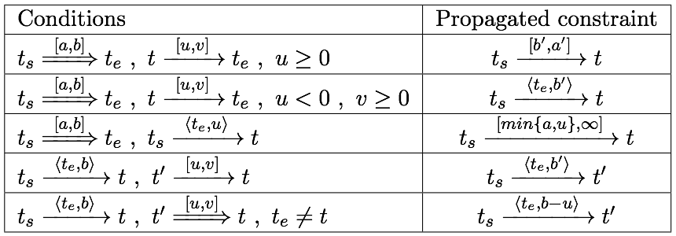

Additional Constraint Propagation Rules
t_{s}
t_{e}
Case 1: u ≥ 0
  t must come before t_{e}
Add a composition constraint [a′,b′]
Find [a′,b′] such that [a′,b′] • [u,v] = [a,b]
  [a′+u, b′+v] = [a,b]
  a′ = a – u, b′ = b – v
[a, b]
[u, v]
t
I think this should be [a′, b′]
⇒ contingent
→ controllable

Slide 76

Additional Constraint Propagation Rules
Case 2: u < 0 and v ≥ 0
  t may be either before or after t_{e}
Add a wait constraint
  Wait until either t_{e} occurs
  or current time is t_{s} + b – v,
  whichever comes first
As before, let b′ = b – v
t_{s}
[a, b]
t_{e}
[u, v]
t
⇒ contingent
→ controllable

Slide 77
Extended Version of PC
We want a fast algorithm that TemPlan can run at each node, to decide whether to backtrack
There’s an extended version of PC that runs in polynomial time, but it has high overhead
Possible compromise: use ordinary PC most of the time
  Run extended version occasionally, or at end of search before returning plan

Slide 78
Outline
Introduction
Representation
Temporal planning
Consistency and controllability
4.5 Acting with temporal models
  Acting with atemporal refinement
  Dispatching
  Observation actions

Slide 79
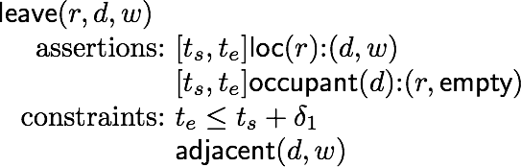
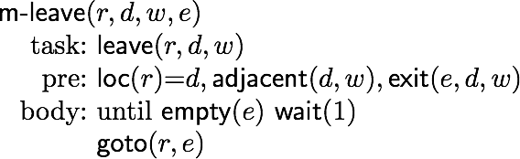
Atemporal Refinement of Primitive Actions
Templan’s primitive actions may correspond to compound tasks
  In RAE, use refinement methods to refine them into commands
  Templan’s
  primitive action template
  (descriptive model)
  RAE’s
  refinement method
  (operational model)

Slide 80
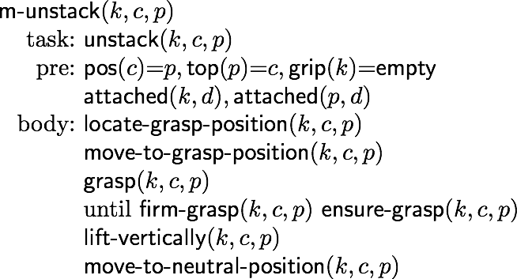
Atemporal Refinement of Primitive Actions
Templan’s primitive actions may correspond to compound tasks
  In RAE, use refinement methods to refine them into commands
  Templan’s
  primitive action template
  (descriptive model)
  RAE’s
  refinement method
  (operational model)
unstack(k,c,p)
assertions: …
constraints: …

Slide 81
Discussion
Pros
  Simple online refinement with RAE
  Avoids breaking down uncertainty of contingent duration
  Can be augmented with temporal monitoring functions in RAE
    E.g., watchdogs, methods with duration preferences
Cons
  Does not handle temporal requirements at the command level,
    e.g., synchronize two robots that must act concurrently
Can augment RAE to include temporal reasoning
  Call it eRae
  One essential component: a dispatching function

Slide 82
Acting With Temporal Models
Dispatching procedure: a dynamic execution strategy
  Controls when to start each action
  Given a dynamically controllable plan with executable primitives, triggers corresponding commands from online observations
Example
  robot r2 needs to leave dock d2
  before robot r1 can enter d2
  crane k needs to uncover c
  then put c onto r1
k
r2
c′
w2
c
q
p
d2
t₃
leave(r2,d2)
w1
r1
t₁
t₂
t₅
d1
leave(r1,d1)
navigate(r1)
enter(r1,d2)
t₈
t₉
t₇
t₆
unstack(k,c)
putdown(k,c,r1)
leave(r1,d2)
t₄
unstack(k,c′,p)
stack(k,c′,q)

Slide 83
Dispatching
Let (V,Ṽ,E,Ẽ ) be a controllable STNU that’s grounded
Different from a grounded expression in logic
  At least one time point in (V,Ṽ,E,Ẽ ) is instantiated
Bounds every time point t_{i} within an interval [l_{i},u_{i}]
Controllable time point t in the future:
t_{i} is alive if current time now ∈ [l_{i} , u_{i}]
t_{i} is enabled if
  it’s alive
  for every precedence constraint t′ < t_{i}, t′ has occurred
  for every wait constraint ⟨t_{e}, α⟩, t_{e} has occurred or α has expired
t₁
[15, 25]
t₂
[0, 5]
t₃
[15, 20]
t₄
bring
move
[-5, 5]
[10,10]
uncover
t₅
[5, 10]
t₆
Let t₁ = 0. Then:
  t₂ ∈ [15,25]
  t₃ ∈ [t, t+5]
  t₄ ∈ [t₃+15, t₃+20]
  t₅ ∈ [t₄+10, t₄+10]
  t₆ ∈ [t₅+5, t₅+10]
Suppose bring finishes at t=20, and now = 25. Then
  t3

Slide 84
Dispatching
Let (V,Ṽ,E,Ẽ ) be a controllable STNU that’s grounded
Different from a grounded expression in logic
  At least one time point in (V,Ṽ,E,Ẽ ) is instantiated
Bounds every time point t_{i} within an interval [l_{i},u_{i}]
Controllable time point t in the future:
t_{i} is alive if current time now ∈ [l_{i} , u_{i}]
t_{i} is enabled if
  it’s alive
  for every precedence constraint t′ < t_{i}, t′ has occurred
  for every wait constraint ⟨t_{e}, α⟩, t_{e} has occurred or α has expired
Dispatch(V,Ṽ,E,Ẽ )
initialize the network
while there are time points in V that
haven’t been triggered, do
  update now
  update the time points in Ṽ that were triggered since the last iteration
  update enabled
  trigger every t_{i} ∈ enabled such that now = u_{i}
  arbitrarily choose other time points in enabled, and trigger them
  propagate values of triggered timepoints (change [l_{j},u_{j}] for each future timepoint t_{j})
t_{i} is bounded
by [l_{i} , u_{i}]

Slide 85
Abstract Example
Dispatch(V,Ṽ,E,Ẽ )
initialize the network
while there are time points in V that
haven’t been triggered, do
  update now
  update the time points in Ṽ that were triggered since the last iteration
  update enabled
  trigger every t_{i} ∈ enabled such that now = u_{i}
  arbitrarily choose other time points in enabled, and trigger them
  propagate values of triggered timepoints (change [l_{j},u_{j}] for each future timepoint t_{j})
trigger t₁, propagate [l_{j},u_{j}] values
observe leave finish, this enables t₂
Trigger t₂, propagate [l_{j},u_{j}] values
This enables t₃, t₄
trigger t₃ soon enough to allow enter(r1,d2) at time t₅
  propagate [l_{j},u_{j}] values
trigger t₄ soon enough to allow stack(k,c′) at time t₆
  propagate [l_{j},u_{j}] values
rest of plan is linear: trigger each t_{i} after previous action ends
before u₃
t_{i} is bounded
by [l_{i} , u_{i}]
before u₄
t₃
leave(r2,d2)
t₁
t₂
t₅
leave(r1,d1)
navigate(r1)
enter(r1,d2)
t₈
t₉
t₇
t₆
unstack(k,c)
putdown(k,c,r1)
leave(r1,d2)
t₄
unstack(k,c′,p)
stack(k,c′,q)

Slide 86
Detailed Example
Dispatch(V,Ṽ,E,Ẽ )
initialize the network
while there are time points in V that
haven’t been triggered, do
  update now
  update the time points in Ṽ that were triggered since the last iteration
  update enabled
  trigger every t_{i} ∈ enabled such that now = u_{i}
  arbitrarily choose other time points in enabled, and trigger them
  propagate values of triggered timepoints (change [l_{j},u_{j}] for each future timepoint t_{j})
t₁
[15, 25]
t₂
[0, 5]
t₃
[15, 20]
t₄
bring
move
[-5, 5]
[10,10]
Initial constraints:
  t₁ ∈ [–∞, ∞]
  t₂ ∈ [t₁+15, t₁+25]
  t₃ ∈ [t₂, t₂+5]
  t₄ ∈ [t₃+15, t₃+20]
  t₅ ∈ [t₃+10, t₃+10]
  t₆ ∈ [t₅+5, t₅+10]
  ∩ [t₄–5, t₄+5]
Start at time now=0
  enabled = {t₁}
Trigger t₁ (bring)
when now=0
Propagate t₁=0:
  t₂ ∈ [15,25]
uncover
t_{i} is bounded
by [l_{i} , u_{i}]
t₅
[5, 10]
t₆
Suppose bring ends at now=20
  enabled = {t₃}
Propagate t₂ = 20
  t₃ ∈ [20, 25]
Trigger t₃ (move) when now=25
Propagate t₃=25:
  t₄ ∈ [40, 45]
  t₅ ∈ [35, 35]
At time now=35,
  enabled = {t₅}
  now = u₅ , must trigger t₅
Trigger t₅ (uncover) when now = 35
Propagate t₅=35:
  t₆ ∈ [40, 45] ∩ [t₄–5, t₄+5]
Suppose move takes 15 time units, ends at now=40
  enabled = ∅
Propagate t₄=40
  t₆ ∈ [40, 45] ∩ [35, 45] = [40, 45]

Slide 87
Deadline Failures
Suppose something makes it impossible to start an action on time
Do one of the following:
  stop the delayed action, and look for new plan
  let the delayed action finish; try to repair the plan by resolving violated constraints at the STNU propagation level
    e.g., accommodate a delay in navigate by delaying the whole plan
  let the delayed action finish; try to repair the plan some other way
t₁
[15, 25]
t₂
[0, 5]
t₃
[15, 20]
t₄
bring
move
[-5, 5]
[10,10]
uncover
t₅
[5, 10]
t₆

Slide 88
Partial Observability
Tacit assumption: all occurrences of contingent events are observable
  Observation needed for dynamic controllability
In general, not all events are observable
POSTNU (Partially Observable STNU)
Dynamically controllable?
Controllable
Timepoints Invisible
Contingent
Observable

Slide 89
Observation Actions
t0
[19:00, 19:30]
t1
t
[1, 2]
t′
[20, 25]
t2
working
driving
[-5, 10]
[25, 30]
t3
cooking
t4
Controllable
Contingent
Invisible
observable

Slide 90
Dynamic Controllability
A POSTNU is dynamically controllable if
  there exists an execution strategy that chooses future controllable points to meet all the constraints, given the observation of past visible points
Observable ≠ visible
Observable means it will be known when observed
It can be temporarily hidden
t0
[19:00, 19:30]
t1
t
[1, 2]
t′
[20, 25]
t2
working
driving
[-5, 10]
Controllable
Timepoints Invisible
Contingent Visible
Observable
Hidden
[25, 30]
t3
cooking
t4

Slide 91
Outline
Introduction
Representation
Temporal planning
Consistency and controllability
Acting with executable primitives
Summary

Slide 92
Summary of Sections 4.4, 4.5
Managing constraints in TemPlan: like CSPs
  Temporal constraints: STNs, PC algorithm (path consistency)
Acting
  Dynamic controllability
  STNUs
  RAE and eRAE
  Dispatching

