Slide 1
Chapter 8 Probabilistic Representation and Acting
Dana S. Nau
University of Maryland
with contributions from
Mark “mak” Roberts

Slide 2
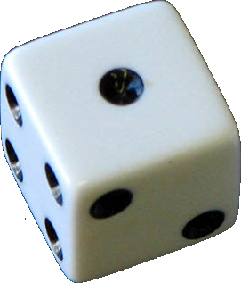
Motivation
Situations where actions have multiple possible outcomes and each outcome has a known probability distribution of occurring
Part IV: Non-deterministic Models addresses multiple actions outcomes with unknown probability distributions
Several possible action representations
Bayes nets, probabilistic actions, …
Book doesn’t commit to any representation
Mainly concentrates on the underlying semantics
Credit: Dennis Hill, CC BY 2.0
roll-die(d)
pre: holding(d) = true
eff:
1/6: top(d) ← 1
1/6: top(d) ← 2
1/6: top(d) ← 3
1/6: top(d) ← 4
1/6: top(d) ← 5
1/6: top(d) ← 6

Slide 3
Definitions and Example
m52
←
Probabilistic domain model: Σ = (S, A, γ, Pr, cost)
S and A – finite sets of states and actions
γ: S × A → 2^{S}
γ(s,a) = {all possible “next states” after applying action a in state s}
a is applicable in state s iff γ(s,a) ≠ ∅
Pr(s′ | s, a) = probability that a will take us to s′ from s
Pr(s′ | s, a) ≠ 0 iff s′ ∈ γ(s,a)
cost: S ×A×S → R
cost(s,a,s′) = cost if a takes us to s′ from s
may omit, default is cost(s,a,s′) = 1
Applicable(s) = {all actions applicable in s} = {a ∈ A | γ(s,a) ≠ ∅}
(no m25)
m23
→ 0.2
d5
d2
→
→ 0.8
↔
↔
d3
↔
Start: s₀= d1
m14
r1
→ 0.5
d4
Goal: S_{g}= {d4}
→
→
→ 0.5
←
d1
Start at d1, want to get to d4
Some roads are one-way, some are two-way
Unreliable steering when the road forks
may take the wrong fork
Simplified state and action names:
write {loc(r1)=d2} as d2
write move(r1,d2,d3) as m23
Notes:
Check with Dana; had to correct last line of left side

Slide 4
Example
m52
←
(no m25)
γ(d1,m12) = {d2}
Pr(d2 | d1, m12) = 1
m21, m34, m41, m43, m45, m52, m54:
deterministic like m12
γ(d1,m14) = {d1,d4}
Pr(d4 | d1, m14) = 0.5
Pr(d1 | d1, m14) = 0.5
γ(d2,m23) = {d3,d5}
Pr(d3 | d2, m23) = 0.8
Pr(d5 | d2, m23) = 0.2
there’s no m25
m23
→ 0.2
d5
d2
→
→ 0.8
↔
↔
d3
↔
Start: s₀= d1
m14
r1
→ 0.5
d4
Goal: S_{g}= {d4}
→
→
→ 0.5
←
d1
Start at d1, want to get to d4
Some roads are one-way, some are two-way
Unreliable steering when the road forks
may take the wrong fork
Simplified state and action names:
write {loc(r1)=d2} as d2
write move(r1,d2,d3) as m23

Slide 5
Example
m52
d5
γ(d1,m12) = {d2}
Pr(d2 | d1, m12) = 1
m21, m34, m41, m43, m45, m52, m54:
deterministic like m12
γ(d1,m14) = {d1,d4}
Pr(d4 | d1, m14) = 0.5
Pr(d1 | d1, m14) = 0.5
γ(d2,m23) = {d3,d5}
Pr(d3 | d2, m23) = 0.8
Pr(d5 | d2, m23) = 0.2
there’s no m25
0.2
d2
m23
0.8
d3
m12
m21
m54
m43
m34
m41
m45
Start: s₀= d1
d1
d4
m14
0.5
0.5
Goal: S_{g}= {d4}
We will represent these problems as a graph
Nodes are assignments to variables (i.e., states)
Weighted edges change the assignment (i.e, actions)
Label is action instance; value indicates Pr(s’| s,a)
Simplified state and action names:
write {loc(r1)=d2} as d2
write move(r1,d2,d3) as m23

Slide 6
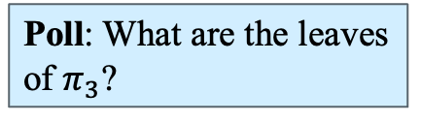
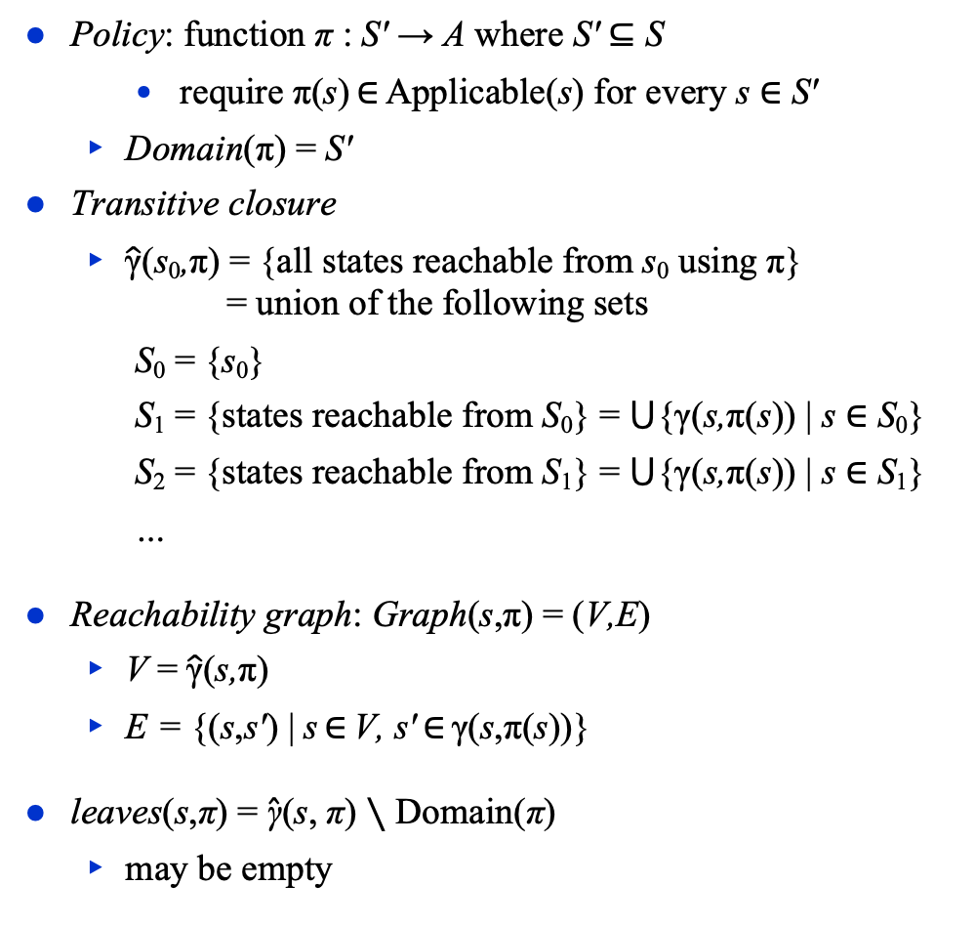
Policies
m52
d6
Policy: function π : S′ → A where S′ ⊆ S
require π(s) ∈ Applicable(s) for every s ∈ S′
Domain(π) = S′
Transitive closure
$\hat{\text{γ}}$(s₀,π) = {all states reachable from s₀ using π} = union of the following sets
S₀ = {s₀}
S₁ = {states reachable from S₀} = ⋃{γ(s,π(s)) | s ∈ S₀}
S₂ = {states reachable from S₁} = ⋃{γ(s,π(s)) | s ∈ S₁}
…
Reachability graph: Graph(s,π) = (V,E)
V = $\hat{\text{γ}}$(s,π)
E = {(s,s′) | s ∈ V, s′ ∈ γ(s,π(s))}
leaves(s,π) = $\hat{\text{γ}}$(s, π) ∖ Domain(π)
may be empty
d5
d7
0.2
d2
m23
0.8
d3
m12
m21
m54
m43
m34
m41
m45
Start: s₀= d1
d1
d4
m14
0.5
0.5
Goal: S_{g}= {d4}
Poll: Can we use a plan (sequence of actions) instead?
A. yes B. no C. don’t know
π₁ = {(d1,m12), (d2,m23), (d3,m34)}
π₂ = {(d1,m12), (d2,m23), (d3,m34), (d5,m54)}
π₃ = {(d1,m12), (d2,m23), (d3,m34), (d5,m56)}
π₄ = {(d1,m12), (d2,m23), (d3,m34), (d5,m57), (d7,m75)}
Poll: What are the leaves of $π_{3}$?
Set minus

Slide 7
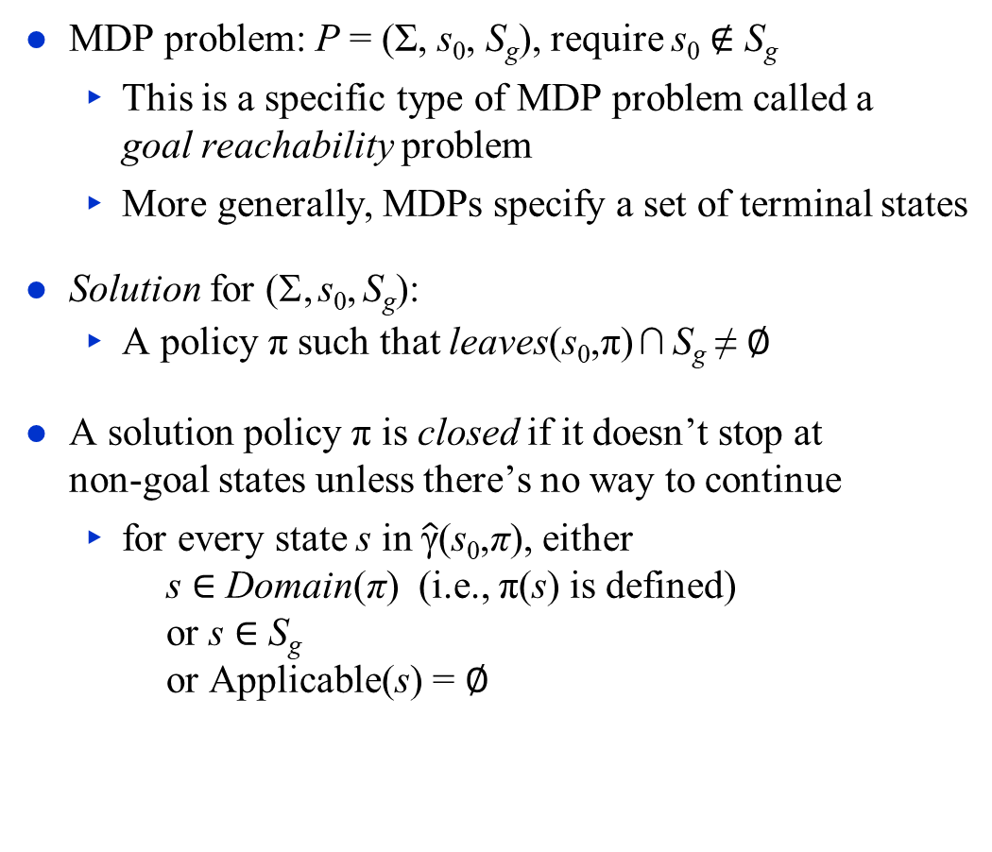
Problems, Solutions
m52
d6
d5
d7
MDP problem: P = (Σ, s₀, S_{g}), require s₀ ∉ S_{g}
This is a specific type of MDP problem called a goal reachability problem
More generally, MDPs specify a set of terminal states
Solution for (Σ, s₀, S_{g}):
A policy π such that leaves(s₀,π) ∩ S_{g} ≠ ∅
A solution policy π is closed if it doesn’t stop at non-goal states unless there’s no way to continue
for every state s in $\hat{\text{γ}}$(s₀,π), either s ∈ Domain(π) (i.e., π(s) is defined) or s ∈ S_{g} or Applicable(s) = ∅
0.2
d2
m23
0.8
d3
m12
m21
m54
m43
m34
m41
m45
Start: s₀= d1
d1
d4
m14
0.5
0.5
Goal: S_{g}= {d4}
Poll. Suppose d3 was the goal instead. Which policies are closed wrt. d3?
π₁ = {(d1,m12), (d2,m23), (d3,m34)}
π₂ = {(d1,m12), (d2,m23), (d3,m34), (d5,m54)}
π₃ = {(d1,m12), (d2,m23), (d3,m34), (d5,m56)}
π₄ = {(d1,m12), (d2,m23), (d3,m34), (d5,m57), (d7,m75)}
Poll. Is π₁ a solution?
A. yes B. no C. don’t know
Poll. Is π₁ a closed solution?

Slide 8
Histories
Run-Policy(Σ, s₀, S_{g}, π)
s ← s₀
while s ∉ S_{g} and s ∈ Domain(π) do
perform action π(s)
s ← observe resulting state
d6
m52
d5
d7
0.2
d2
m23
0.8
d3
History: sequence of states σ = ⟨s₀, s₁, s₂, …⟩ produced by Run-Policy
May be finite or infinite
Let H(s,π) = {all possible histories from s using π}
If σ ∈ H(s, π) then
Pr (σ | s, π) = ∏ Pr (s_{i+1} | s_{i}, π(s_{i}))
s_{i} ,s_{i+1}∈σ
= product of probabilities of state transitions
∑_{σ ∈ H(s,π)} Pr (σ | s, π) = 1
m12
m21
m54
m43
m34
m41
m45
Start: s₀= d1
d1
d4
m14
0.5
0.5
Goal: S_{g}= {d4}
π₃ = {(d1,m12), (d2,m23), (d3,m34), (d5,m56)}
H(s₀, π₃) = {σ₁, σ₂}, where:
σ₁ = ⟨d1,d2,d3,d4⟩
σ₂ = ⟨d1,d2,d5,d6⟩
Pr(σ₁ | s₀, π₃) = 1×0.8×1 = 0.8
Pr(σ₂ | s₀, π₃) = 1×0.2×1 = 0.2
Poll. If s ∉ Domain(π) then what is H(s,π)? A. undefined B. ∅ C. {⟨⟩} D. {s} E. {⟨s⟩} F. other G. unsure

Slide 9
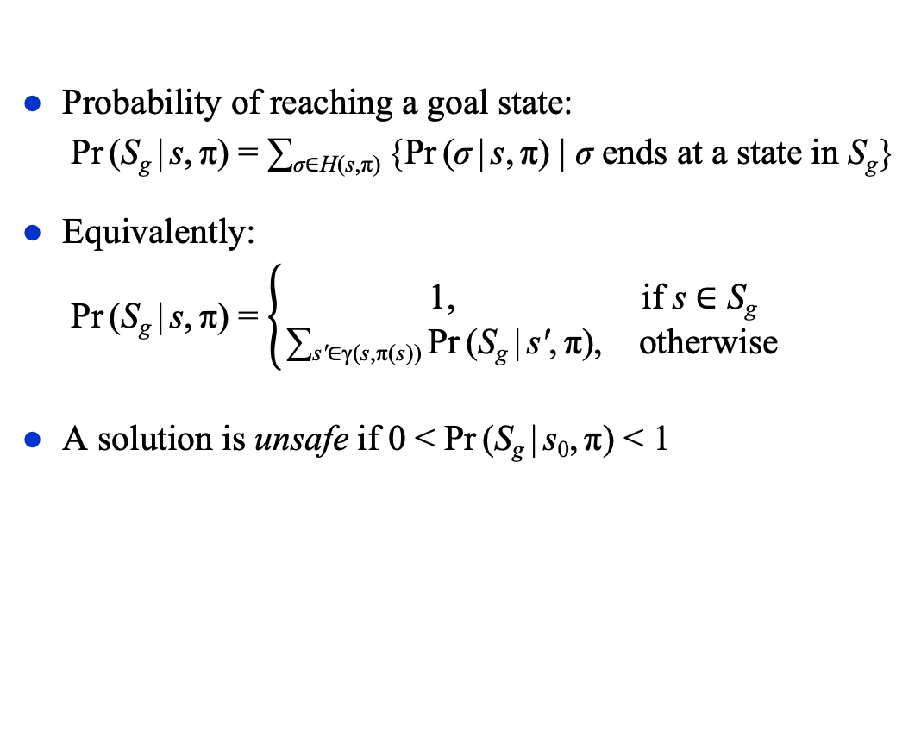
Unsafe Solutions
m52
d6
d5
d7
Probability of reaching a goal state:
Pr (S_{g} | s, π) = ∑_{σ∈H(s,π)} {Pr (σ | s, π) | σ ends at a state in S_{g}}
Equivalently:
Pr (S_{g} | s, π) = $\left\{\begin{matrix}\text{1}\text{,} & \text{if} \text{s}\text{ ∈ }\text{S}\text{g} \\ \text{∑}\text{s}\text{′}\text{∈}\text{γ}\text{(}\text{s}\text{,}\text{π}\text{(}\text{s}\text{))} \text{Pr} \text{(}\text{S}\text{g} \text{|} \text{s}\text{′}\text{,} \text{π}\text{),} & \text{otherwise}\end{matrix}\right.$
A solution is unsafe if 0 < Pr (S_{g} | s₀, π) < 1
0.2
d2
m23
0.8
d3
m12
m21
m54
m43
m34
m41
m45
Start: s₀= d1
d1
d4
m14
0.5
0.5
Goal: S_{g}= {d4}
π₃ = {(d1,m12), (d2,m23), (d3,m34), (d5,m56)}
H(s₀, π₃) = {σ₁, σ₂}:
σ₁ = ⟨d1,d2,d3,d4⟩ ends at a goal state; Pr(σ₁ | s₀, π₃) = 1×0.8×1 = 0.8
σ₂ = ⟨d1,d2,d5,d6⟩ doesn’t; Pr(σ₂ | s₀, π₃) = 1×0.2×1 = 0.2
Pr(S_{g} | s₀, π₃) = Pr(σ₁ | s₀, π₃) = 0.8

Slide 10
Unsafe Solutions
m52
d6
d5
d7
Probability of reaching a goal state:
Pr (S_{g} | s, π) = ∑_{σ∈H(s,π)} {Pr (σ | s, π) | σ ends at a state in S_{g}}
Equivalently:
Pr (S_{g} | s, π) = $\left\{\begin{matrix}\text{1}\text{,} & \text{if} \text{s}\text{ ∈ }\text{S}\text{g} \\ \text{∑}\text{s}\text{′}\text{∈}\text{γ}\text{(}\text{s}\text{,}\text{π}\text{(}\text{s}\text{))} \text{Pr} \text{(}\text{S}\text{g} \text{|} \text{s}\text{′}\text{,} \text{π}\text{),} & \text{otherwise}\end{matrix}\right.$
A solution is unsafe if 0 < Pr (S_{g} | s₀, π) < 1
0.2
d2
m23
0.8
d3
m12
m21
m54
m43
m34
m41
m45
Start: s₀= d1
d1
d4
m14
0.5
0.5
Goal: S_{g}= {d4}
π₄ = {(d1,m12), (d2,m23), (d3,m34), (d5,m57), (d7,m75)}
H(s₀, π₄) = {σ₁, σ₂}:
σ₁ = ⟨d1,d2,d3,d4⟩ ends at a goal state; Pr(σ₁ | s₀, π₄) = 1×.8×1 = 0.8
σ₃ = ⟨d1,d2,d5,d7,d5,d7,…⟩ doesn’t; Pr(σ₃ | s₀, π₄) = 1×.2×1×1×1×… = 0.2
Pr(S_{g} | s₀, π₄) = Pr(σ₁ | s₀, π₄) = 0.8

Slide 11
Safe Solutions
m52
d5
A solution is safe if Pr (S_{g} | s₀, π) = 1
An acyclic safe solution:
π₂ = {(d1, m12), (d2, m23), (d3, m34), (d5, m54)}
H(s₀, π₂) = {σ₁, σ₂}, where:
σ₁ = ⟨d1, d2, d3, d4⟩ Pr (σ₁ | s₀, π₂) = 1×.8×1 = .8
σ₄ = ⟨d1, d2, d5, d4⟩ Pr (σ₄ | s₀, π₂) = 1×.2×1 = .2
Pr (S_{g} | s₀, π₂) = .8 + .2 = 1
0.2
d2
m23
0.8
d3
m12
m21
m54
m43
m34
m41
m45
Start: s₀= d1
d1
d4
m14
0.5
0.5
Goal: S_{g}= {d4}

Slide 12
Safe Solutions
m52
d5
A solution is safe if Pr (S_{g} | s₀, π) = 1
A cyclic safe solution:
π₅ = {(d1, m14}
H(s₀, π₅) contains infinitely many histories:
σ₅ = ⟨d1, d4 ⟩ Pr (σ₅ | s₀, π₅) = ½
σ₆ = ⟨d1, d1, d4⟩ Pr (σ₆ | s₀, π₅) = (½)² = ¼
σ₇ = ⟨d1, d1, d1, d4⟩ Pr (σ₇ | s₀, π₅) = (½)³ = ¹/₈
• • •
σ∞ = ⟨d1, d1, d1, d1, d1, …⟩
Pr (S_{g} | s₀, π₅) = ½ + ¼ + ¹/₈ + … = 1
0.2
d2
m23
0.8
d3
m12
m21
m54
m43
m34
m41
m45
Start: s₀= d1
d1
d4
m14
0.5
0.5
Goal: S_{g}= {d4}
Poll: what is Pr (σ∞ | s₀, π₅)?
1
0
a number between 0 and 1
undefined

Slide 13
Safe and Unsafe States
m67
m56
d6
d7
d5
s is safe if ∃π such that Pr (S_{g} | s, π) = 1
same as saying (Σ, s, S_{g}) has a safe solution
d1, d2, d3, d4
s is unsafe if ∃π s.t. Pr (S_{g} | s, π) > 0 and ∀π, Pr (S_{g} | s, π) < 1
same as saying (Σ, s, S_{g}) has an unsafe solution but no safe solution
d5
s is a dead end if ∀π, Pr(S_{g} | s, π) = 0
same as saying (Σ, s, S_{g}) has no solution
d6, d7, d8, d9
An MDP is safe if all of its states are safe
0.2
d8
d2
m23
0.8
d3
0.5
0.5
d9
m12
m21
m43
m34
m41
m54
Start: s₀= d1
d1
d4
Goal: S_{g}= {d4}
m14
0.5
0.5
d7 is an immediate dead end
No applicable actions
d6, d8, d9 are deep dead ends
Applicable actions, but can’t reach S_{g}

Slide 14
Expected Cost
cost(s,a,s′) = cost of using a in s
Extend example so that:
each “horizontal” action costs 1
each “vertical” action costs 100
Let σ = ⟨s₀, s₁, s₂, …⟩ ∈ H(s₀,π)
i.e., starting at s₀, π can produce history σ
Then cost(σ) = ∑ _{i} cost(s_{i},π(s_{i}))
Let π be a safe solution, i.e., Pr(S_{g}|s₀,π) = 1
At each state s ∈ Domain(π), expected cost of following π to goal:
Weighted sum of history costs:
V^{π}(s) = ∑_{σ ∈ H(s,π)} Pr(σ | s, π) cost(σ)
Recursive equation
V^{π}(s) = 0, if s ∈ S_{g}
∑_{s′ ∈ γ(s,π(s))} Pr(s′ | s, π(s))[cost(s,π(s),s′ )+ V^{π}(s′)], otherwise
d5
c = 1
0.2
Poll: Are the two versions equivalent?
A. yes
B. no
d2
0.8
d3
c = 100
c = 100
Start: s₀= d1
d1
c = 1
d4
Goal: S_{g}= {d4}
0.5
0.5
Run-Policy(Σ, s₀, S_{g}, π)
s ← s₀
while s ∉ S_{g} and s ∈ Domain(π) do
perform action π(s)
s ← observe resulting state
My version
From the book
Notes:
Ask Dana about red text on this slide – what was it for?

Slide 15
Example
d5
c = 1
0.2
π₃ = {(d1, m12), (d2, m23), (d3, m34), (d5, m54)}
Weighted sum of history costs:
σ₁ = ⟨d1, d2, d3, d4⟩
Pr (σ₁ | s₀, π₃) = 0.8
cost(σ₁) = 100 + 1 + 100 = 201
σ₂ = ⟨d1, d2, d5, d4⟩
Pr (σ₂ | s₀, π₃) = 0.2
cost(σ₂) = 100 + 1 + 100 = 201
V ^{π3}(d1) = .8(201) + .2(201) = 201
d2
0.8
d3
c = 100
c = 100
Start: s₀= d1
d1
c = 1
d4
Goal: S_{g}= {d4}
0.5
0.5
Recursive equation ⇒ 4 equations, 4 unknowns
V ^{π3}(d1) = 100 + V ^{π3}(d2) V ^{π3}(d2) = 1 + .8(V ^{π3}(d3)) + .2(V ^{π3}(d5)) V ^{π3}(d3) = 100 + V ^{π3}(d4) V ^{π3}(d5) = 100 + V ^{π3}(d4)
V ^{π3}(d4) = 0
So V ^{π3}(d1) = 100 + 1 + .8(100) + .2(100) = 201

Slide 16
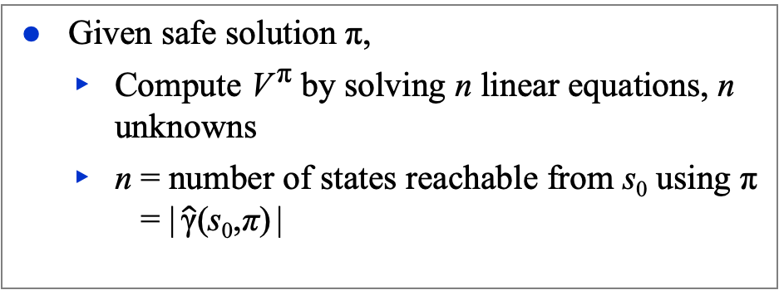
Example
d5
π₇ = {(d1, m14), (d2, m23), (d3, m34), (d5, m54)}
Weighted sum of history costs:
σ₅ = ⟨d1, d4 ⟩
Pr (σ₅ | π₇) = ½, cost (σ₅) = 1
σ₆ = ⟨d1, d1, d4⟩
Pr (σ₆ | π₇) = (½)², cost (σ₆) = 2
σ₇ = ⟨d1, d1, d1, d4⟩
Pr (σ₇ | π₇) = (½)³, cost (σ₇) = 3
• • •
V ^{π7}(d1) = (½)1 + (½)² 2 + (½)³ 3 + … = 2
Recursive equation:
V ^{π7}(d1) = 1 + ½(0) + ½(V ^{π7}(d1))
½V ^{π7}(d1) = 1
V ^{π7}(d1) = 2
c = 1
0.2
d2
0.8
d3
c = 100
c = 100
Start: s₀= d1
d1
c = 1
d4
Goal: S_{g}= {d4}
0.5
0.5
Given safe solution π,
Compute V ^{π} by solving n linear equations, n unknowns
n = number of states reachable from s₀ using π = | $\hat{\text{γ}}$(s₀,π) |

Slide 17
Dominance and Optimality
d5
c = 1
0.2
Let π and π′ be safe solutions
π dominates π′ if V^{π}(s) ≤ V^{π′}(s) at every state s where they’re both defined
i.e., every state s ∈ Domain(π) ∩ Domain(π′)
On the previous two slides
π₃ = {(d1, m12), (d2, m23), (d3, m34), (d5, m54)}
π₇ = {(d1, m14), (d2, m23), (d3, m34), (d5, m54)}
They differ only at d1
V ^{π3}(d1) = 201; V ^{π7}(d1) = 2
π₇ dominates π₃
Compare π₃ with π₅ = {(d1,m14)}
the only state in the domain of both policies is d1
V ^{π3}(d1) = 201; V ^{π5}(d1) = 2
π₅ dominates π₃
d2
0.8
d3
c = 100
c = 100
Start: s₀= d1
d1
c = 1
d4
Goal: S_{g}= {d4}
0.5
0.5
π is optimal if π dominates every safe solution
If π and π′ are both optimal, then V^{π}(s) = V^{π′}(s) at every state where they’re both defined
Example: compare π₅ and π₇
the only state where both are defined is d1
V ^{π5}(d1) = V ^{π7}(d1) = 2

Slide 18
Optimality
d5
c = 15
0.2
d2
Let V*(s) = expected cost of an optimal safe solution
Optimality principle (Bellman’s theorem):
V*(s) = 0, if s is a goal
min_{a∈Applicable(s)} ∑_{s′∈γ(s,a)} Pr(s′ | s,a)[cost(s,a,s′) + V*(s′)], otherwise
Example:
V*(d4) = 0
V*(d3) = 100
V*(d5) = min{100, 15+ V*(d2)}
V*(d2) = 0.8[15 + V*(d3)] + 0.2[15 + V*(d5)] = 15 + 0.8V*(d3) + 0.2 V*(d5) = 95 + 0.2V*(d5)
V*(d6) = 1
V*(d1) = min{10+V*(d2), 0.5[20+V*(d6)] + 0.5[20]} = min{10+V*(d2), 20 + 0.5V*(d6)} = min{10+V*(d2), 20.5}
0.8
d3
c = 10
d6
c = 100
0.5
c = 1
Start: s₀= d1
c = 20
d1
0.5
d4
Goal: S_{g}= {d4}
Poll. What is V*(d5)?
A. 100 B. 15+V*(d2) C. other D. don’t know
Poll. What is V*(d1)?
A. 10+V*(d2) B. 20.5 C. other D. don’t know

Slide 19
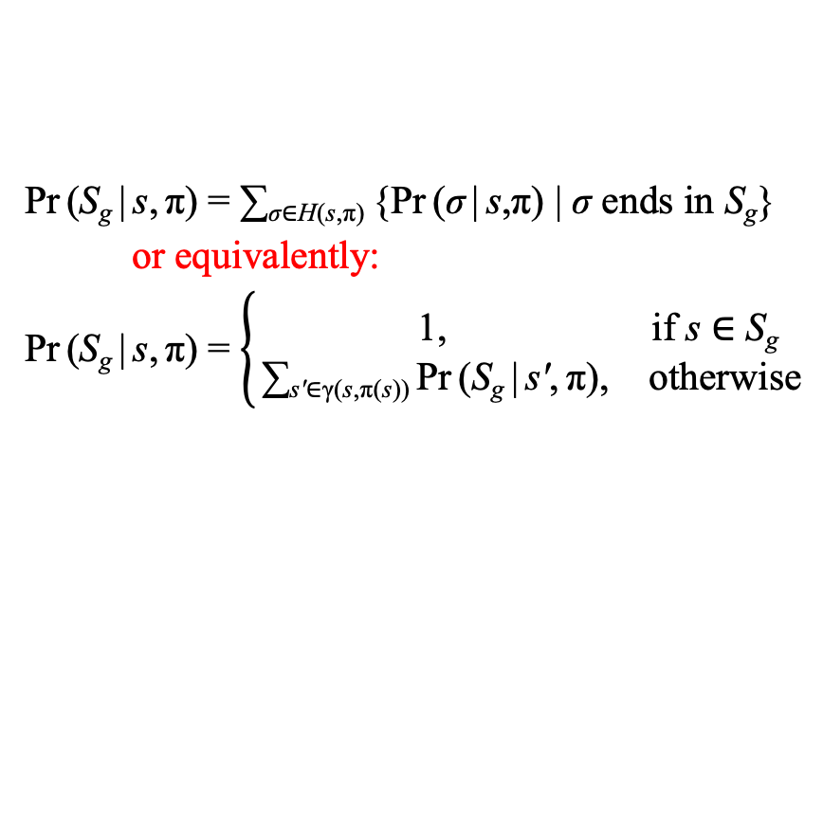
Summary
Actions with probabilistic outcomes
γ(s,a) = a set of states, Pr(s′ | s, a)
cost(s,a,s′) ∈ R
Policies
Transitive closure
Reachability graph, leaves
MDP problem: P = (Σ, s₀, S_{g}), require s₀ ∉ S_{g}
This is a goal reachability problem
Solutions, closed solutions
History: sequence of states σ = ⟨s₀, s₁, s₂, …⟩ produced by Run-Policy
H(s,π) = {all possible histories from s using π}
Probability of reaching a goal state:
Unsafe and safe solutions
Acyclic and cyclic safe solutions
Expected cost
V^{π}(s) = ∑_{σ ∈ H(s,π)} Pr(σ | s, π) cost(σ)
or equivalently:
V^{π}(s) = 0, if s ∈ S_{g}
= ∑_{s′ ∈ γ(s,π(s))} Pr(s′ | s, π(s))[cost(s,π(s),s′ )+ V^{π}(s′)], otherwise
Planning as optimization
Pr (S_{g} | s, π) = ∑_{σ∈H(s,π)} {Pr (σ | s,π) | σ ends in S_{g}}
or equivalently:
Pr (S_{g} | s, π) = $\left\{\begin{matrix}\text{1}\text{,} & \text{if} \text{s}\text{ ∈ }\text{S}\text{g} \\ \text{∑}\text{s}\text{′}\text{∈}\text{γ}\text{(}\text{s}\text{,}\text{π}\text{(}\text{s}\text{))} \text{Pr} \text{(}\text{S}\text{g} \text{|} \text{s}\text{′}\text{,} \text{π}\text{),} & \text{otherwise}\end{matrix}\right.$

