Slide 1
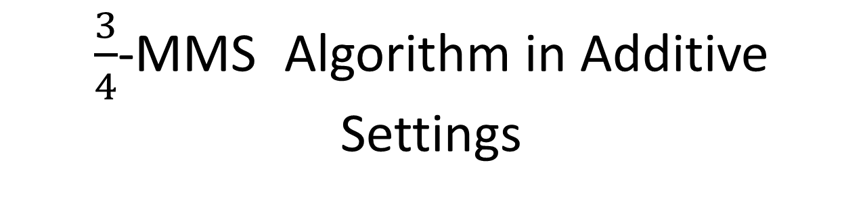
$\frac{3}{4}$-MMS Algorithm in Additive Settings

Slide 2
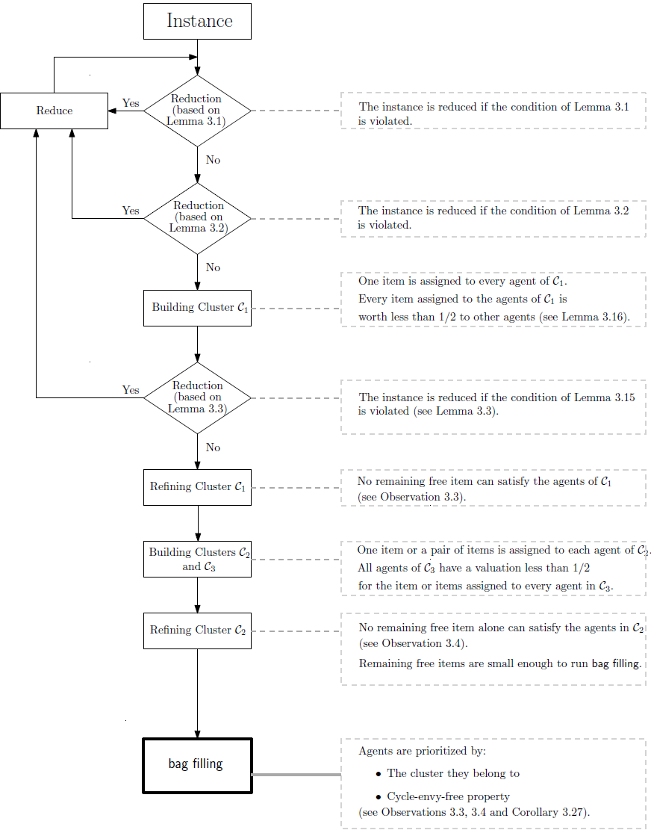
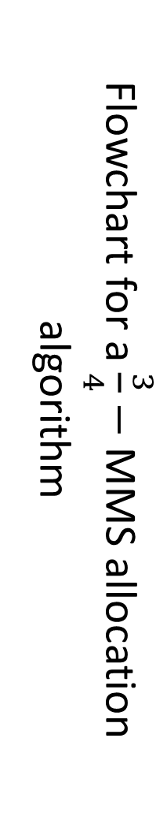
Flowchart for a $\frac{3}{4}−$ MMS allocation algorithm

Slide 3
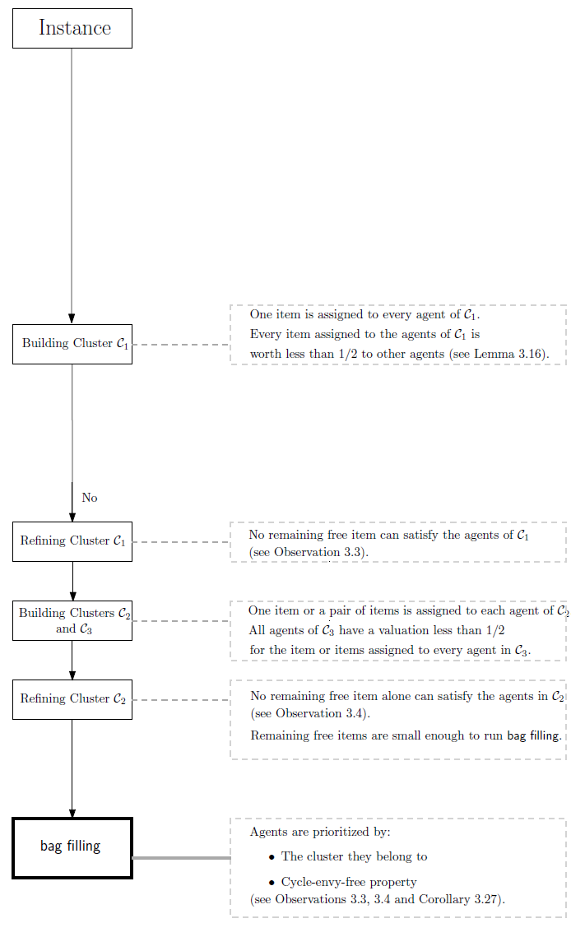

Flowchart for a $\frac{3}{4}−$ irreducible instance
In the paper, it is proved that it only suffices to solve the problem for $\frac{3}{4}$-irreducible instances

Slide 4
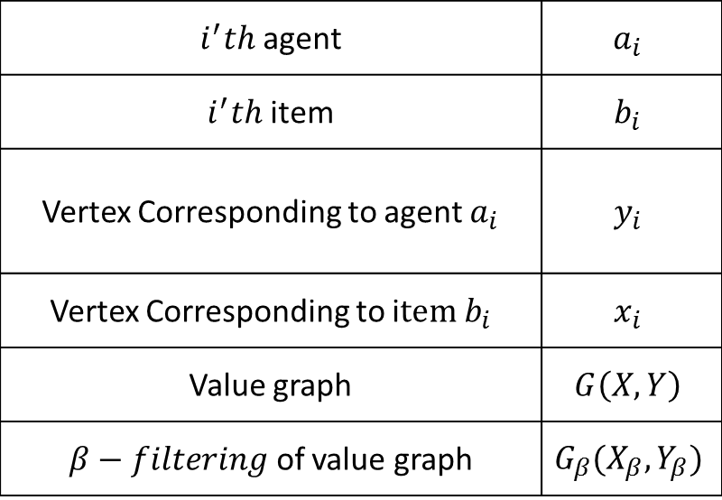
Notations
$i^{′}th$ agent | $$a_{i}$$
$i^{′}th$ item | $$b_{i}$$
Vertex Corresponding to agent $a_{i}$ | $$y_{i}$$
Vertex Corresponding to i$tem b_{i}$ | $$x_{i}$$
Value graph | $$G\left(X,Y\right)$$
$β−filtering$ of value graph | $$G_{β}(X_{β},Y_{β})$$

Slide 5
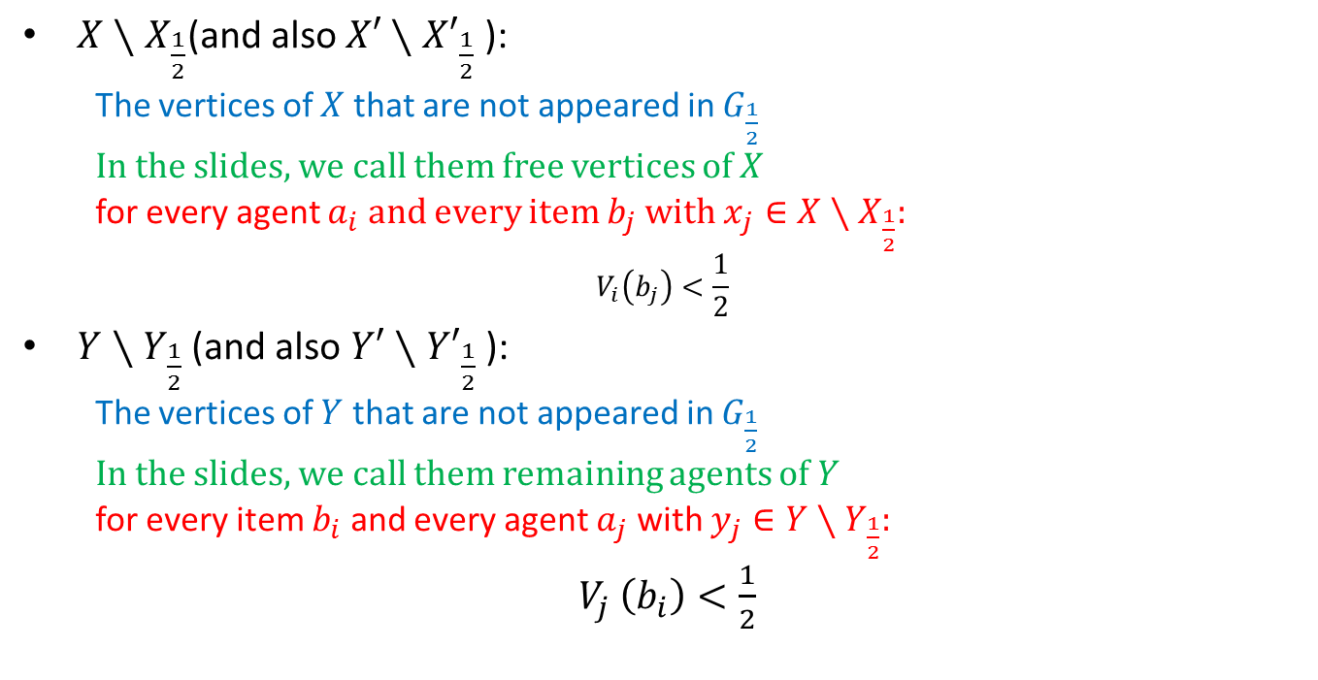
Some facts…
$X∖X_{\frac{1}{2}}\text{(}\text{and} \text{also} X′∖{X′}_{\frac{1}{2}} \text{):}$
  The vertices of $X$ that are not appeared in $G_{\frac{1}{2}}$
  In the slides, we call them free vertices of $X$
  for every agent $a_{i}$ and every item $b_{j}$ with $x_{j}∈X∖X_{\frac{1}{2}}:$
$$V_{i}\left(b_{j}\right)<\frac{1}{2}$$
$Y∖Y_{\frac{1}{2}}$ (and also $Y′∖{Y′}_{\frac{1}{2}}$):
  The vertices of $Y$ that are not appeared in $G_{\frac{1}{2}}$
  In the slides, we call them remaining agents of $Y$
  for every item $b_{i}$ and every agent $a_{j}$ with $y_{j}∈Y∖Y_{\frac{1}{2}}:$
$V_{j }\left(b_{i}\right)<\frac{1}{2}$

Slide 6
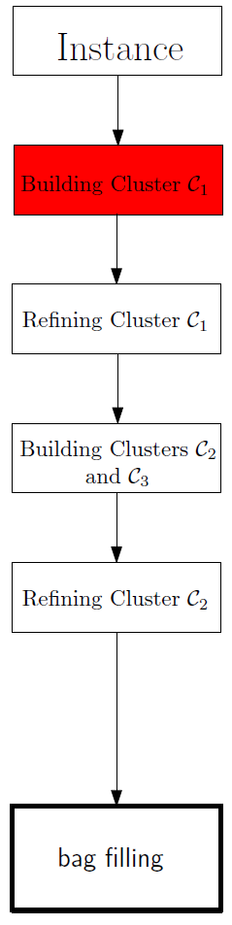

Slide 7

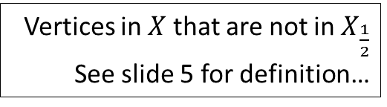

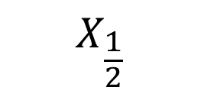
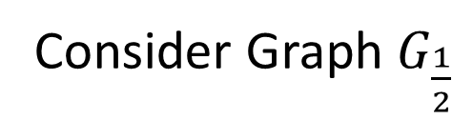
Consider Graph $G_{\frac{1}{2}}$
$$X_{\frac{1}{2}}$$
Free vertices
Remaining agents
$$Y_{\frac{1}{2}}$$
Vertices in $X$ that are not in $X_{\frac{1}{2}}$
See slide 5 for definition…
Vertices in $Y∖Y_{\frac{1}{2}}$

Slide 8
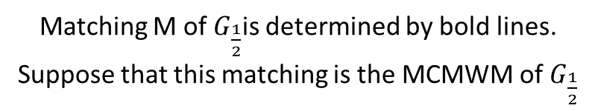
$$X_{\frac{1}{2}}$$
Free vertices
Remaining agents
$$Y_{\frac{1}{2}}$$
Matching M of $G_{\frac{1}{2}}$is determined by bold lines.
Suppose that this matching is the MCMWM of $G_{\frac{1}{2}}$

Slide 9



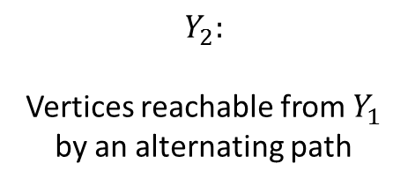
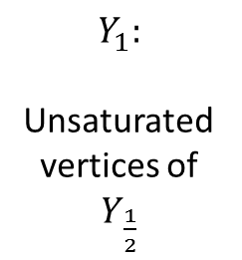
$$F_{G_{\frac{1}{2}}}\left(M,X_{\frac{1}{2}}\right)=X_{\frac{1}{2}}∖N(Y_{2})$$
$$N(Y_{2})$$
Free vertices
Remaining agents
$$N\left(F_{G_{\frac{1}{2}}}\left(M,X_{\frac{1}{2}}\right)\right)$$
$$Y_{2}:$$
Vertices reachable from $Y_{1}$ by an alternating path
$$Y_{1}:$$
Unsaturated vertices of $Y_{\frac{1}{2}}$
By definition, there is no edge between$F_{G_{\frac{1}{2}}}\left(M,X_{\frac{1}{2}}\right)$ and $Y_{2}∪Y_{1}∪Remaining Agents$

Slide 10

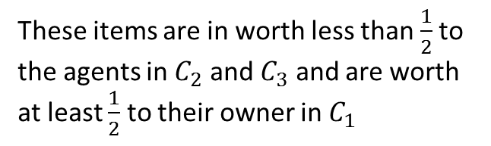
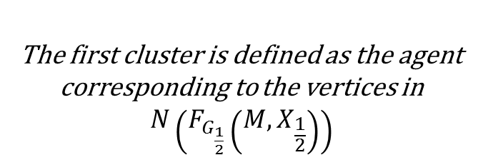
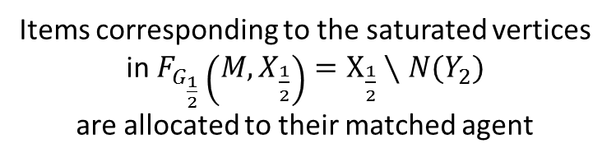
Items corresponding to the saturated vertices in $F_{G_{\frac{1}{2}}}\left(M,X_{\frac{1}{2}}\right)=X_{\frac{1}{2}}∖N(Y_{2})$
are allocated to their matched agent
Free vertices
Remaining agents
These items are in worth less than $\frac{1}{2}$to the agents in $C_{2}$ and $C_{3}$ and are worth at least $\frac{1}{2}$ to their owner in $C_{1}$
The first cluster is defined as the agent corresponding to the vertices in
$$N\left(F_{G_{\frac{1}{2}}}\left(M,X_{\frac{1}{2}}\right)\right)$$

Slide 11
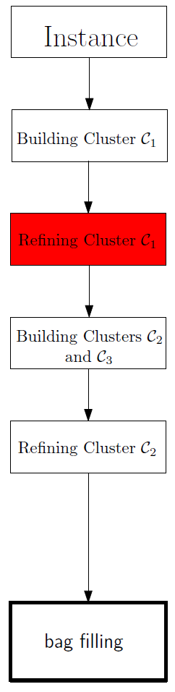

Slide 12
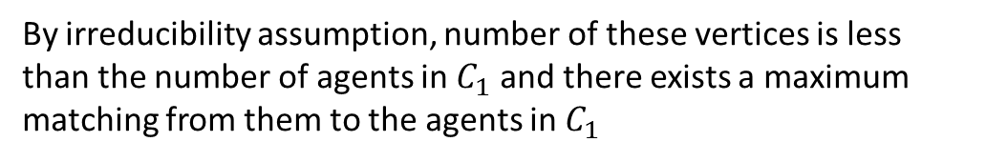
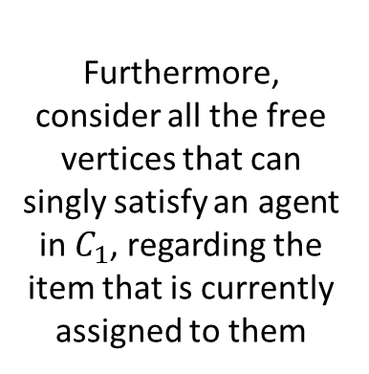
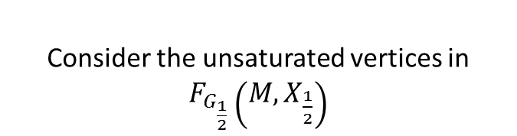
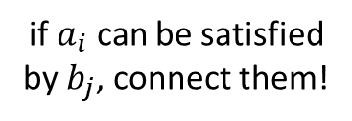
By irreducibility assumption, number of these vertices is less than the number of agents in $C_{1}$ and there exists a maximum matching from them to the agents in $C_{1}$
Allocate the items with regard the special matching described in the paper
Free vertices
Furthermore, consider all the free vertices that can singly satisfy an agent in $C_{1}$, regarding the item that is currently assigned to them
Finally, remove allocated items and satisfied agents and their corresponding vertices
Remaining agents
if $a_{i}$ can be satisfied by $b_{j}$, connect them!
Consider the unsaturated vertices in $F_{G_{\frac{1}{2}}}\left(M,X_{\frac{1}{2}}\right)$
The remaining agents will be satisfied in bag filling.

Slide 13
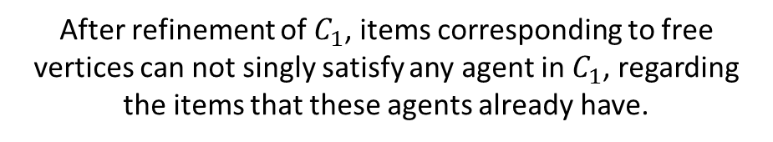
Free vertices
After refinement of $C_{1}$, items corresponding to free vertices can not singly satisfy any agent in $C_{1}$, regarding the items that these agents already have.
Remaining agents

Slide 14
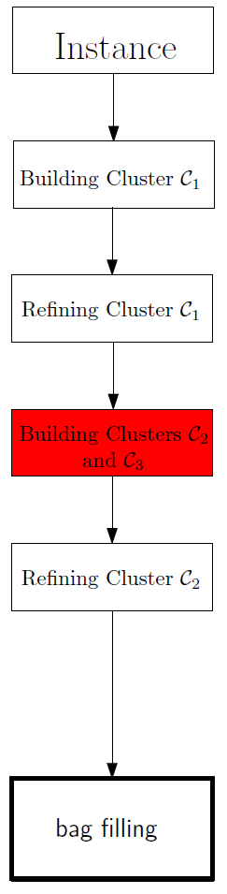

Slide 15

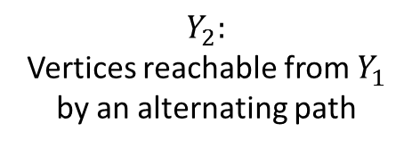

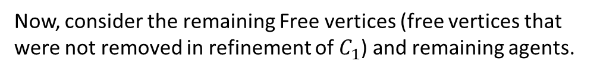
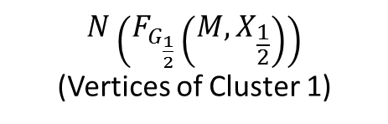
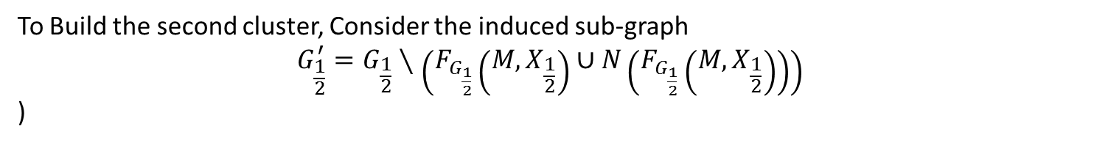

Now, consider the remaining Free vertices (free vertices that were not removed in refinement of $C_{1}$) and remaining agents.
$$F_{G_{\frac{1}{2}}}\left(M,X_{\frac{1}{2}}\right)=X_{\frac{1}{2}}∖N(Y_{2})$$
$$N(Y_{2})$$
Free vertices
Remaining agents
$$N\left(F_{G_{\frac{1}{2}}}\left(M,X_{\frac{1}{2}}\right)\right)$$
(Vertices of Cluster 1)
$$Y_{2}:$$
Vertices reachable from $Y_{1}$ by an alternating path
$$Y_{1}:$$
Unsaturated vertices by M
To Build the second cluster, Consider the induced sub-graph
$$G_{\frac{1}{2}}^{′}=G_{\frac{1}{2}}∖\left(F_{G_{\frac{1}{2}}}\left(M,X_{\frac{1}{2}}\right)∪N\left(F_{G_{\frac{1}{2}}}\left(M,X_{\frac{1}{2}}\right)\right)\right)$$
)

Slide 16




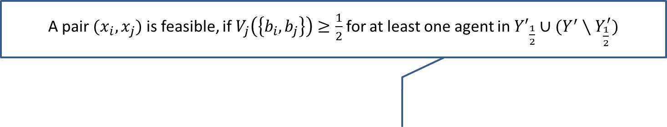
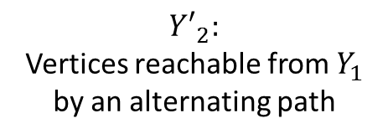

A pair $(x_{i},x_{j})$ is feasible, if $V_{j}\left(\left\{b_{i},b_{j}\right\}\right)≥\frac{1}{2}$ for at least one agent in ${Y′}_{\frac{1}{2}}∪(Y^{′}∖Y_{\frac{1}{2}}^{′})$
$${N({Y^{′}}_{2})= X}_{\frac{1}{2}}^{′}$$
Free vertices ($X′∖{X′}_{\frac{1}{2}})$
$$Y_{\frac{1}{2}}^{′}$$
$${Y′}_{2}:$$
Vertices reachable from $Y_{1}$ by an alternating path
$${Y′}_{1}:$$
Unsaturated vertices by M
Remaining Agents ($Y′∖Y_{\frac{1}{2}}^{′})$
Vertices that are not in ${G′}_{\frac{1}{2}}$
For $G_{\frac{1}{2}}^{′}\left(X_{\frac{1}{2}}^{′},Y_{\frac{1}{2}}^{′}\right),$currently, $F_{G_{\frac{1}{2}}^{′}}\left(M,X_{\frac{1}{2}}^{′}\right)=∅$. Also, for every set $S∈X_{\frac{1}{2}}^{′}, \left|N\left(S\right)\right|>\left|S\right|$

Slide 17
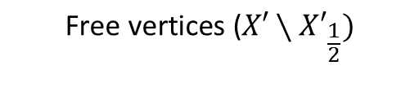




Feasible pair
$$N({Y′}_{2})$$
$$\text{Free} \text{vertices}\text{ (}X′∖{X′}_{\frac{1}{2}})$$
$${Y′}_{2}:$$
$${Y′}_{1}:$$
$$\text{Remaining} \text{Agents}\text{ (}Y′∖Y_{\frac{1}{2}}^{′})$$
Suppose that the red pair is feasible for green vertices.
Merge red vertices to obtain a merged vertex.

Slide 18
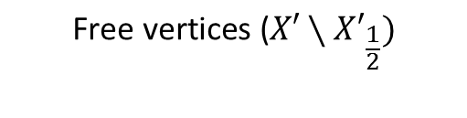
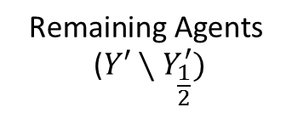
Merged vertex
$$N({Y′}_{2})$$
$$\text{Free} \text{vertices}\text{ (}X′∖{X′}_{\frac{1}{2}})$$
$${Y′}_{2}:$$
$${Y′}_{1}:$$
$$\text{Remaining} \text{Agents}\text{ (}Y′∖Y_{\frac{1}{2}}^{′})$$
Suppose that the red pair is feasible for green vertices.
Merge red vertices to obtain a merged vertex.

Slide 19





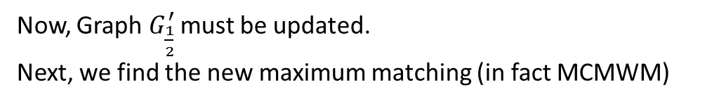

New $X_{\frac{1}{2}}^{′}$ after updating $G_{\frac{1}{2}}^{′}$
$$\text{Free} \text{vertices}\text{ (}X′∖{X′}_{\frac{1}{2}})$$
new$Y_{\frac{1}{2}}^{′},$ after updating $G_{\frac{1}{2}}^{′}$
$${Y′}_{2}$$
$${Y′}_{1}$$
$$\text{Remaining} \text{Agents}\text{ (}Y′∖Y_{\frac{1}{2}}^{′})$$
Now, Graph $G_{\frac{1}{2}}^{′}$ must be updated.
Next, we find the new maximum matching (in fact MCMWM)

Slide 20
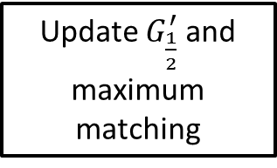
Find a feasible pair
Merge the pair
Update $G_{\frac{1}{2}}^{′}$ and maximum matching
Any feasible pair remained?
Yes
No
Done!

Slide 21

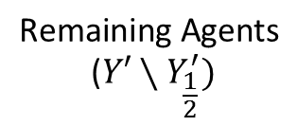


Feasible pair
$$X_{\frac{1}{2}}^{′}=N({Y′}_{2})$$
$$\text{Free} \text{vertices}\text{ (}X′∖{X′}_{\frac{1}{2}})$$
$$Y_{\frac{1}{2}}^{′}$$
$${Y′}_{2}$$
$${Y′}_{1}$$
$$\text{Remaining} \text{Agents}\text{ (}Y′∖Y_{\frac{1}{2}}^{′})$$
Merging (Continued)…

Slide 22


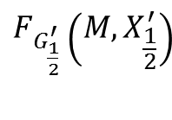
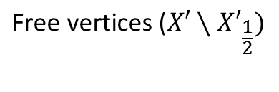


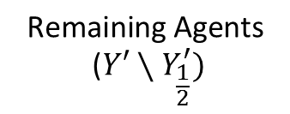
$$F_{G_{\frac{1}{2}}^{′}}\left(M,X_{\frac{1}{2}}^{′}\right)$$
$$\text{Free} \text{vertices}\text{ (}X′∖{X′}_{\frac{1}{2}})$$
$$N({Y′}_{2})$$
$${Y′}_{2}$$
$${Y′}_{1}$$
$$N\left(F_{G_{\frac{1}{2}}^{′}}\left(M,X_{\frac{1}{2}}^{′}\right)\right)$$
$$\text{Remaining} \text{Agents}\text{ (}Y′∖Y_{\frac{1}{2}}^{′})$$
Updating maximum matching…
Now, suppose that the merging process terminates

Slide 23
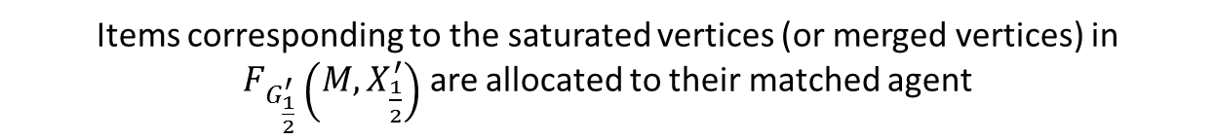
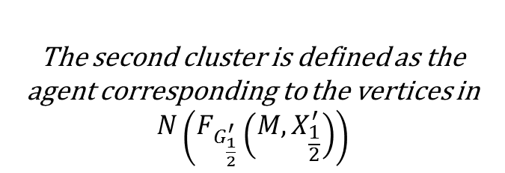
Items corresponding to the saturated vertices (or merged vertices) in $F_{G_{\frac{1}{2}}^{′}}\left(M,X_{\frac{1}{2}}^{′}\right)$ are allocated to their matched agent
$$N({Y′}_{2})$$
$$\text{Free} \text{vertices}\text{ (}X′∖{X′}_{\frac{1}{2}})$$
The second cluster is defined as the agent corresponding to the vertices in
$$N\left(F_{G_{\frac{1}{2}}^{′}}\left(M,X_{\frac{1}{2}}^{′}\right)\right)$$

Slide 24




The third cluster is defined as the agents corresponding to the rest of vertices
$$N({Y′}_{2})$$
$$\text{Free} \text{vertices}\text{ (}X′∖{X′}_{\frac{1}{2}})$$
$$C_{3}^{s}$$
$$C_{3}^{b}$$
$$C_{3}^{f}$$

Slide 25
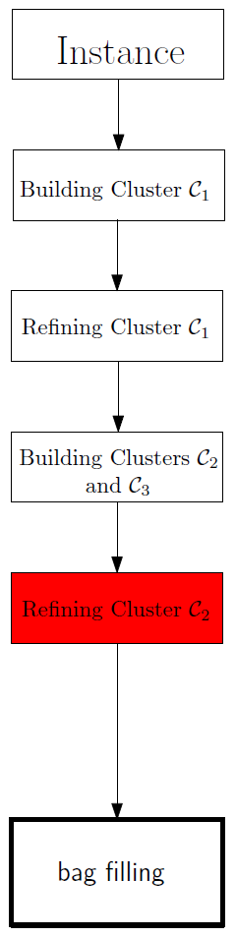

Slide 26
Sort the agents according to their topological ordering.
If an item with corresponding vertex in free vertices could singly satisfy the first agent, do so.
Go on with the next agents…
The remaining agents will be satisfied in bag filling.

Slide 27
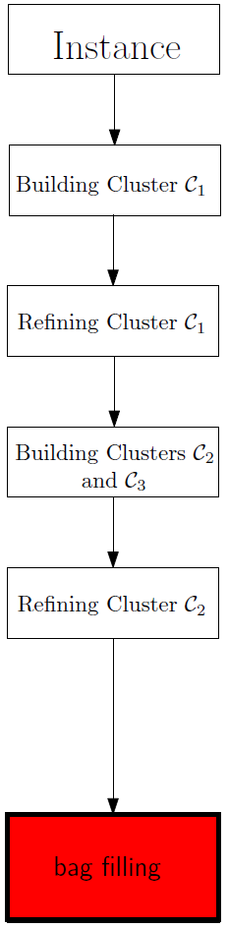

Slide 28






Bag Filling - overview
Free Items
$$C_{3}^{s}$$
$$C_{3}^{b}$$
$$C_{3}^{f}$$
$$C_{1}$$
$$C_{2}$$
$$C_{3}$$

Slide 29
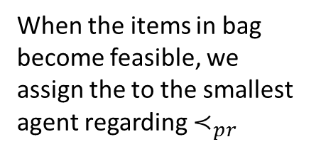
We add free items one by one, until an agent becomes satisfied by the items
Free Items
When the items in bag become feasible, we assign the to the smallest agent regarding $≺_{pr}$
$$C_{3}^{s}$$
$$C_{3}^{b}$$
$$C_{3}^{f}$$
$$C_{1}$$
$$C_{2}$$
$$C_{3}$$

Slide 30
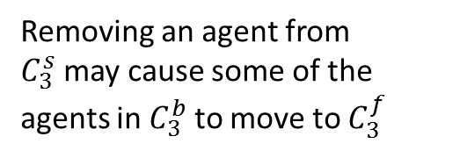
We add free items one by one, until an agent becomes satisfied by the items
Free Items
Removing an agent from $C_{3}^{s}$may cause some of the agents in $C_{3}^{b}$ to move to $C_{3}^{f}$
$$C_{3}^{s}$$
$$C_{3}^{b}$$
$$C_{3}^{f}$$
$$C_{1}$$
$$C_{2}$$
$$C_{3}$$

Slide 31

We add free items one by one, until an agent becomes satisfied by the items
Free Items
Here, the another green agent in $C_{3}^{f}$is moved to $C_{3}^{b}$
$$C_{3}^{s}$$
$$C_{3}^{b}$$
$$C_{3}^{f}$$
$$C_{1}$$
$$C_{2}$$
$$C_{3}$$

Slide 32


Now, the red item is moved to one of $C_{3}^{f}$ or $C_{3}^{b}$
Free Items
Here, the green agent takes his desired item from the red agent in $C_{3}^{s}$
$$C_{3}^{s}$$
$$C_{3}^{b}$$
$$C_{3}^{f}$$
$$C_{1}$$
$$C_{2}$$
$$C_{3}$$

Slide 33
The process goes on, until all the agents become satisfied…

