Slide 1



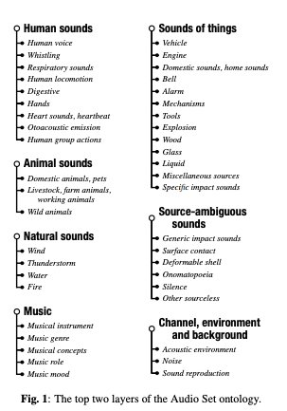
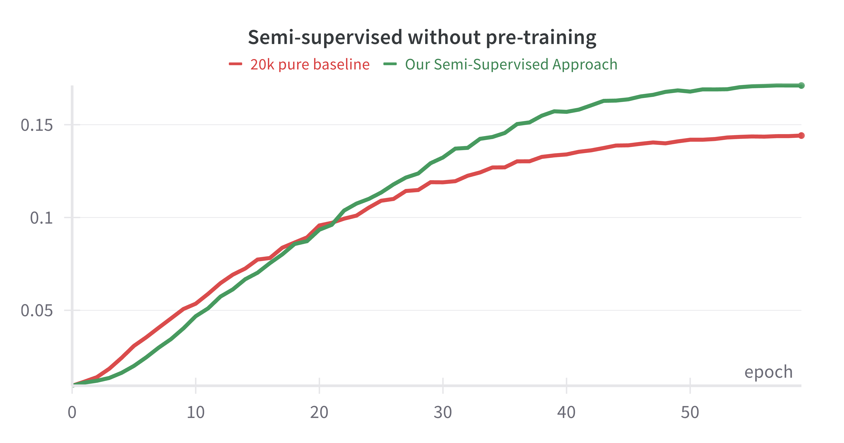
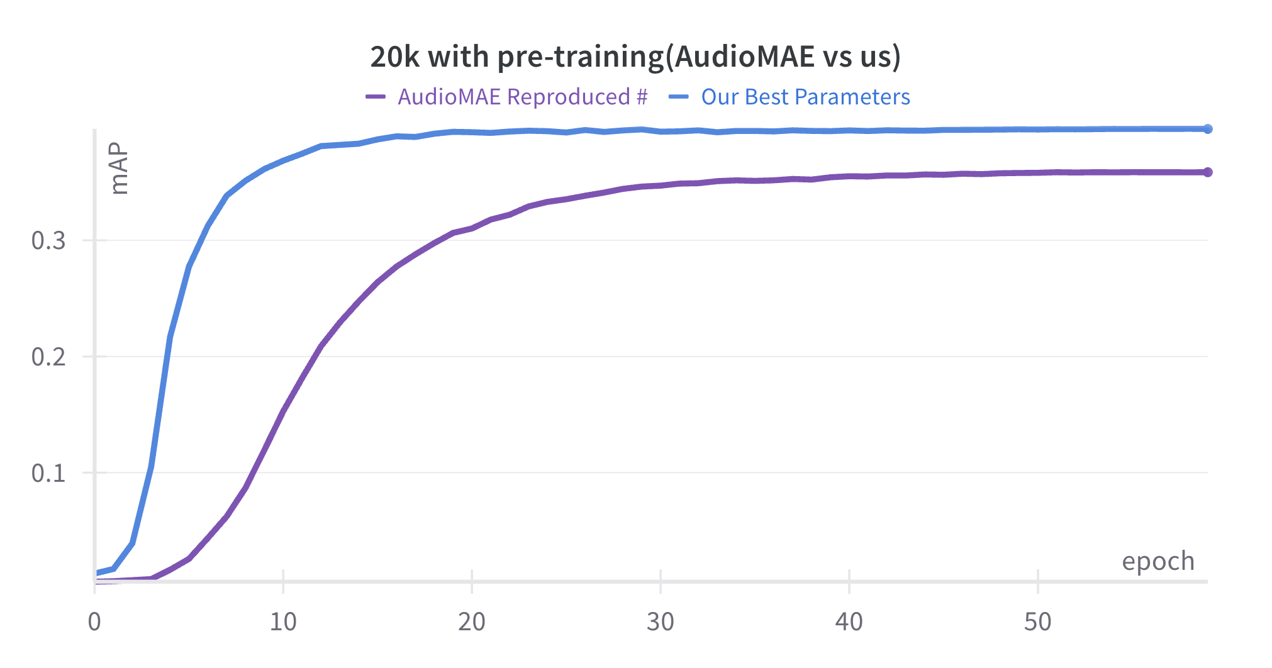
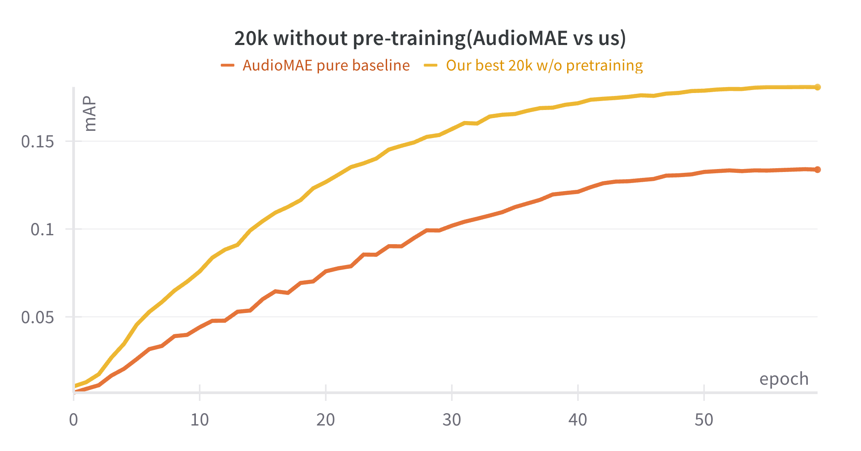
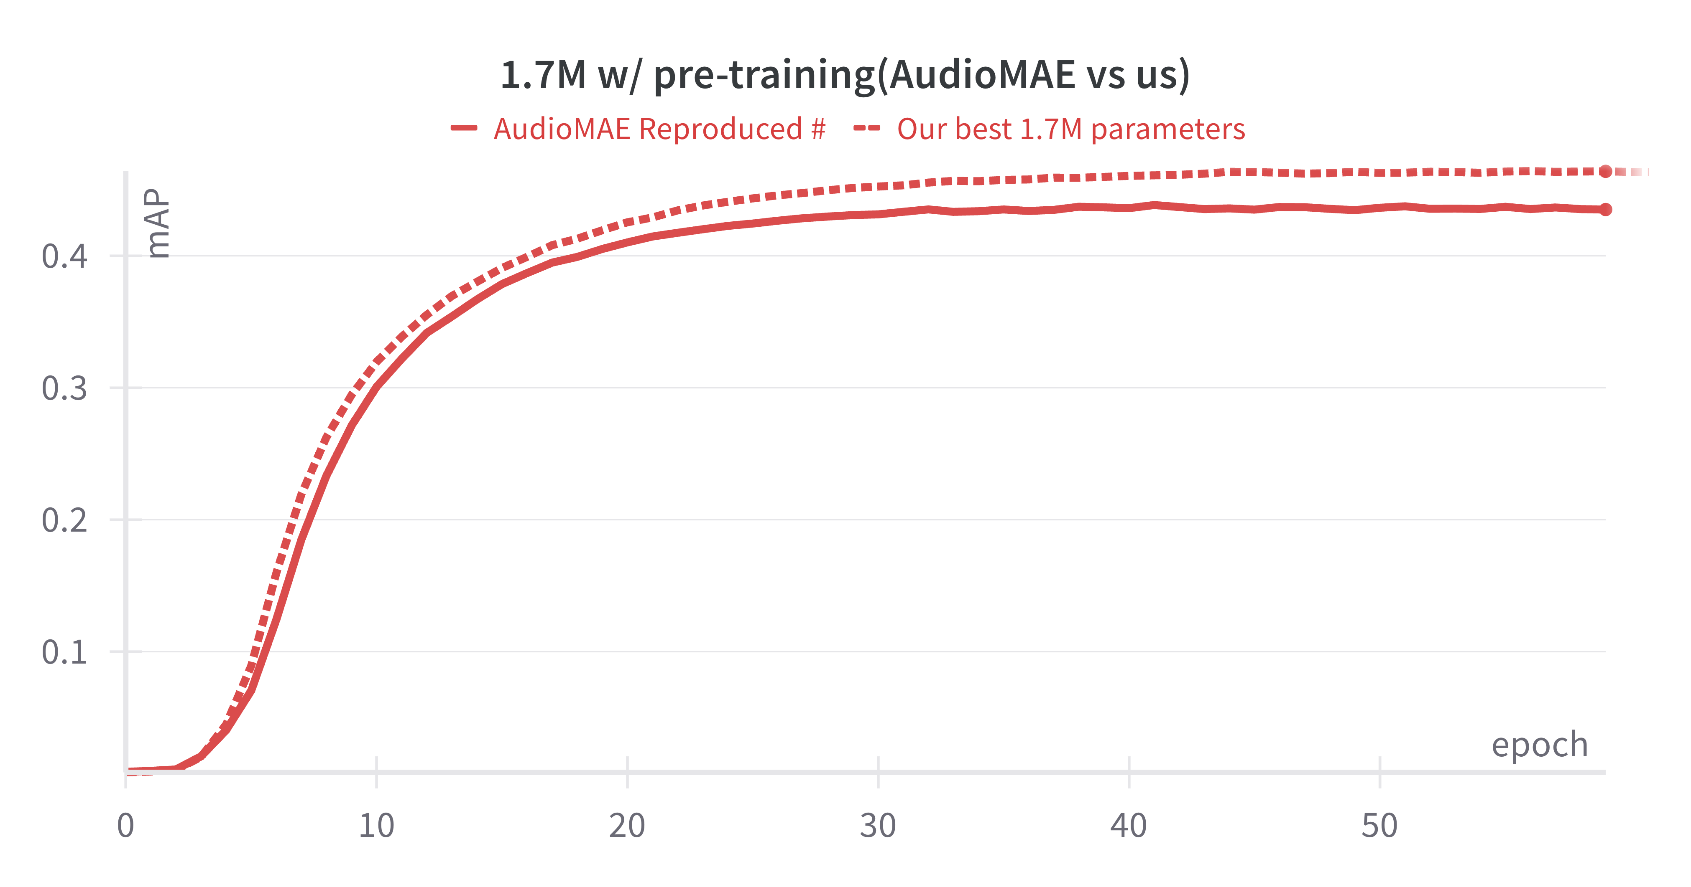
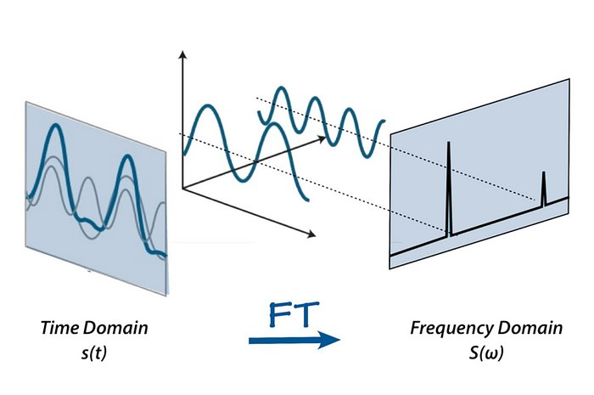
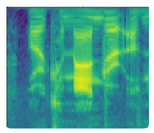
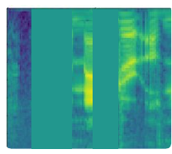
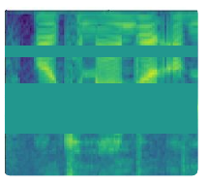
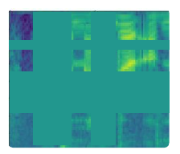
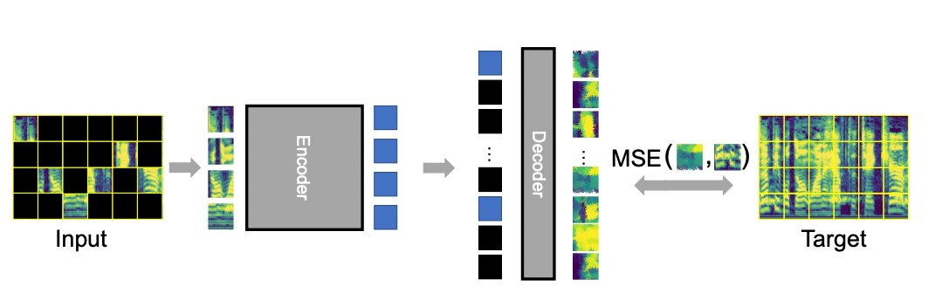
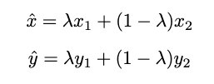
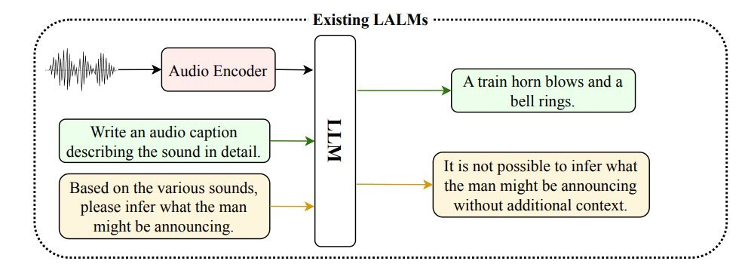

Improving Audio Event Recognition with Consistency Regularization
Shanmuka Sadhu¹, Weiran Wang²
¹Rutgers University Dept. Of Computer Science, ²University of Iowa Dept. Of Computer Science
Introduction
Results
Semi-Supervised Results
Preliminary Results
AudioSet Dataset:
20k Dataset Results
20k best params w/ pre-training | 39.6 mAP
20k baseline w/ pre-training | 37.9 mAP
20k w/o pure baseline pre-training | 17.2 mAP
20k best params w/o pretraining | 19.3 mAP
Number presented in [2] | 37.0 mAP
Hierarchical audio dataset of multi-class 10 second YouTube audio clips.
Consists of 527 balanced classes
Two sub-datasets used of sizes ~20k and ~1.7M.
AudioSet Classification:
1.7M Dataset Results
Transform .wav files into log-mel spectrograms.
Fast-Fourier Transform(FFT) decomposes .wav into frequency and time wavs.
Log-mel spectrogram visualizes frequency as a function of time.
Methods
SpecAugment:
Diagram
Conclusion & Next Steps
Model Architecture:
Time Masking(x-axis) and Frequency Masking(y-axis)
Consistency Regularization improves upon mAP performance in AudioSet Classification by relative ~4%.
An increased number of augmentations helps consistency regularization perform better on smaller datasets(~20k samples).
A semi-supervised(labeled data+unlabeled data) approach demonstrates improvement on a non-pre-trained model.
Next Steps: LALMs(Large Audio Language Models) have grown to popularity. LALMs have not generalized well for Audio Event Recognition, especially on AudioSet. We believe that using our encoder paradigm rather than the encoder presented in [3], will show an improved performance.
Input is masked in the frequency and time dimension.
Pre-training:
Vision Transformer-based encoder(Neural Network) learns unmasked patches.
A decoder is used to predict the masked patches and compared against the original patches.
Original
Time Masking
Frequency Masking
Time+Frequency Masking
Mixup:
Creates a new sample(x̂) which is ratio(λ) of 2 spectrograms(x1 and x2) by linearly combining them.
Audio Event Detection:
Consistency Regularization (CR):
Binary Cross-Entropy(BCE) compares the probability distribution between the predicted labels and target labels.
CR aims to push two probability distributions together using KL-Divergence.
Given 2 augmentations, CR will train the model to learn augmented variations of an audio sample.
References
[1] J. F. Gemmeke, D. P. Ellis, D. Freedman, A. Jansen, W. Lawrence, R. C. Moore, M. Plakal, and M. Ritter, “Audio set: An ontology and human-labeled dataset for audio events,” in 2017 IEEE International Conference on Acoustics, Speech and Signal Processing (ICASSP). IEEE, 2017, pp. 776–780.
[2] Hu Xu, Juncheng Li, Alexei Baevski, Michael Auli, Wojciech Galuba, Florian Metze, Christoph Feichtenhofer, et al. Masked autoencoders that listen. arXiv preprint arXiv:2207.06405, 2022.
[3] D. S. Park, W. Chan, Y. Zhang, C.-C. Chiu, B. Zoph, E. D. Cubuk, and Q. V. Le, “Specaugment: A simple data augmentation method for automatic speech recognition,” ArXiv, vol. abs/1904.08779, 2019.
[4] Sreyan Ghosh, Sonal Kumar, Ashish Seth, Chandra Kiran Reddy Evuru, Utkarsh Tyagi, S Sakshi, Oriol Nieto, Ramani Duraiswami, and Dinesh Manocha. Gama: A large audio-language model with advanced audio understanding and complex reasoning abilities. arXiv preprint arXiv:2406.11768, 2024.

