Slide 1
Randomness Extraction in the Presence of
Quantum Side Information
Xiaodi Wu (MIT)
Simons Reunion Workshop, May, 2015
Notes:
A new way of extracting pure randomness from physics systems

Slide 2
Randomness Extraction
01110100011000100001
10010101100010001001
10010001001001111000
10010100100100010010
10101010010101010….
Weak randomness (e.g., collected from physical signals, thermal fluctuations)
Uniform random string (useful for algorithmic and cryptographic applications)
ISSUEs: “weak” random source, the procedure, assumptions,
efficiency, (quantum) security, ……

Slide 3




Randomness Extractor: Multi-source
[CG85, BIK04, Raz, Rao, Bourgain, Li ……]
A deterministic function converts indep. weak random sources with entropy to almost-uniform randomness
weak random source
$$…$$
weak random source
X₁
X_{t}
$$Ext$$
$≈$uniform output
Z

Slide 4


Randomness Extractor: Seeded
[SV84,Vaz85,VV85,CG85,Vaz87,CW89,Zuc90,Zuc91,…]
A deterministic function converts indep. weak random sources with entropy to almost-uniform randomness
source
seed
X
U_{d}
$$Ext$$
$≈$uniform output
Z

Slide 5
Randomness Extraction
 | Extractor | Classical Adversary | Quantum Adversary
 | deterministic function
 | deterministic function

Slide 6
The Role of Side Info
Info correlated with the source(s)
  Goal: output close to uniform given side info.
  Important for crypto applications
Single source & side info
  classical side info → no side info by conditioning
  non-trivial for quantum side info
Multiple sources & side info
  non-trivial even for classical side info
  new phenomena: entanglement; quantum rushing
Notes:
Say that side info models any info correlated with the sources, for example, in the generation of the source, or after-the-fact leakage,
Think of it as held in an adversary
Say that original formulation does not model side info; for good reason

Slide 7
Randomness Extraction
 | Extractor | Classical Adversary | Quantum Adversary
 | deterministic function | side information cond.min-entropy | q. side info q.c. min-entropy
 | deterministic function | side information a proposal here | q. side info a proposal here

Slide 8
Applications beyond randomness
Classical TCS
  Cryptography, Derandomization [Sis88, NZ93,…], Distributed algorithms [WZ95], Data structures [Ta02], Hardness of Approximation [Zuc93,…]
Quantum Information
  Privacy amplification (QKD) [BB84,…], device-independent crypto [VV12, MS14, CSW14, B+, …]
  Bounded-storage model [DFSS08,…]

Slide 9

Network Extractors [KLRZ08]—
Crypto with Imperfect Randomness
Most crypto tasks impossible using weak source [DOPS04]
Network extractor: rand. extraction in distributed setting
  Parties hold private (indep.) weak source; may be malicious
  Goal: private uniform output for honest parties
Notes:
If the extractor is not a deterministic function. Emphasize importance of perfect randomness in crypto

Slide 10
Randomness Extraction
 | Extractor | Classical Adversary | Quantum Adversary
 | deterministic function | side information cond.min-entropy | q. side info q.c. min-entropy
 | deterministic function | side information a proposal here | q. side info a proposal here
 | network protocol | side information & faculty parties | even stronger quantum attack

Slide 11
Randomness Extraction
 | Extractor | Classical Adversary | Quantum Adversary
 | deterministic function | side information cond.min-entropy | q. side info q.c. min-entropy
 | deterministic function | side information a proposal here | q. side info a proposal here
 | network protocol | side information & faculty parties | even stronger quantum attack
DI- or physical randomness extractor | protocol w/ untrusted devices | N/A | cheating devices

Slide 12
Results
 | Extractor | Classical Security | Quantum Security
 | deterministic function | side information cond.min-entropy | Optimal cons. for most apps
 | deterministic function | Proposal for (q.) side info model Cons. w/ matching parameters
 | network protocol | best-known construction | First cons. w/ q. security
DI- or physical randomness extractor | protocol w/ untrusted devices | N/A | Chung, Shi, W
Notes:
New models of multi-source side info
Subsume and unify previous models
New techniques to deal with it
New multi-source/network extractors against classical/quantum side info
same parameters as best-known constructions*
handle multi-source side info for free!

Slide 13
Plan of Talk
Modelling of (Quantum) Side Information
Multi-source Extractors
- based on joint work w/ Chung, Li
Network Extractors
- based on joint work w/ Chung, Li
Single-source Extractors
- based on joint work w/ Chung
Summary & Perspectives

Slide 14
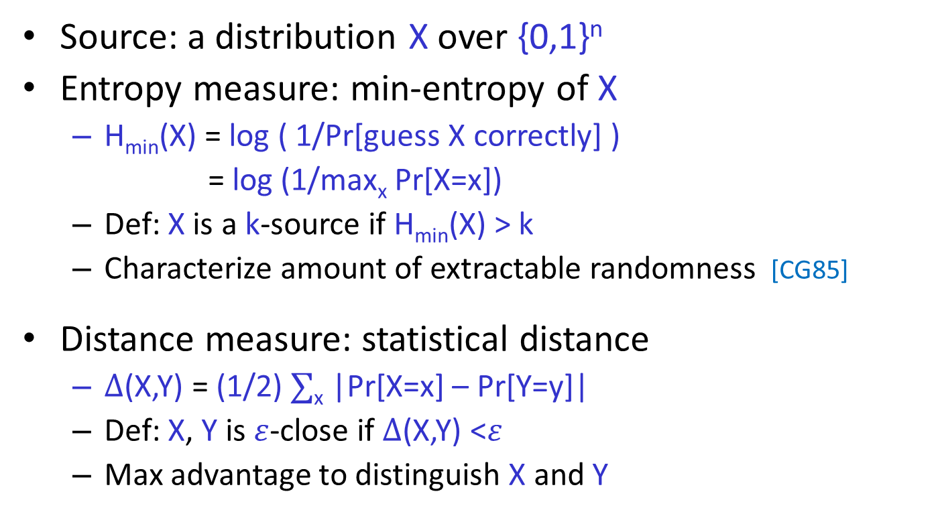
Measure of Entropy and Distance without side information
Source: a distribution X over {0,1}^{n}
Entropy measure: min-entropy of X
  H_{min}(X) = log ( 1/Pr[guess X correctly] )
  = log (1/max_{x} Pr[X=x])
  Def: X is a k-source if H_{min}(X) > k
  Characterize amount of extractable randomness [CG85]
Distance measure: statistical distance
  $∆$(X,Y) = (1/2) $∑$_{x} |Pr[X=x] – Pr[Y=y]|
  Def: X, Y is $ε$-close if $∆$(X,Y) <$ε$
  Max advantage to distinguish X and Y

Slide 15
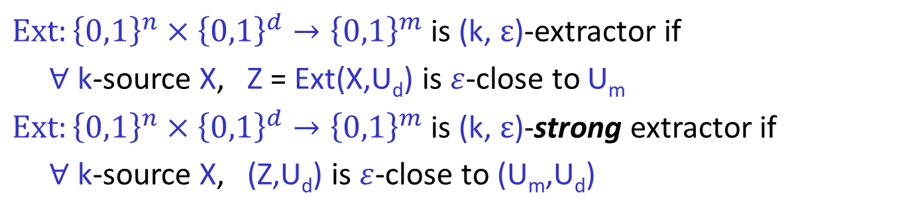
Seeded Extractors [NZ96,Z96]
$Ext:{\left\{0,1\right\}}^{n}×{\left\{0,1\right\}}^{d}→{\left\{0,1\right\}}^{m}$ is (k, $ε$)-extractor if
$∀$ k-source X, Z = Ext(X,U_{d}) is $ε$-close to U_{m}
$Ext:{\left\{0,1\right\}}^{n}×{\left\{0,1\right\}}^{d}→{\left\{0,1\right\}}^{m}$ is (k, $ε$)-strong extractor if
$∀$ k-source X, (Z,U_{d}) is $ε$-close to (U_{m},U_{d})
Seeded Randomness Extractor
source
seed
X
U_{d}
$$Ext$$
$≈$uniform output
Z
Notes:
Says entropy from X

Slide 16



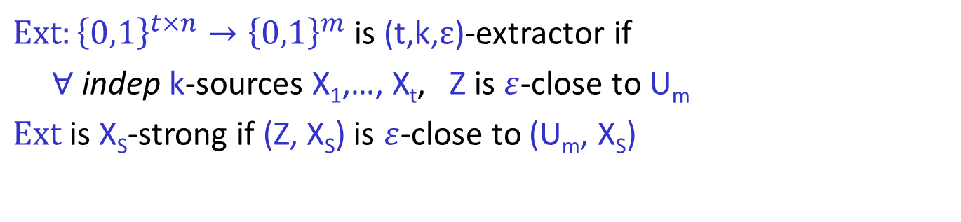
Multi-source Extractors [BIW04]
$Ext:{\left\{0,1\right\}}^{t×n}→{\left\{0,1\right\}}^{m}$ is (t,k,$ε$)-extractor if
$∀$ indep k-sources X₁,…, X_{t}, Z is $ε$-close to U_{m}
$Ext$is X_{S}-strong if (Z, X_{S}) is $ε$-close to (U_{m}, X_{S})
Multi-source Extractor
source
$$…$$
source
X₁
X_{t}
$$Ext$$
$≈$uniform output
Z

Slide 17
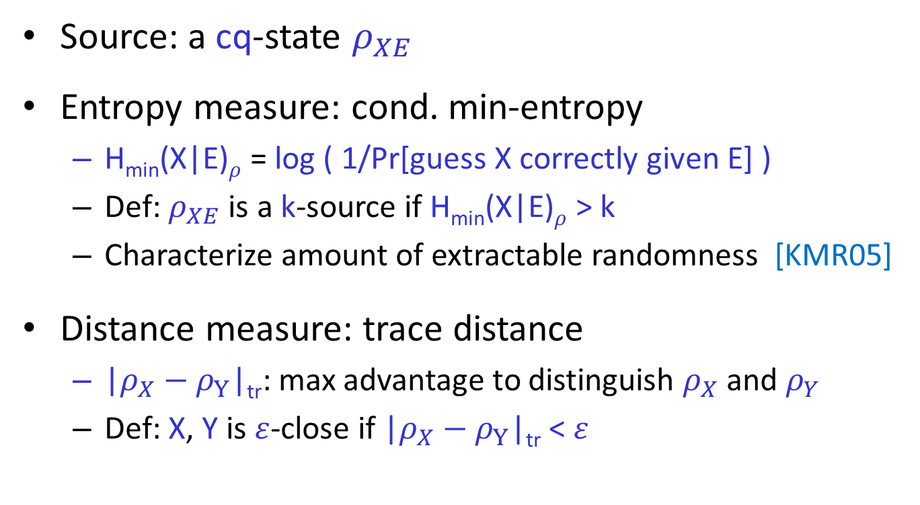
In Presence of (Quantum) Side Info
Source: a cq-state $ρ_{XE}$
Entropy measure: cond. min-entropy
  H_{min}(X|E)$ρ$ = log ( 1/Pr[guess X correctly given E] )
  Def: $ρ_{XE}$ is a k-source if H_{min}(X|E)$ρ$ > k
  Characterize amount of extractable randomness [KMR05]
Distance measure: trace distance
  |$ρ_{X}−ρ_{Y}$|_{tr}: max advantage to distinguish $ρ_{X}$ and $ρ_{Y}$
  Def: X, Y is $ε$-close if |$ρ_{X}−ρ_{Y}$|_{tr} < $ε$

Slide 18


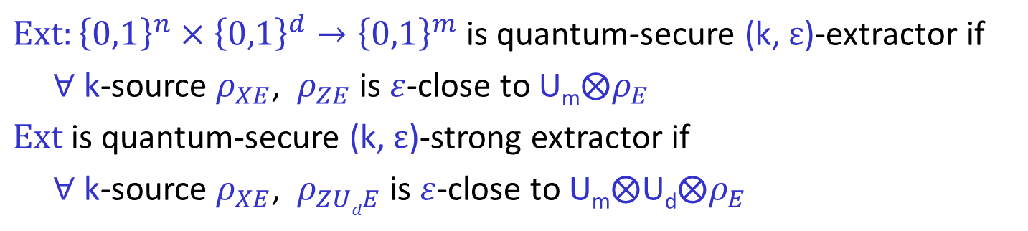
Seeded Extractors against Side Info [R05,KMR05,KT08,DV10,T11,DPVR11]
$Ext:{\left\{0,1\right\}}^{n}×{\left\{0,1\right\}}^{d}→{\left\{0,1\right\}}^{m}$ is quantum-secure (k, $ε$)-extractor if
$∀$ k-source $ρ_{XE}$, $ρ_{ZE}$ is $ε$-close to U_{m}$⨂ρ_{E}$
$Ext$ is quantum-secure (k, $ε$)-strong extractor if
$∀$ k-source $ρ_{XE}$, $ρ_{ZUdE}$ is $ε$-close to U_{m}$⨂\text{U}\text{d}⨂ρ_{E}$
classical-secure
marginal-secure
for no side-info
for classical side-info
classical-secure
marginal-secure
Seeded Randomness Extractor
source
seed
X
U_{d}
adversary
$$Ext$$
$$E$$
$≈$uniform output
Z

Slide 19
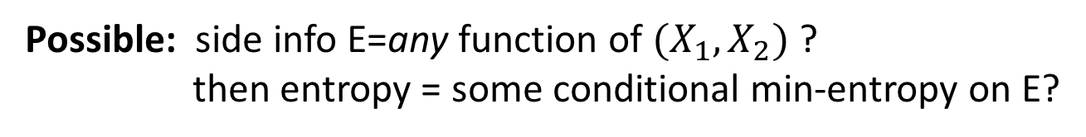
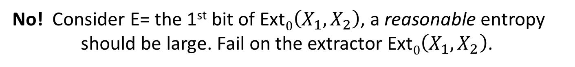
Extension to multiple sources?
Want: a general definition of entropy ,
sufficient entropy => extractability.
Possible: side info E=any function of $(X_{1},X_{2})$ ?
then entropy = some conditional min-entropy on E?
No! Consider E= the 1st bit of Ext$0\left(X_{1},X_{2}\right)$, a reasonable entropy
should be large. Fail on the extractor Ext$0\left(X_{1},X_{2}\right)$.
Restriction on E
is necessary!
adversary
$$E$$
Notes:
On this slides, give the obstacle, the example, side information (F(x)), and then the general principle

Slide 20
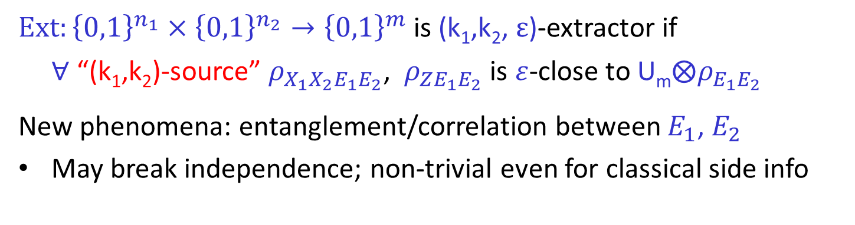




Two-source Extractors against Side Info [KK12]
$Ext:{\left\{0,1\right\}}^{n_{1}}×{\left\{0,1\right\}}^{n_{2}}→{\left\{0,1\right\}}^{m}$ is (k₁,k₂, $ε$)-extractor if
$∀$ “(k₁,k₂)-source” $ρ_{X_{1}X_{2}E_{1}E_{2}}$, $ρ_{ZE_{1}E_{2}}$ is $ε$-close to U_{m}$⨂ρ_{E_{1}E_{2}}$
New phenomena: entanglement/correlation between $E_{1}$, $E_{2}$
May break independence; non-trivial even for classical side info
Remarks:
1. Could refer to a practical scenario of generating side-info: when parties are far apart from each other & leaking procedure is short!
2. Unclear about extension to multiple rounds. Could fall into the previous counter-example .
Two-source Extractor
source
source
X₁
X₂
E₁
E₂
adversary
adversary
A₁
A₂
$$Ext$$
$$E_{1}$$
$$E_{2}$$
$≈$uniform output
Z
Notes:
one proposal from KK: by describing a way to generate the side information; allow entanglement, break independence.
mention why the generation of the side information could be practical ! When the side information is generated far far apart, won’t have change to generate again
Won’t be able to allow more rounds, otherwise fall into the counter-example in the previous slides.

Slide 21
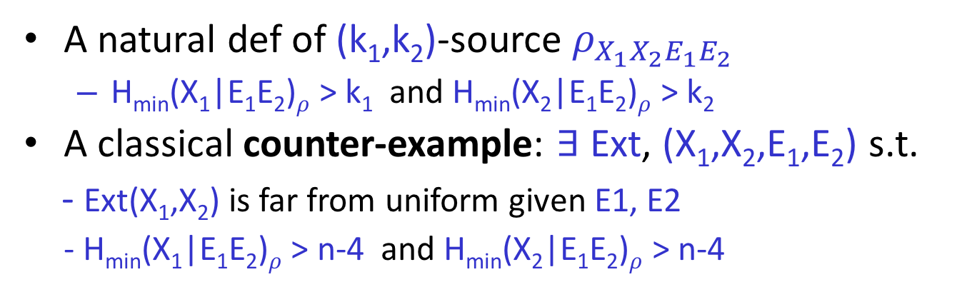
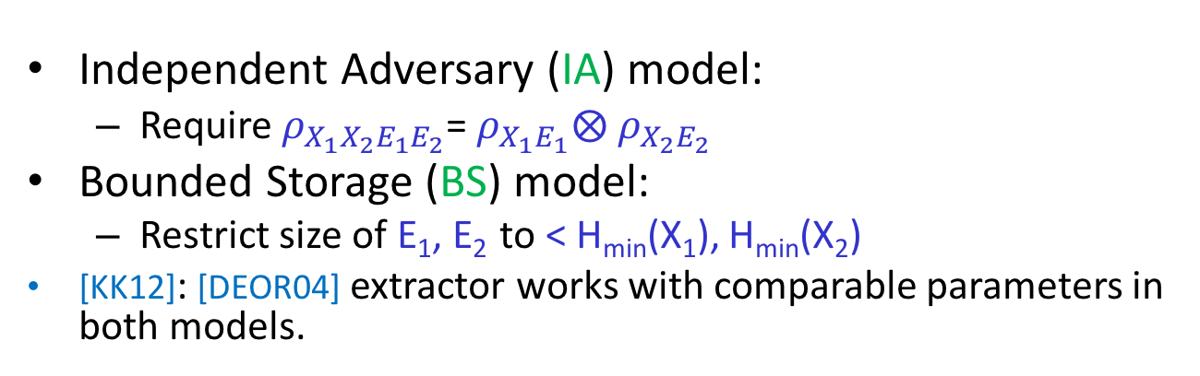
Entropy measure: problematic [KK12]
A natural def of (k₁,k₂)-source $ρ_{X_{1}X_{2}E_{1}E_{2}}$
  H_{min}(X₁|E₁E₂)$ρ$ > k₁ and H_{min}(X₂|E₁E₂)$ρ$ > k₂
A classical counter-example: $∃$ Ext, (X₁,X₂,E₁,E₂) s.t.
- Ext(X₁,X₂) is far from uniform given E1, E2
  - H_{min}(X₁|E₁E₂)$ρ$ > n-4 and H_{min}(X₂|E₁E₂)$ρ$ > n-4
As a result, [KK12] introduces
Independent Adversary (IA) model:
  Require $ρ_{X_{1}X_{2}E_{1}E_{2}}$= $ρ_{X_{1}E_{1}}⨂{ ρ}_{X_{2}E_{2}}$
Bounded Storage (BS) model:
  Restrict size of E₁, E₂ to < H_{min}(X₁), H_{min}(X₂)
[KK12]: [DEOR04] extractor works with comparable parameters in both models.
Notes:
Shrink it!!!

Slide 22
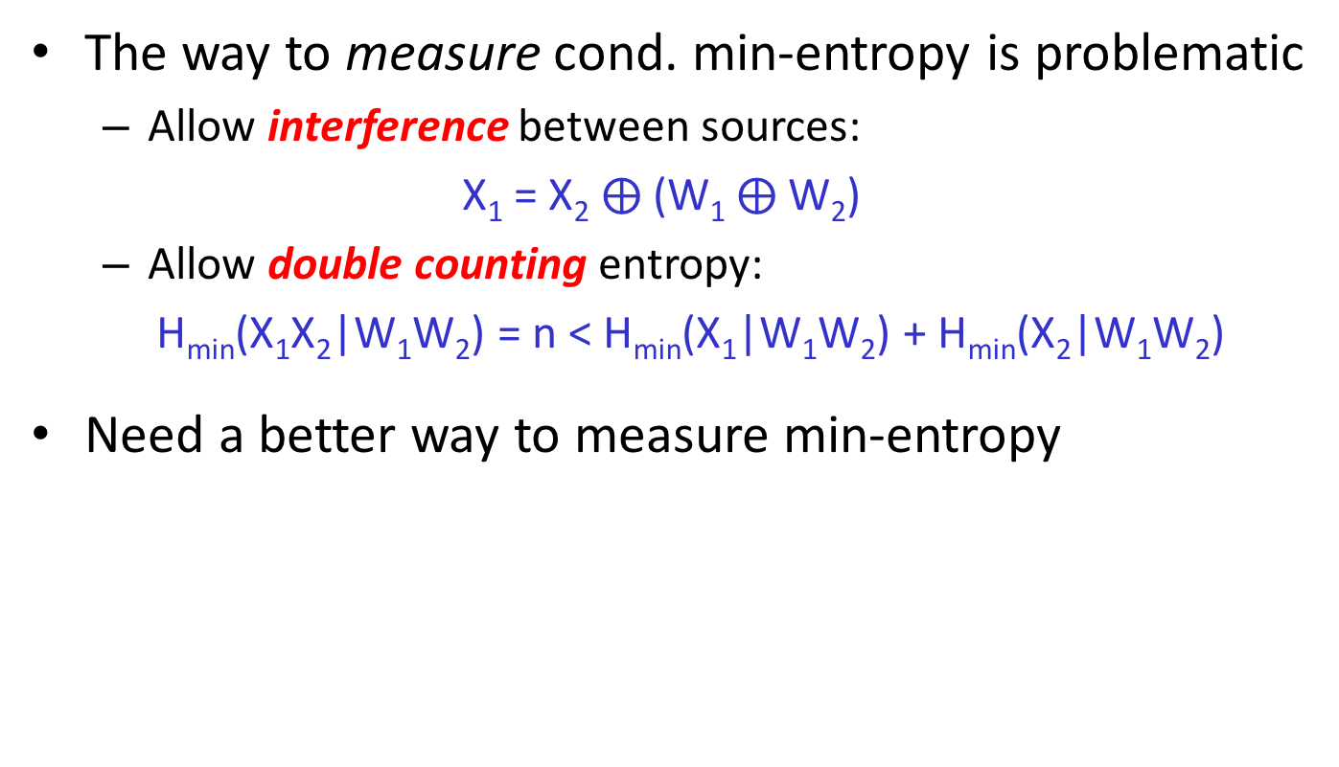


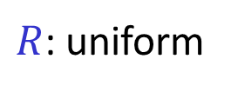
Our Lesson from [KK12]’s Example
The way to measure cond. min-entropy is problematic
  Allow interference between sources:
  X₁ = X₂ $⨁$(W₁ $⨁$W₂)
  Allow double counting entropy:
  H_{min}(X₁X₂|W₁W₂) = n < H_{min}(X₁|W₁W₂) + H_{min}(X₂|W₁W₂)
Need a better way to measure min-entropy
X₁
X₂
adversary
$R$: uniform
$$W_{1}=X_{1}⨁R$$
$$W_{2}=X_{2}⨁R$$
Notes:
Not structure of side info is problematic
But the way to measure entropy is

Slide 23


General Entangled (GE) Model
Allow general entanglement; new way to measure entropy
Measure entropy of X_{i} right after receiving E_{i}
  k_{i} = H_{min}(X_{i}|E_{i}A_{-i})$ρ$
No interference: entropy of X_{-i} don’t go to X_{i}
$$…$$
X₁
X₂
X_{t}
E₁
A₂
E₂
E_{t}
A₁
A_{t}
adversary
A₁
A_{t}
Notes:
Speak of the side information generation procedure again!
Mention that X1,…,Xt are initially independent
Say that no structural restriction, only change the way to measure entropy
Justify the one-round generative model:
One round is necessary: interaction impose interference, and allow Adv to learn Ext(X)
If side info come from generation of sources, and sources gen. around the same time, then one-round is reasonable
Independence is very crucial, it’s hard to go beyond, which we do!

Slide 24
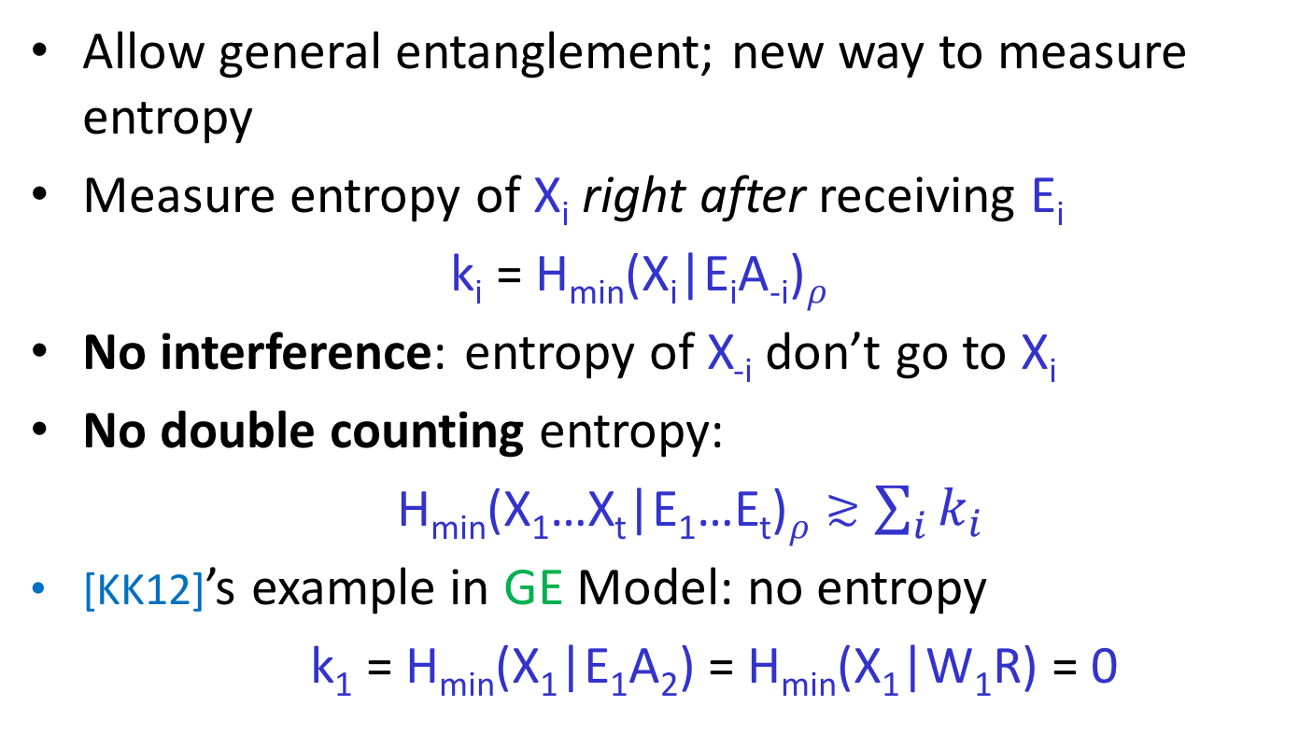
General Entangled (GE) Model
Allow general entanglement; new way to measure entropy
Measure entropy of X_{i} right after receiving E_{i}
  k_{i} = H_{min}(X_{i}|E_{i}A_{-i})$ρ$
No interference: entropy of X_{-i} don’t go to X_{i}
No double counting entropy:
H_{min}(X₁…X_{t}|E₁…E_{t})$ρ≳$ $\sum_{i}{k_{i}}$
[KK12]’s example in GE Model: no entropy
k₁ = H_{min}(X₁|E₁A₂) = H_{min}(X₁|W₁R) = 0
Notes:
So fail of extraction is valid

Slide 25
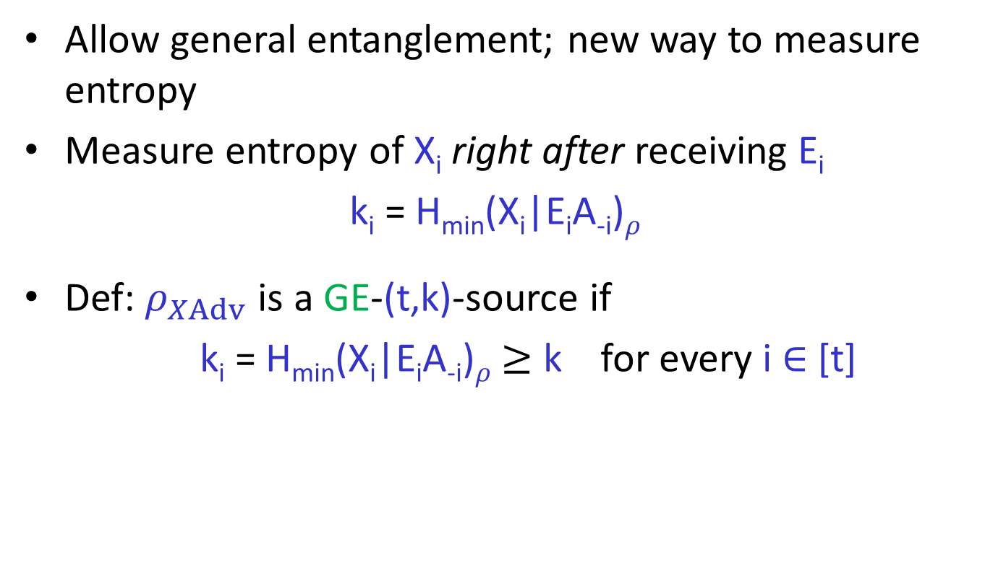
General Entangled (GE) Model
Allow general entanglement; new way to measure entropy
Measure entropy of X_{i} right after receiving E_{i}
  k_{i} = H_{min}(X_{i}|E_{i}A_{-i})$ρ$
Def: $ρ_{XAdv}$ is a GE-(t,k)-source if
k_{i} = H_{min}(X_{i}|E_{i}A_{-i})$ρ$ $≥$ k for every i $∈$ [t]
Notes:
Mention introduce notation, X for all X_i, Adv for the side info

Slide 26
GE vs. IA vs. BS
IA & BS are restriction of GE
  IA = GE with independent A_{i}’s
  BS = GE with bounded size E_{i}’s
  Entropy in GE = entropy in IA
We show GE-sources are extractable
  even non-trivial for classical side info!
Notes:
Claim unclear how to cond., pause for ppl to think

Slide 27
Plan of Talk
Modelling of (Quantum) Side Information
Multi-source Extractors
- based on joint work w/ Chung, Li
Network Extractors
- based on joint work w/ Chung, Li
Single-source Extractors
- based on joint work w/ Chung
Summary & Perspectives

Slide 28

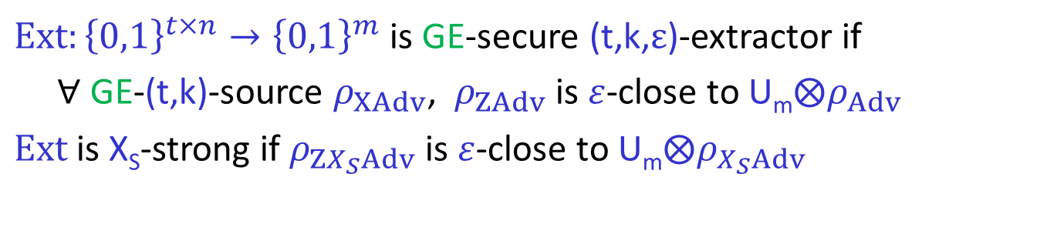
GE-secure Multi-source Extractors
$Ext:{\left\{0,1\right\}}^{t×n}→{\left\{0,1\right\}}^{m}$ is GE-secure (t,k,$ε$)-extractor if
$∀$ GE-(t,k)-source $ρ_{XAdv}$, $ρ_{ZAdv}$ is $ε$-close to U_{m}$⨂ρ_{Adv}$
$Ext$is X_{S}-strong if $ρ_{ZX_{S}Adv}$ is $ε$-close to U_{m}$⨂ρ_{X_{S}Adv}$
Multi-source Extractor
source
$$…$$
source
X₁
X_{t}
adversary
$$Ext$$
$$Adv$$
$≈$uniform output
Z

Slide 29

One-sided Adversary (OA) Model
Only get side info from a single source
  at adversary’s choice (without seeing the sources)
Weaker than IA & GE
OA-sources & OA-secure extractors defined similarly
$$…$$
$$…$$
X₁
X_{i}
X_{t}
A_{i}
E_{i}
adversary
Notes:
Say anything more?

Slide 30

Strong OA-GE Security Equivalence
Thm: For any S $⊂$ [t] with |S|=t-1,
if Ext is X_{S}-strong OA-secure (t,k,$ε$)-extractor,
$⟹$ Ext is X_{S}-strong GE-secure (t,k,$ε$)-extractor.
IA
classical
side-info
M
OA
GE
no side-info
BS
strong ext.
Notes:
Say slowly, main observation is that for strong extractors, OA and GE security are equivalent!!
Perhaps surprise, powerful consequence
Very simple to proof!!!

Slide 31


Strong OA-GE Security Equivalence
Thm: Let S $=$ [t-1],
if Ext is X_{S}-strong OA-secure (t,k,$ε$)-extractor,
$⟹$ Ext is X_{S}-strong GE-secure (t,k,$ε$)-extractor.
S
$$…$$
X₁
X₂
X_{t}
E₁
A₂
E₂
E_{t}
A₁
A_{t}
adversary
Leaking on X_{S}
Apply Ext
A₂
A₁
Notes:
Intuitioin

Slide 32
Proof: simulation b/c
Leaking on X_{S}
COMMUTE
(strong)
Apply OA Ext
Leaking on X_{t}, Leaking on X_{S}, Apply Ext
=
Leaking on X_{t}, Apply Ext , Leaking on X_{S}
Apply OA security
w/ sufficient entropy

Slide 33
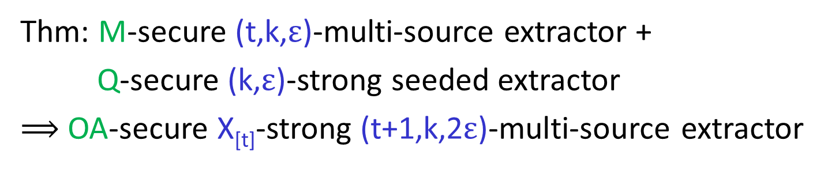



Obtain Strong OA-security (I):
+1 source
Thm: M-secure (t,k,$ε$)-multi-source extractor +
Q-secure (k,$ε$)-strong seeded extractor
$⟹$ OA-secure X_{[t]}-strong (t+1,k,2$ε$)-multi-source extractor
$$…$$
X₁
X_{t}
X_{t+1}
$$MExt$$
$$QExt$$
Y
Z
LIFT: marginal uniform + seeded quantum extractor
-> quantum-proof uniform
Notes:
Add MExt, marginal security, can lift its security by using a quantum-proof seeded extractor, with an independent seed.

Slide 34
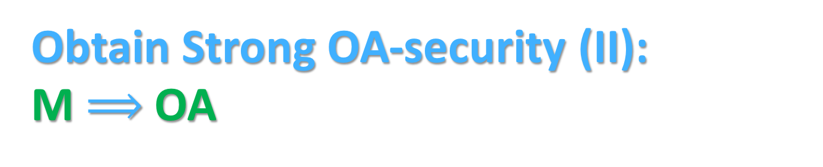
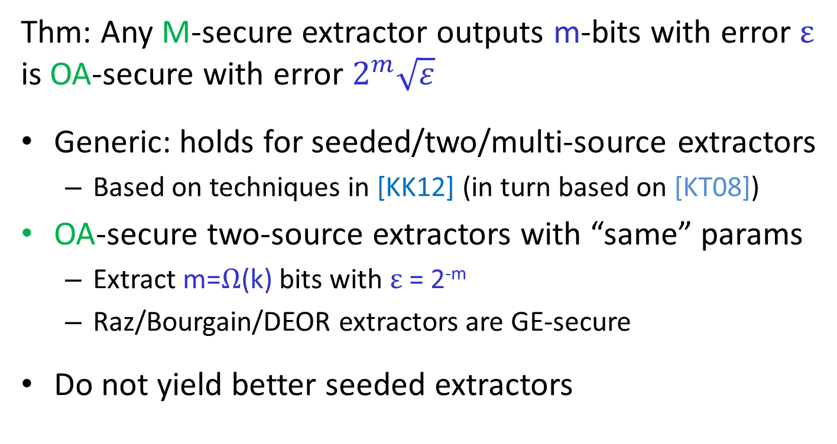
Obtain Strong OA-security (II):
M $⟹$ OA
Thm: Any M-secure extractor outputs m-bits with error $ε$ is OA-secure with error $2^{m}\sqrt{ε}$
Generic: holds for seeded/two/multi-source extractors
  Based on techniques in [KK12] (in turn based on [KT08])
OA-secure two-source extractors with “same” params
  Extract m=$Ω$(k) bits with $ε$ = 2^{-m}
  Raz/Bourgain/DEOR extractors are GE-secure
Do not yield better seeded extractors
Notes:
What points xiaodi wanna make?

Slide 35
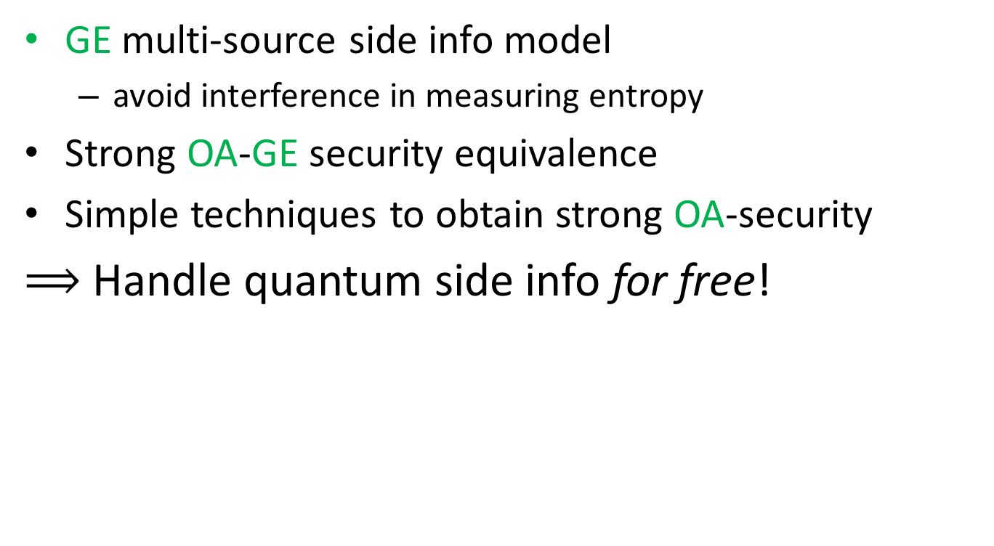
Summary
GE multi-source side info model
  avoid interference in measuring entropy
Strong OA-GE security equivalence
Simple techniques to obtain strong OA-security
$⟹$ Handle quantum side info for free!
IA
M
OA
GE
BS
strong ext.

Slide 36
Plan of Talk
Modelling of (Quantum) Side Information
Multi-source Extractors
- based on joint work w/ Chung, Li
Network Extractors
- based on joint work w/ Chung, Li
Single-source Extractors
- based on joint work w/ Chung
Summary & Perspectives

Slide 37
Network Extractors [KLRZ08]—
Crypto with Imperfect Randomness
Most crypto tasks impossible using weak source [DOPS04]
Network extractor: rand. extraction in distributed setting
  Parties hold private (indep.) weak source; may be malicious
  Goal: private uniform output for honest parties
Notes:
Emphasize importance of perfect randomness in crypto

Slide 38

Network Extractors: settings & adversaries [KLRZ08]
t players, each P_{i} hold a private indep. k source X_{i}
  Up to s players are faulty, controlled by Adv_{Net}
Synchronized, full-info model
  Adv_{Net} sees all communication
  Rushing: honest players’ message published first at each round, then Adv_{Net} decides faculty players’ message
Goal: private uniform Z_{i} for (as many) honest P_{i}
  Z_{i} close to uniform given transcript T
  and other players’ output Z_{-i}
Notes:
Change a lot from here!!!

Slide 39


Network Extractors against side info
GE side info E=(E₁,…,E_{t}) collected by Adv_{SI}
  $ρ_{XAdv}$ forms a GE-(t,k) sources
  Require Z_{i} close to uniform given T, Z_{-i}, and E
Quantum rushing (QR): a new phenomena
  Adv_{Net} uses E (Adv_{SI}) in rushing attack
  Challenging to deal with
Classical rushing (CR): Adv_{Net} not use E
Desiderata
  Tolerate more faulty players (large s)
  Scarify fewer honest players (large g)
  Handle lower entropy (small k)
  Extract all entropy (large m $≈$ k)
Adv_{SI}
E
Notes:
High light two adversaries. + Considerate + first state the case where they don’t collaborate, list results, say not so interesting to the audience, though a complicated undertaking, make use of a lot classical tools.

Slide 40
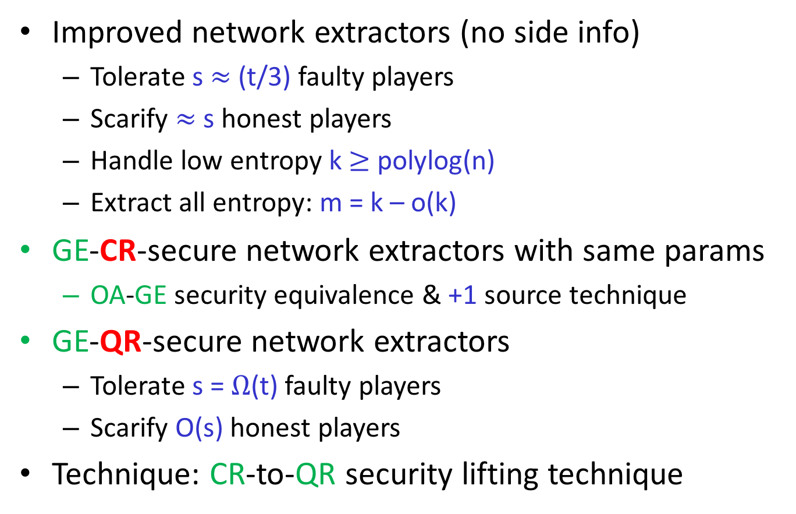
Our Results
Improved network extractors (no side info)
  Tolerate s $≈$ (t/3) faulty players
  Scarify $≈$ s honest players
  Handle low entropy k $≥$ polylog(n)
  Extract all entropy: m = k – o(k)
GE-CR-secure network extractors with same params
  OA-GE security equivalence & +1 source technique
GE-QR-secure network extractors
  Tolerate s = $Ω$(t) faulty players
  Scarify O(s) honest players
Technique: CR-to-QR security lifting technique
Notes:
Parameters of KLRZ???

Slide 41
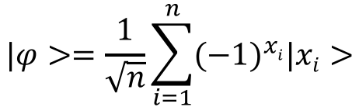

Quantum Rushing: a toy example
Inspired by Hidden Matching Problem [GKKRW]
$$|φ>=\frac{1}{\sqrt{n}}\sum_{i=1}^{n}{{(−1)}^{xi}|xi>}$$
$$M=\{\left(i1,j1\right),\left(i2,j2\right),…\}$$
Can generate (i, j), x_{i} XOR x_{j} correlation!
Adv_{Net} secretly steers the protocol to (i, j)
OA-GE security equivalence break down
  Don’t commute. Cannot defer the collection of side info
Create correlation from quantum rushing
  Known sol’n: create public “seed” Y to extract private X_{i}
  QR creates correlation between Y & X_{i}
Notes:
Explain what is quantum rushing! Have the power to do both!
Explain the potential threat!
Say reason is general but consider known protocol for concreteness
Say that we need to carefully design protocol to restrict “rushing length”

Slide 42
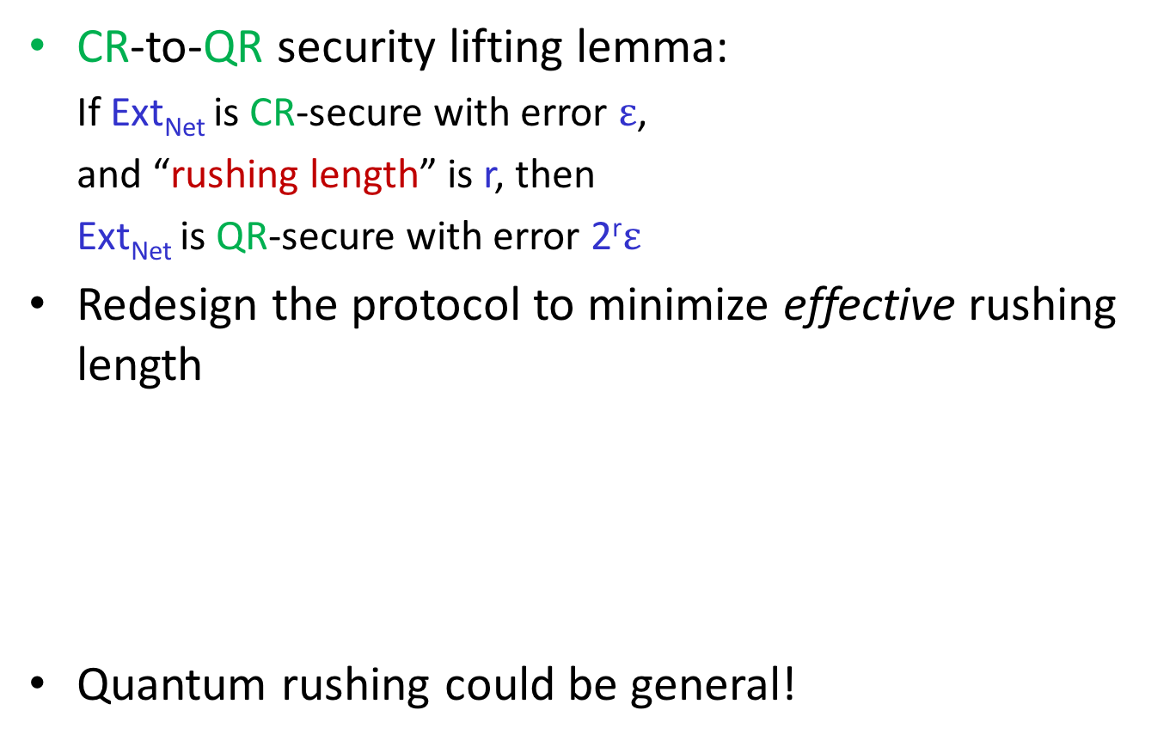
Quantum Rushing : a solution
CR-to-QR security lifting lemma:
If Ext_{Net} is CR-secure with error $ε$,
and “rushing length” is r, then
Ext_{Net} is QR-secure with error 2^{r}$ε$
Redesign the protocol to minimize effective rushing length
Quantum rushing could be general!
Don’t let Adv_{Net} touch q. side info.
Post-select as if Adv_{Net} rushes depending on q. side info
rushing
rush
At the cost of scarifying
more honest players
Notes:
Explain what is quantum rushing!
Explain the potential threat!
Say reason is general but consider known protocol for concreteness
Say that we need to carefully design protocol to restrict “rushing length”

Slide 43
Plan of Talk
Modelling of (Quantum) Side Information
Multi-source Extractors
- based on joint work w/ Chung, Li
Network Extractors
- based on joint work w/ Chung, Li
Single-source Extractors
- based on joint work w/ Chung
Summary & Perspectives

Slide 44
Seeded Extractors against Side Info [R05,KMR05,KT08,DV10,T11,DPVR11]
$Ext:{\left\{0,1\right\}}^{n}×{\left\{0,1\right\}}^{d}→{\left\{0,1\right\}}^{m}$ is quantum-secure (k, $ε$)-extractor if
$∀$ k-source $ρ_{XE}$, $ρ_{ZE}$ is $ε$-close to U_{m}$⨂ρ_{E}$
$Ext$ is quantum-secure (k, $ε$)-strong extractor if
$∀$ k-source $ρ_{XE}$, $ρ_{ZUdE}$ is $ε$-close to U_{m}$⨂\text{U}\text{d}⨂ρ_{E}$
classical-secure
marginal-secure
for no side-info
for classical side-info
classical-secure
marginal-secure
Seeded Randomness Extractor
source
seed
X
U_{d}
adversary
$$Ext$$
$$E$$
$≈$uniform output
Z

Slide 45
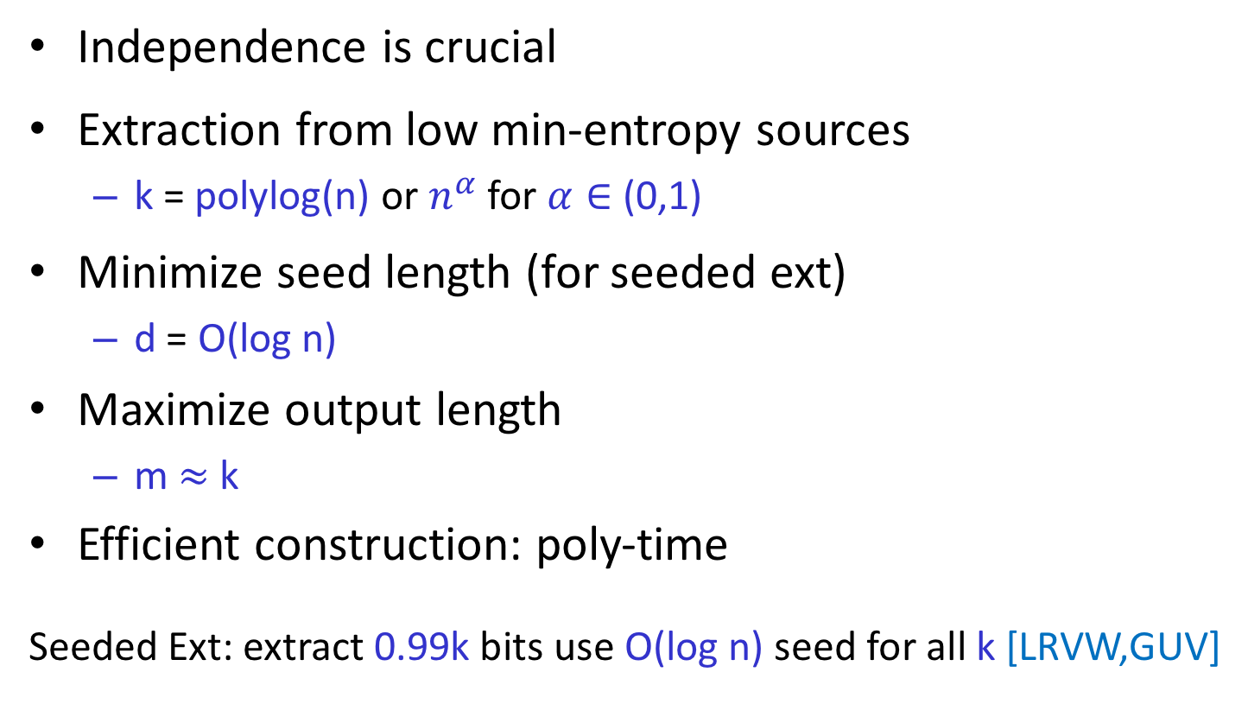
What do we want?
Independence is crucial
Extraction from low min-entropy sources
  k = polylog(n) or $n^{α}$ for $α∈$ (0,1)
Minimize seed length (for seeded ext)
  d = O(log n)
Maximize output length
  m $≈$ k
Efficient construction: poly-time
Seeded Ext: extract 0.99k bits use O(log n) seed for all k [LRVW,GUV]
Notes:
Defer to the seeded extractor section!!!

Slide 46
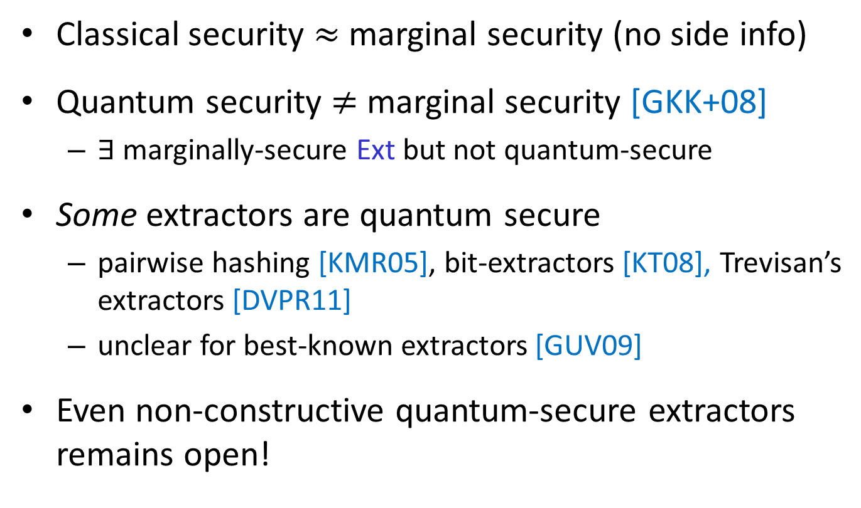
No vs. Classical vs. Quantum Side Info
Classical security $≈$ marginal security (no side info)
Quantum security $≠$ marginal security [GKK+08]
  $∃$ marginally-secure Ext but not quantum-secure
Some extractors are quantum secure
  pairwise hashing [KMR05], bit-extractors [KT08], Trevisan’s extractors [DVPR11]
  unclear for best-known extractors [GUV09]
Even non-constructive quantum-secure extractors remains open!
Notes:
What is the status of classical

Slide 47
Difficulties w/ Q Side Info
No “conditioning”; carry q side info in analysis
Probabilistic arg. fails b/c large dim of q. side info
Existing Techs:
  1 bit-extractors (Pretty Good Measurement) [KT08] Trevisan’s extractor (reduction to 1-bit) [DVPR11]
  pairwise hashing (dis-to-uniform, lose dim) [KMR05]
GUV requires: condenser w/ high min-entropy output. Extend to q. (smooth) min-entropy?
How to bound q. (smooth) min-entropy generated by classical operations? e.g. [VV12], need more!
Notes:
What is the status of classical

Slide 48
Our strategy & results
Resort to extractors [NZ,SZ, Zuc] before Trevisian, based on sampling & block-extraction.
What’s better: improve these extractors & extend the improved ones to the quantum setting.
Results:
Main Thm: there exists an efficient quantum-secure extractor
Ext : {0,1}^{n} x {0,1}^{d} -> {0,1}^{m}, s.t., for any (n,k) source, k=nª for
const 0<a<1, with seed length O(log(n/eps)), output length m=
k^{0.99} , error eps optimal up to const
Remark: inverse-poly rate sources are good for most applications!
Notes:
What is the status of classical

Slide 49



Sampling & Block-extraction [NZ,SZ,Zuc]
Sampling:
distribute entropy
Keep entropy rate
Block-extraction:
Recursively
Apply!
Tune Parameters: 1) able to sample
2) able to extract
=> optimal paras for const entropy-rate sources
Notes:
Why need two steps: because sampling cannot improve the entropy rate.

Slide 50
Contribution: a win-win argument (key step)
(n,k)
Sampling ( if success -> extraction, otherwise condensing)
E₁
Sample again on a shorter input
E₂
……
E₃
const Rounds
(C0, E1,E2,…) -> const rate source
……
C₀ length k
Quantum: 1) sampling [KR] 2) remaining analysis & comp.
Notes:
Either you can continue sampling, or the part already sampled has large entropy ( a condenser, or increase the entropy rate).
We don’t know what happens.

Slide 51
Plan of Talk
Modelling of (Quantum) Side Information
Multi-source Extractors
- based on joint work w/ Chung, Li
Network Extractors
- based on joint work w/ Chung, Li
Single-source Extractors
- based on joint work w/ Chung
Summary & Perspectives

Slide 52
Results
 | Extractor | Classical Security | Quantum Security
 | deterministic function | side information cond.min-entropy | Optimal cons. for most apps
 | deterministic function | Proposal for (q.) side info model Cons. w/ matching parameters
 | network protocol | best-known construction | First cons. w/ q. security
DI- or physical randomness extractor | protocol w/ untrusted devices | N/A | Chung, Shi, W
Notes:
New models of multi-source side info
Subsume and unify previous models
New techniques to deal with it
New multi-source/network extractors against classical/quantum side info
same parameters as best-known constructions*
handle multi-source side info for free!

Slide 53
Crypto against Quantum Side Info
Post-quantum crypto focus on adversary with quantum computation power
Power of quantum side info receives little attention
Widely open directions
  Privacy amplification with active adversary
  Leakage-resilient crypto with quantum side info
  …
Notes:
Growing attention on post-quantum crypto focus on adversary with quantum computation power
We do first step
Many more direction

Slide 54
Thanks!
Questions?

Slide 55
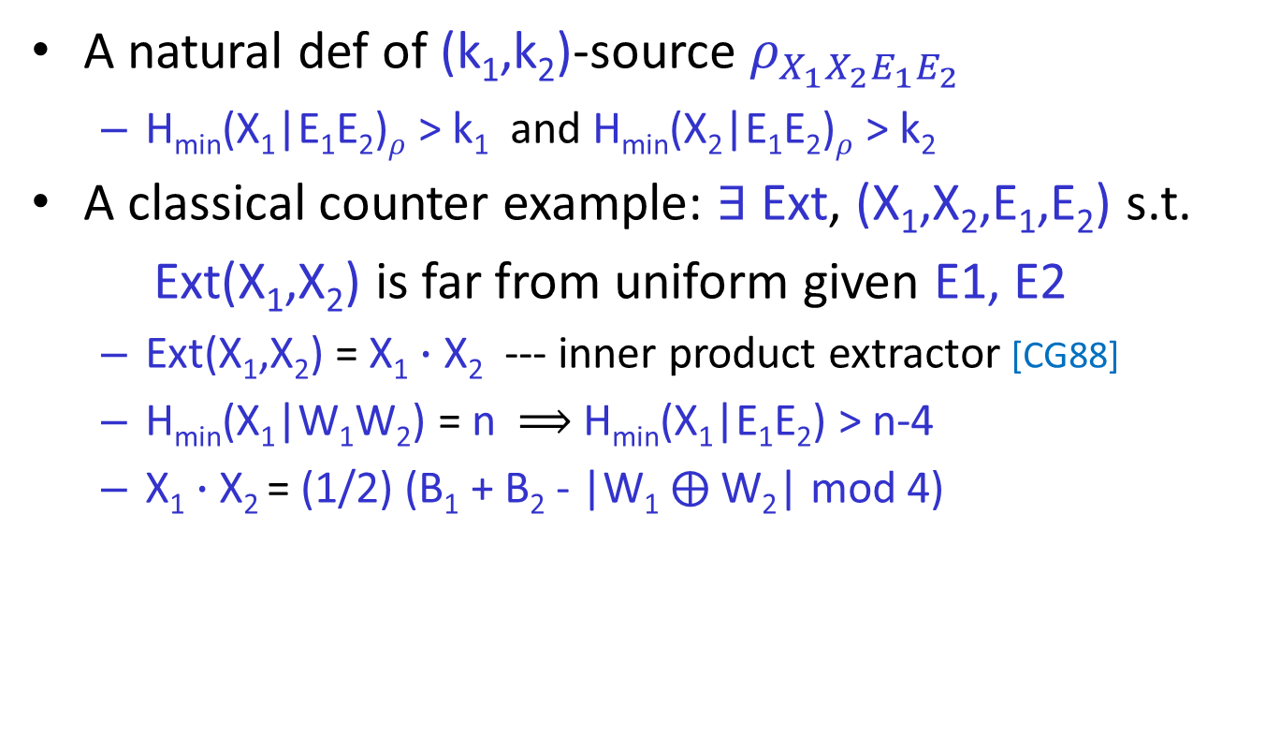
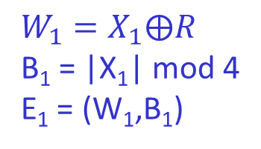
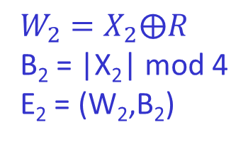


Entropy measure: problematic [KK12]
A natural def of (k₁,k₂)-source $ρ_{X_{1}X_{2}E_{1}E_{2}}$
  H_{min}(X₁|E₁E₂)$ρ$ > k₁ and H_{min}(X₂|E₁E₂)$ρ$ > k₂
A classical counter example: $∃$ Ext, (X₁,X₂,E₁,E₂) s.t.
  Ext(X₁,X₂) is far from uniform given E1, E2
  Ext(X₁,X₂) = X₁ $∙$ X₂ --- inner product extractor [CG88]
  H_{min}(X₁|W₁W₂) = n $⟹$ H_{min}(X₁|E₁E₂) > n-4
  X₁ $∙$ X₂ = (1/2) (B₁ + B₂ - |W₁ $⨁$W₂| mod 4)
X₁
X₂
adversary
$R$: uniform
$$W_{1}=X_{1}⨁R$$
B₁ = |X₁| mod 4
E₁ = (W₁,B₁)
$$W_{2}=X_{2}⨁R$$
B₂ = |X₂| mod 4
E₂ = (W₂,B₂)
$|X|$: Hamming weight
Notes:
Shrink it!!!

Slide 56
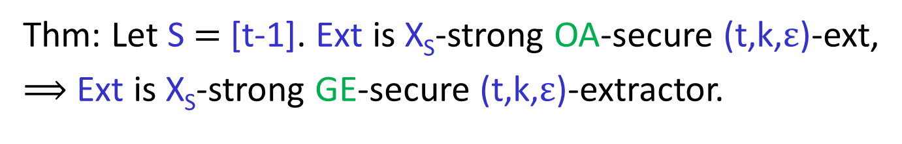
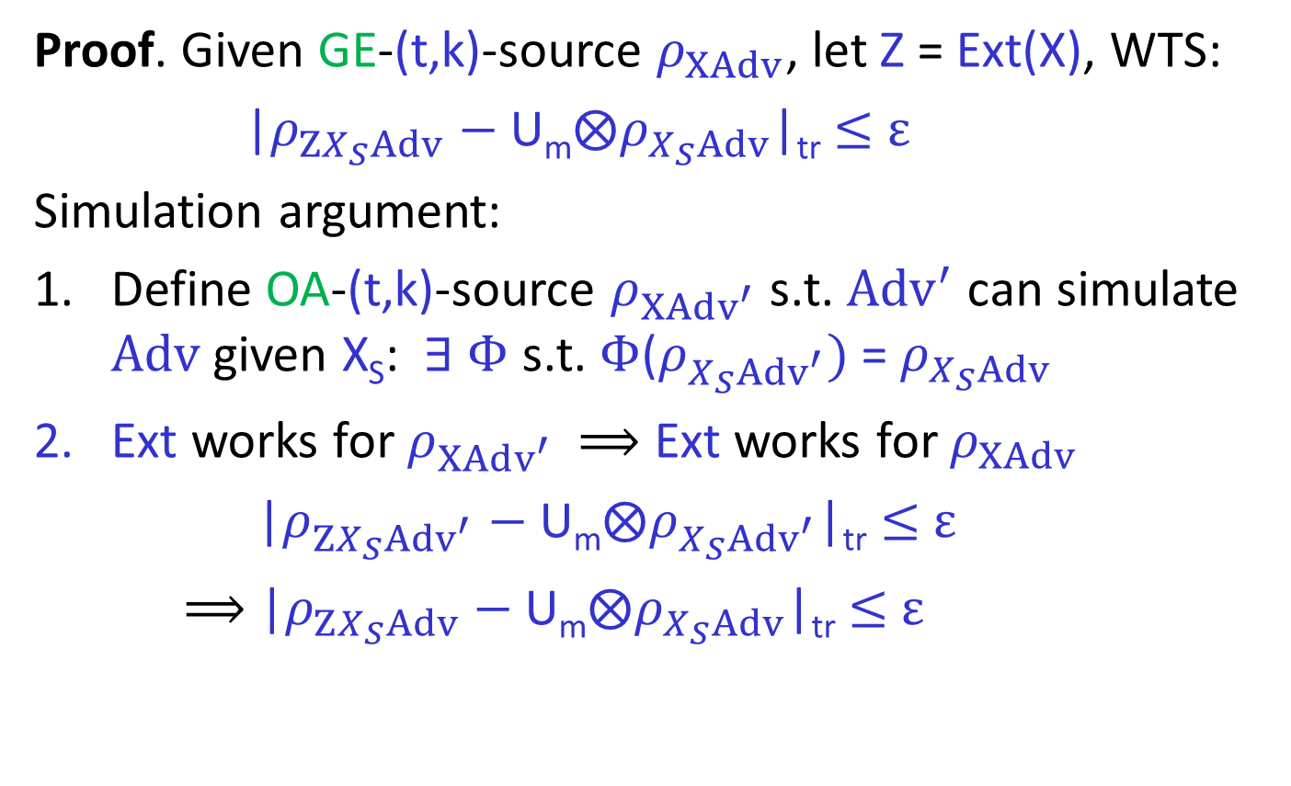
Thm: Let S $=$ [t-1]. Ext is X_{S}-strong OA-secure (t,k,$ε$)-ext,
$⟹$ Ext is X_{S}-strong GE-secure (t,k,$ε$)-extractor.
Proof. Given GE-(t,k)-source $ρ_{XAdv}$, let Z = Ext(X), WTS:
|$ρ_{ZX_{S}Adv}$ $−$ U_{m}$⨂ρ_{X_{S}Adv}$|_{tr} $≤$ $ε$
Simulation argument:
Define OA-(t,k)-source $ρ_{X{Adv}^{′}}$ s.t. ${Adv}^{′}$ can simulate $Adv$ given X_{S}: $∃ Φ$ s.t. $Φ$($ρ_{X_{S}{Adv}^{′}})$ = $ρ_{X_{S}Adv}$
Ext works for $ρ_{X{Adv}^{′}}$ $⟹$ Ext works for $ρ_{XAdv}$
|$ρ_{ZX_{S}{Adv}^{′}}$ $−$ U_{m}$⨂ρ_{X_{S}{Adv}^{′}}$|_{tr} $≤$ $ε$
$⟹$ |$ρ_{ZX_{S}Adv}$ $−$ U_{m}$⨂ρ_{X_{S}Adv}$|_{tr} $≤$ $ε$
Notes:
Goal: |$ρ_{ZX_{S}Adv}$ $−$ U_{m}$⨂ρ_{X_{S}Adv}$|_{tr} $≤$ $ε$

Slide 57
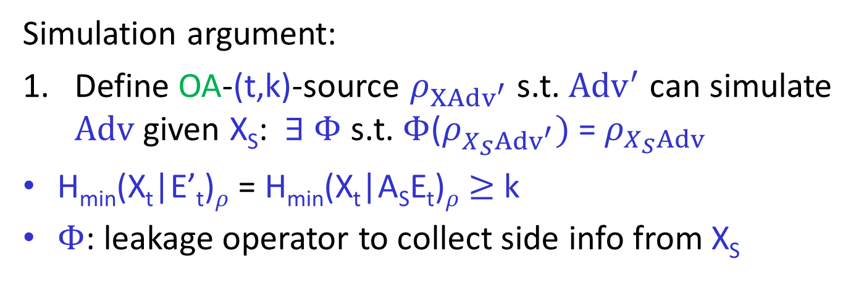
Simulation argument:
Define OA-(t,k)-source $ρ_{X{Adv}^{′}}$ s.t. ${Adv}^{′}$ can simulate $Adv$ given X_{S}: $∃ Φ$ s.t. $Φ$($ρ_{X_{S}{Adv}^{′}})$ = $ρ_{X_{S}Adv}$
H_{min}(X_{t}|E’_{t})$ρ$ = H_{min}(X_{t}|A_{S}E_{t})$ρ$ $≥$ k
$Φ$: leakage operator to collect side info from X_{S}
$$…$$
X₁
X₂
X_{t}
E’_{t} = (A_{S}, E_{t})
A’_{t} = (A₁,…,A_{t})
adversary
Notes:
Goal: |$ρ_{ZX_{S}Adv}$ $−$ U_{m}$⨂ρ_{X_{S}Adv}$|_{tr} $≤$ $ε$

Slide 58
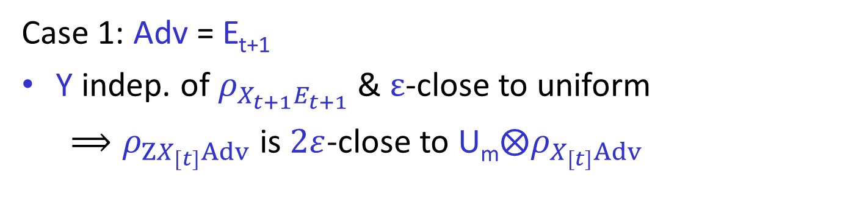
Obtain Strong OA-security (II):
+1 source
Case 1: Adv = E_{t+1}
Y indep. of $ρ_{X_{t+1}E_{t+1}}$ & $ε$-close to uniform
$⟹ρ_{ZX_{[t]}Adv}$ is $2ε$-close to U_{m}$⨂ρ_{X_{[t]}Adv}$
$$…$$
X₁
X_{t}
X_{t+1}
adversary
$$MExt$$
$$QExt$$
Y
E_{t+1}
Z
Notes:
What points xiaodi wanna make?

Slide 59
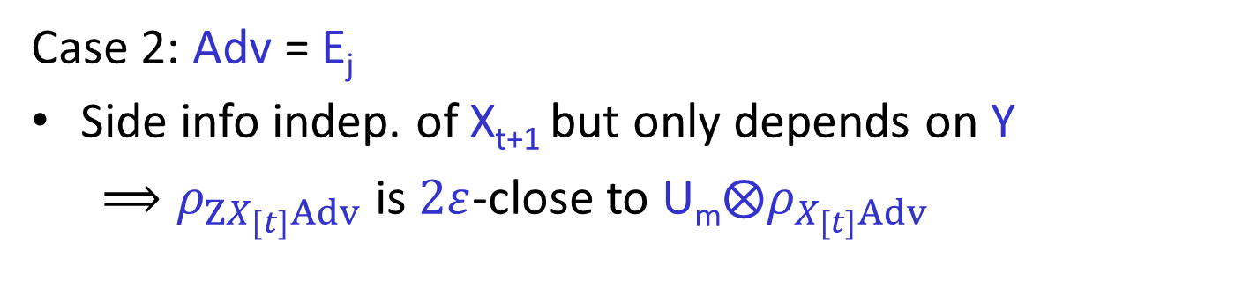
Obtain Strong OA-security (II):
+1 source
Case 2: Adv = E_{j}
Side info indep. of X_{t+1} but only depends on Y
$⟹ρ_{ZX_{[t]}Adv}$ is $2ε$-close to U_{m}$⨂ρ_{X_{[t]}Adv}$
$$…$$
X₁
X_{t}
X_{t+1}
$$MExt$$
$$QExt$$
Y
adversary
Z
E_{j}
Notes:
What do we want to say here?

Slide 60
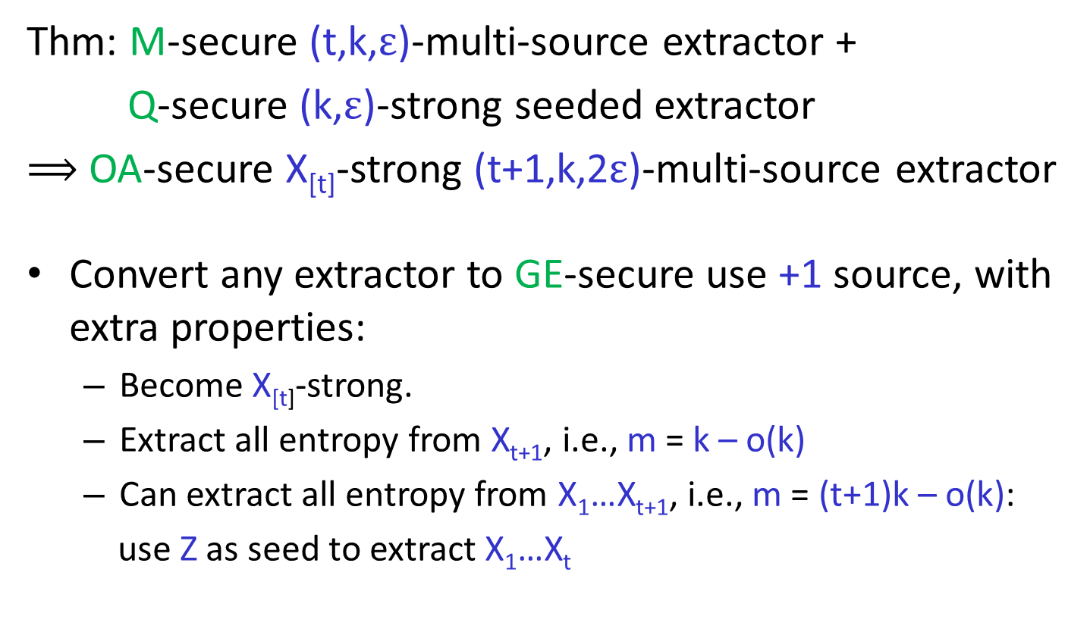
Obtain Strong OA-security (II):
+1 source
Thm: M-secure (t,k,$ε$)-multi-source extractor +
Q-secure (k,$ε$)-strong seeded extractor
$⟹$ OA-secure X_{[t]}-strong (t+1,k,2$ε$)-multi-source extractor
Convert any extractor to GE-secure use +1 source, with extra properties:
  Become X_{[t]}-strong.
  Extract all entropy from X_{t+1}, i.e., m = k – o(k)
  Can extract all entropy from X₁…X_{t+1}, i.e., m = (t+1)k – o(k):
  use Z as seed to extract X₁…X_{t}
Notes:
What points xiaodi wanna make?

