Slide 1


Equilibrium Value Method for Optimization Problems
w/ Applications in Quantum Computation
Xiaodi Wu
University of Michigan, Ann Arbor
IQI Seminar, April 16th, 2013

Slide 2
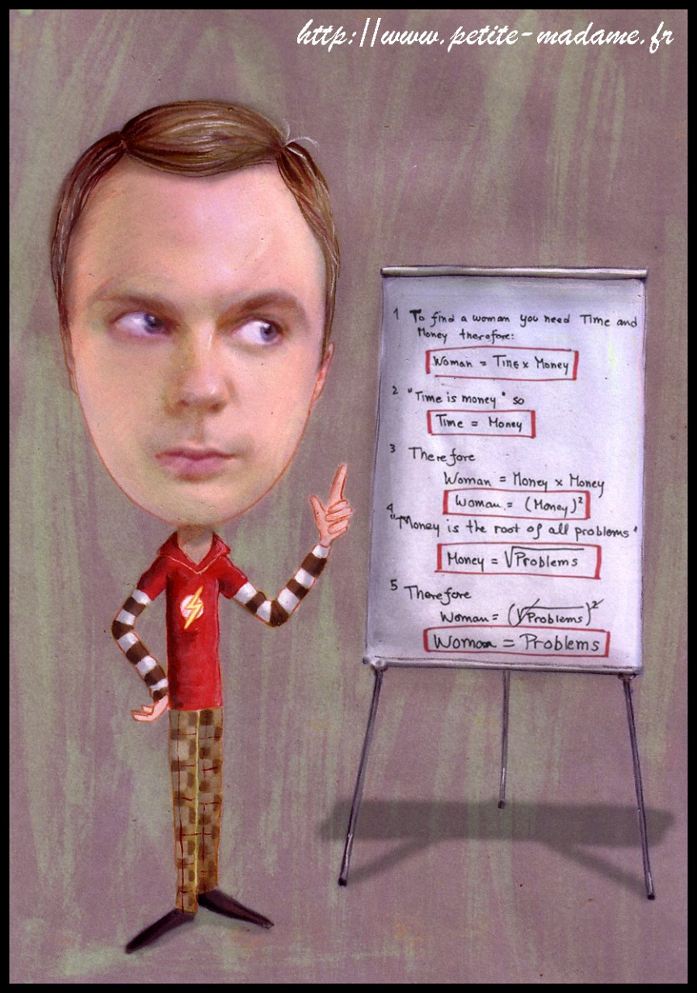

FUN with Optimizations
Optimization problems
are everywhere,
the issue is
whether you could
handle them?

Slide 3


Let us focus on those Semidefinite Programs (SDP) that arise naturally in quantum information and computation!
Semidefinite Programming? ……
Don’t they admit Polynomial Time Algorithms?
Yes. But they aren’t sufficient for many purposes !! “Equilibrium Value Method” can remedy some cases!
It allows parallelizable solutions and has cool applications to
quantum computational complexity , and …..
AND?
I will talk about its limitations too!

Slide 4
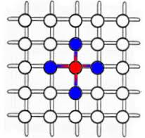
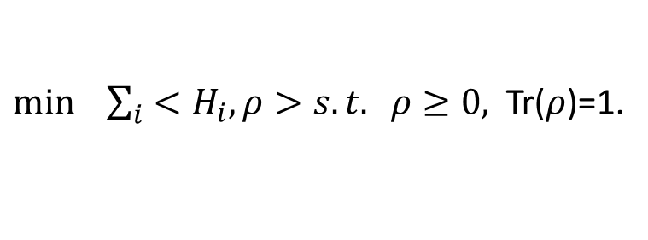
Semidefinite Programming (informal):
optimize linear functions
over semidefinte operators with semidefinite constraints!
Nature performs optimizations all the time!
e.g. what is the ground state of a given Hamiltonian?
$\min{ \sum_{i}{<H_{i},ρ>s.t. ρ≥0,}}$ Tr($ρ$)=1.
linear
operators
constraints
To simulate nature,
we need to solve the optimization problem.
For quantum information tasks, we need to optimize too!!
e.g., what is the best POVM to distinguish among an ensemble of quantum states?
can be formulated as a SDP with POVMs as operators and tricky constraints!

Slide 5


Quantum Computational Complexity ---- Optimization !!!
Boolean Assignment
Quantum State
3-SAT instance
QMA
To simulate QMA by a classical complexity class, it suffices to find the best quantum
state that passes the verifier’s test (POVM). i.e., solve a SDP.
Could be much involved!! See later~
Good News: SDPs admit polynomial time algorithms, e.g., interior point method!!
Well, not so good!

Slide 6


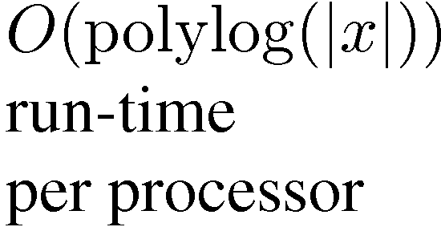
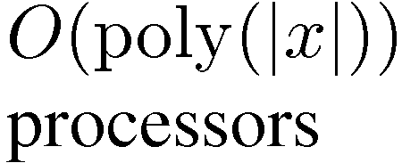
Why?
Time efficiency:
Polynomial time already??
Yes! But it costs too much extra time for special instances as it is designed for generic problems. Not the focus of this talk, though~
Space efficiency:
Stronger notion of efficiency!
Not guaranteed by polynomial time solvers!
Might not be possible in general (implying P=NC) .
Known to be equivalent to parallel efficiency [Bord77].
Solve SDPs on
Parallel Machines
x
PSPACE
Upper bounds
accept,
reject

Slide 7

Why?
Implicit or Explicit:
Being explicit allows easier adaption for special instances!
Being explicit provides more intuitions about where the solution should be!
Unfortunately, known polynomial time solvers are implicit or less explicit.
Main result in this talk!
“Equilibrium Value Method“ for SDPs
that is explicit and space/time efficient for many cases!
How does it work?

Slide 8
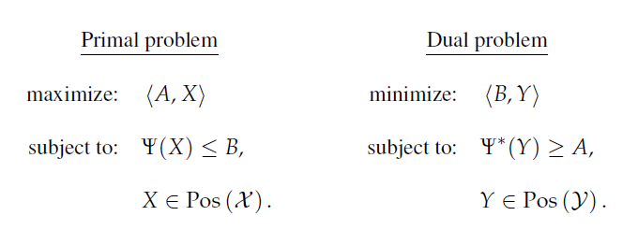
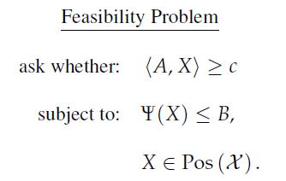
Semi-definite Programming revisit
for some Hermitian A and B and a Hermiticity-preserving super-operator $Ψ$.
Suffice to consider the feasibility problem ,

Slide 9
Solve SDPs as a zero-sum game
(Alice)
(Bob)
Try to provide a
satisfactory X.
Try to find which
constraint X violates.
(projection onto subspaces)
Alice and Bob are competing, zero-sum game!
If there exists a X for Alice, s.t. Bob cannot find any constraint it violates,
then the original problem is feasible!
If for any X for Alice, s.t. Bob can find some constraint it violates,
then the original problem is infeasible!
Or more formally,
the equilibrium value of this zero-sum game determines the feasibility!

Slide 10
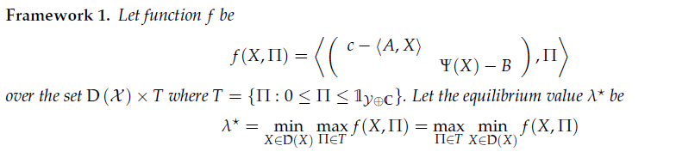

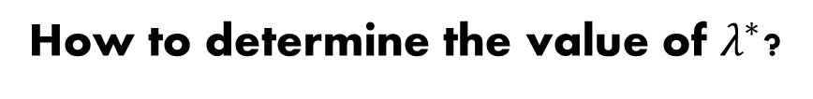
Solve SDPs as a zero-sum game: Mathematical Treatment
(Alice)
(Bob)
“the equilibrium value of this zero-sum game determines the feasibility!”
How to determine the value of $λ^{∗}$?

Slide 11
Finding the equilibrium point/value:
equilibrium point
Potential Problem:
Get into a cycle
A simple approach that does not work!
Multiplicative Weight Update Method:
an approach to break the cycle!
…
T rounds!
Roughly, each round Alice chooses the best
strategy against all known Bob’s strategy
plus some regularization function!
beats
Matrix MWU method:
Good when Alice’s strategy is a density operator
average -> solution
Good dependence of T on errors and dimensions
Bob’s response, optimize on
easy to compute by spectral decomposition!
Sounds Good !

Slide 12

Under Technical Constraints:
the algorithm solves the $λ^{∗}$ and thus the original SDP !
At the same time,
EXPLICIT: BETTER!! with a underlying game story!
SPACE EFFICIENT:
1) Each step is a fundamental matrix operation, incl. MWU and Bob’s Response!
2) These matrix operations admit efficient parallel solutions!
3) These efficient parallel solutions can be naturally composed!
4) MWU guarantees T is good, s.t., the composition is still parallel efficient!
5) Parallel efficiency = Space efficiency!
But why technical constraints?
We already know this approach might not work in general, as implying P=NC.
The technical reason: we can only calculate $λ^{∗}$ approximately!

Slide 13





The NEED for ROUNDING theorem
The error in approximating $λ^{∗}$ can blow up significantly for the original SDP!!
NEED: (a rounding theorem)
a good approximation of $λ^{∗}$ => a near-optimal solution of the original SDP!
And cannot sacrifice too much on the number of iterations T!
Varies on individual cases!
Demonstration by examples!
Focus on its application in quantum computational complexity!
PSPACE upper bounds!
QIP = PSPACE [JJUW10, Wu10]
DQIP=QRG(2) = PSPACE[GW10]
$$⊆$$
$⊆$
QMA(2)[poly, log] $⊆$ PSPACE [SW11]
QIP(2) $⊆$ PSPACE [JUW09, Wu10]
Surprisingly, the proofs can naturally use the notion of equilibrium values
without resorting to SDPs as an intermediate step!

Slide 14
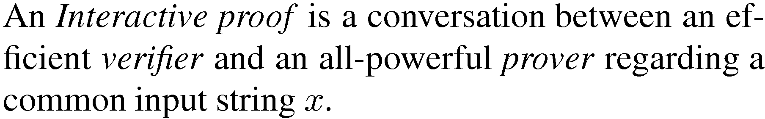


NP with Randomness and Interaction
Quantum Version
Prover
x
accept x,
reject x
x
Verifier

Slide 15
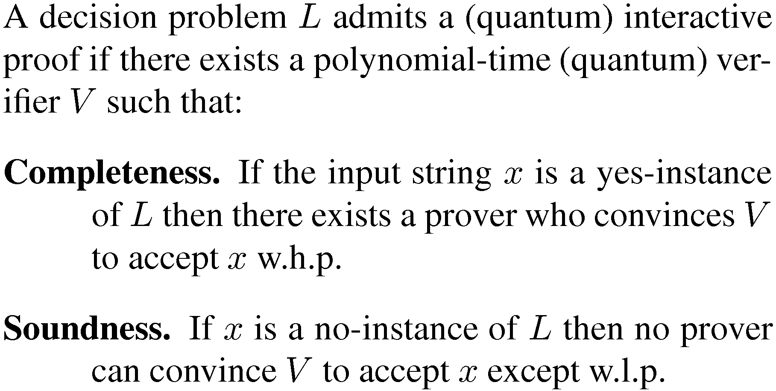
Interactive Proof System

Slide 16
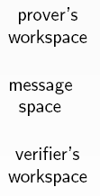
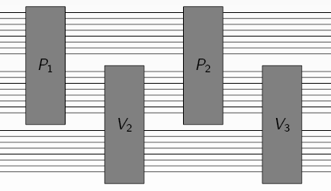
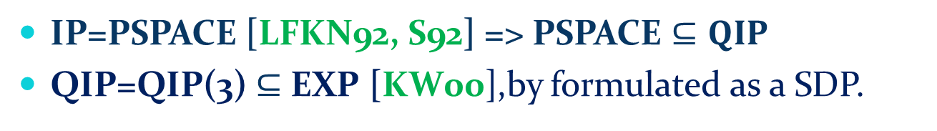
Quantum Interactive Proof
IP=PSPACE [LFKN92, S92] => PSPACE $⊆QIP$
QIP=QIP(3) $⊆$ EXP [KW00],by formulated as a SDP.
all- power
, any quantum circuits
Qubits
1
2
3
efficient quantum circuits

Slide 17
Hard direction:
To show QIP is contained in PSPACE. The trivial direction for IP=PSPACE!
Quantum system poses huge complexity!
a polynomial number of qubits, exponential size matrices even to describe!
Characterizing QIP as SDPs:
Time efficiency: = > EXP
Space efficiency: = > PSPACE
QIP=PSPACE proof by providing space efficient solutions (not by EVM) to
a SDP characterizing QMAM (QMAM=QIP, a simple variant) [JJUW10]
“Equilibrium Value Method“ could help here!
It turns out to even simpler to
directly treat QIP as a zero-sum game!

Slide 18
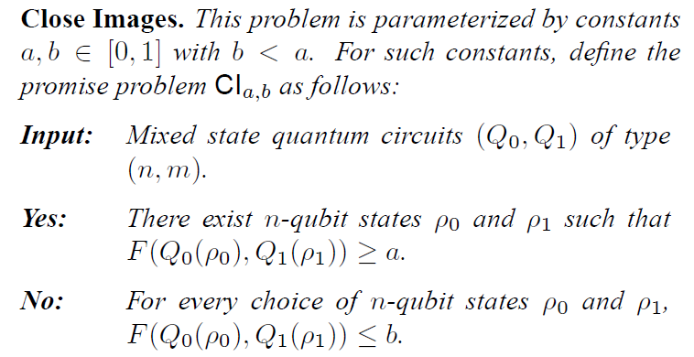

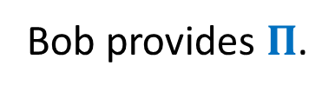
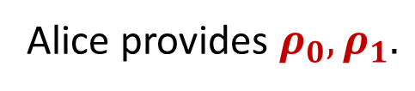
One page proof of QIP=PSPACE
QIP-complete
problem!
Maximize Fidelity
Minimize trace-distance
Note:
$$|σ_{1}−σ_{2}|_{tr}=\max_{0≤Π≤I}{<σ_{1}−σ_{2},Π>}$$
Min-max , equilibrium value
Alice provides $ρ_{0},ρ_{1}.$
Update by the matrix MWU!
Bob provides $Π$.
Obtain by spectral decomposition!
Basic MWU works. No Rounding Needed!

Slide 19
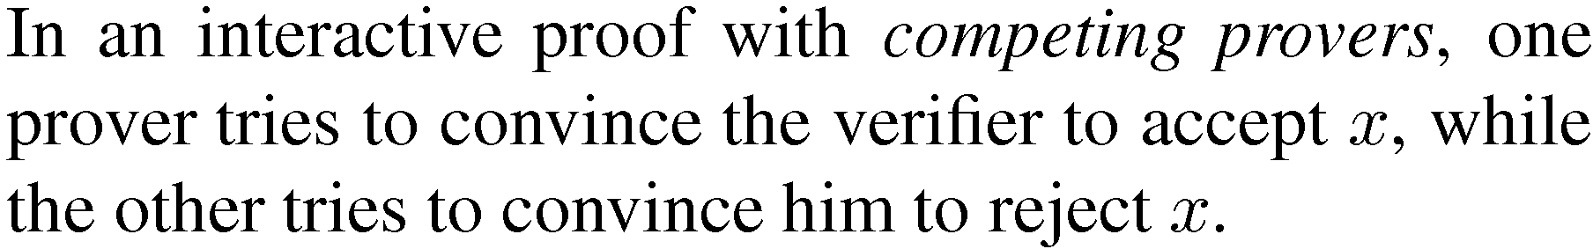
Refereed Games
yes-prover
Quantum Version
x
verifier
accept x,
reject x
x
Two players
x
no-prover

Slide 20
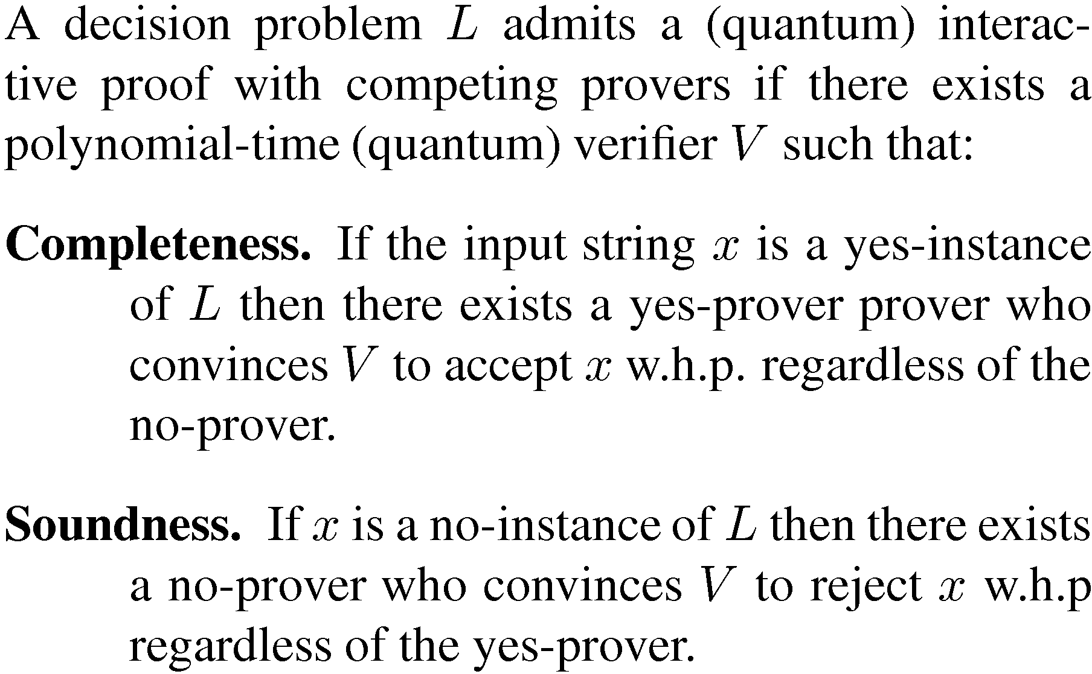
Refereed Games
behavior at equilibrium points

Slide 21
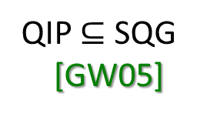
Known Results
quantum result:
QRG=EXP
[GW07]
poly rounds
classical result:
RG(2)=PSPACE
[FK97]
RG=EXP
[KM92, FK97]
Our Results:
Double Quantum Interactive Proof (DQIP)
(interacts with Alice, then Bob)
QIP $⊆$ SQG
[GW05]
DQIP=QRG(2)=PSPACE
Subsume and unify all the previous results.

Slide 22
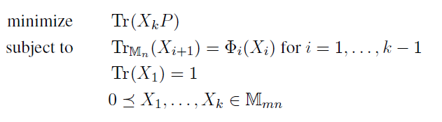
Our Results :
parallel efficient solutions for
Bounded Operator
Admissible quantum operations
Major NEW Proof Difficulties:
Naturally an equilibrium value problem, but Alice’s strategy is no longer
density operator! Cannot directly apply matrix MWU!
Still use MWU on density operators! But with penalties!
2) A good representation of this kind of interaction? And at the same time,
make it easy to obtain a good rounding theorem?
Kitaev’s Transcript Representation!
Inductive Rounding using Bures Metric !

Slide 23
Technical Ingredients
Finding good representations of the strategies
Notes:
Make the final picture and then make the effects

Slide 24
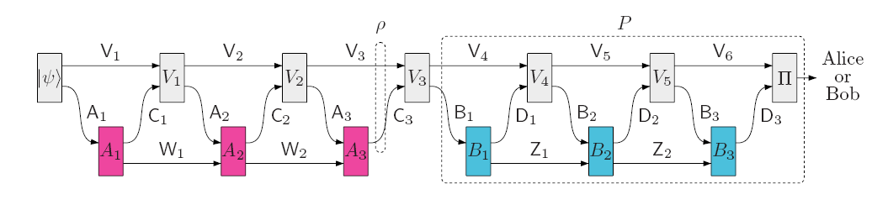
Find good representations
DQIP Circuit
Quantum
operation
qubits
Come from a valid interaction!
strategy
Strategy
inputs=>outputs
density operator
(net-effect of Alice)
POVM measurement
(net-effect of Bob)
Compute:
Min-Max payoff = Max-Min payoff
Notes:
Avoid the use of channel representation!

Slide 25
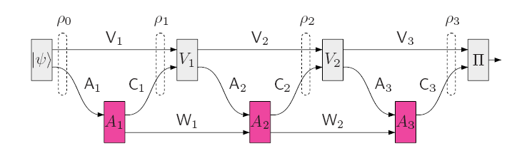
Find good representations
snap-shot of density operators
consistency condition
consistency condition
consistency condition
Transcript Representation [Kitaev03]

Slide 26
Technical Difficulties
Finding good representations of the strategies
Sol: Transcript Represetation
Tailor the “transcript-like” representation into MMW
Sol:
Run many MMWs in parallel
Penalization idea and the Rounding theorem
Notes:
Make the final picture and then make the effects

Slide 27
Penalization idea and Rounding theorem
Fits in the min-max form
Penalty=
trace distance
+
trace distance
+
trace distance
violate
consistency
violate
consistency
violate
consistency
relaxed transcript
valid transcript
Notes:
Make the final picture and then make the effects

Slide 28

Penalization idea and Rounding theorem
Goal: if Alice cheats, then the penalty should be large!
valid
transcript
consistent
consistent
consistent
Bures
metric
Penalty
Advantage
Bures metric
>=
trace distance
$≈$trace distance
+
Bures metric
fidelity trick
invalid
transcript
Notes:
Make the final picture and then make the effects

Slide 29
Technical Difficulties
Finding good representations of the strategies
Sol: Transcript Represetation
Tailor the “transcript-like” representation into MMW
Sol:
Run many MMWs in parallel
Penalization idea and the Rounding theorem
Finding response efficiently in space
Sol:
Call itself as the oracle! Nested!
Notes:
Make the final picture and then make the effects

Slide 30
The universe as we know it
QRG = RG = EXP
QRG(k)
SQG
RG(k)
QRG(2)
QIP
IP = PSPACE = RG(2)
QRG(1)
QIP(2)
RG(1)
QMA
AM
MA
NP

Slide 31
The universe as we know it
QRG = RG = EXP
QRG(k)
SQG
RG(k)
QRG(2)
QIP
IP = PSPACE = RG(2)
QRG(1)
QIP(2)
RG(1)
QMA
AM
MA
NP

Slide 32
The universe as we know it
QRG = RG = EXP
QRG(k)
RG(k)
QIP = IP = PSPACE = SQG = QRG(2) = RG(2)
QRG(1)
QIP(2)
RG(1)
QMA
AM
MA
NP

Slide 33
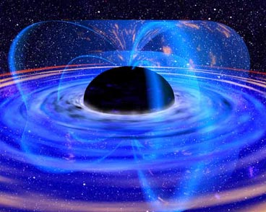
The universe as we know it
QRG = RG = EXP
QRG(k)
RG(k)
PSPACE
QRG(1)
QIP(2)
RG(1)
QMA
AM
MA
NP

Slide 34
The universe as we know it
QRG = RG = EXP
QRG(k)
?
RG(k)
PSPACE
QRG(1)
QIP(2)
RG(1)
QMA
AM
MA
NP

Slide 35

The End?
PSPACE
Oh, Yeah!
Oh, No!

Slide 36
Additional Features
Low rank solutions:
Recall the solution is the average of
In some cases, each will be rank one.
Then the total rank is upper bounded by T.
De-randomization:
For some quantum version of Chernoff bound,
e.g., the Ahlswede-Winter matrix-valued bound.
Extensions
How to solve general convex optimizations?
General methods (e.g., Follow the Regularized Leader) are known to calculate
equilibrium values on convex sets rather than density operators!
Matrix MWU is known to one special case of this framework!
However, the performance varies on different convex sets!
Could work sometime!

Slide 37
Summary
“Equilibrium Value Method”, an explicit and time/space efficient SDP solver!
Known for:
1) PSPACE Upper bounds in Quantum Computational Complexity
Examples, QIP$⊆$PSPACE, DQIP=QRG(2) $⊆$PSPACE, etc….
2) Parallelized Solutions to SDPs.
Additional Feature:
low rank solutions and de-randomization
Open Problems:
More PSPACE Upper bounds?
Larger classes of SDPs that admit parallel solutions?
More applications of the additional feature?

Slide 38
Reference
Xiaodi Wu. Equilibrium Value Method for the proof of QIP=PSPACE. arXiv: 1004.0264.
Xiaodi Wu. Parallelized Solution to Semidefinite Programmings in Quantum Complexity Theory. arXiv: 1009.2211.
Gus Gutoski and Xiaodi Wu. Parallel approximation of min-max problems with applications to classical and quantum zero-sum games. arXiv: 1011.2787.
Yaoyun Shi and Xiaodi Wu. Epsilon-net method for optimizations over separable states. arXiv: 1112.0808.

Slide 39

Thank You!
Q & A
I am ready to put “Equilibrium Value Method” in my toolbox. What are you waiting for?

Slide 40
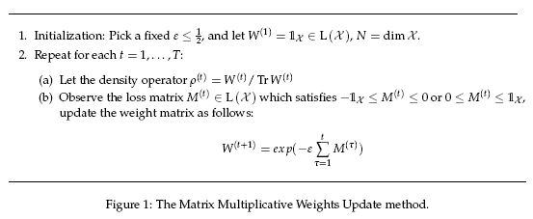
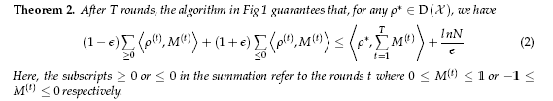
Matrix Multiplicative Weight Update Method

Slide 41
JJUW10 Proof
Start with simpler SDP from QMAM
SDP reformulation
[JJUW10]
makes use of
1
Only one classical bit is sent in the second step
2
3
QIP=QMAM
[MW05]
to get
Simpler solvable SDP
QMAM in NC(poly)
However, still complicated to solve SDPs anyway!

Slide 42
My Minimax Proof
Simple and Clean Proof
QIP-complete problem;
such as close images, quantum channels distinguishability.
Starts with known QIP-complete problem
Solvable by Matrix Multiplicative Weight Update Method
Resulted in a simple Equilibrium Value Problem

Slide 43
SDP reformulation
[JJUW10]
A Neater Proof is available [Wu10]
Use QIP=QMAM
Use definition to formulate
Solve SDP by MMW
Use QIP-Complete Problem
Formulated as equilibrium value
Solved by MMW

